Slide 1
UKeiG Discovering Google's databases - meet the hidden family, 31st March 2022 Pre-course slides: selected Google advanced search commands and options
Karen Blakeman
karen.blakeman@gmail.com
https://twitter.com/karenblakeman
https://www.linkedin.com/in/karenblakeman/

Slide 2
Please work through these slides before the course on the 31st March.
You may know much of it already, in which case just skim through them as a reminder. We shall not be looking at these in detail but may be referring to them during the session so it is important that you know what they do.
These commands apply to the default Google “All” search. Google’s other databases have different commands and search options, which we shall be looking at during the session
If you have any questions or would like further clarification of any of the commands please do get in touch with me at karen.blakeman@gmail.com

Slide 3
Choosing your search terms
Google automatically looks for variations and synonyms but you will get different results if you use synonyms in separate searches
For research oriented searches use technical terms to find more relevant documents instead of the usual consumer/retail oriented articles
For example:
chronic fatigue syndrome for more serious, medical and research information
yuppie flu for more popular, “newsy” stories or magazine articles

Slide 4
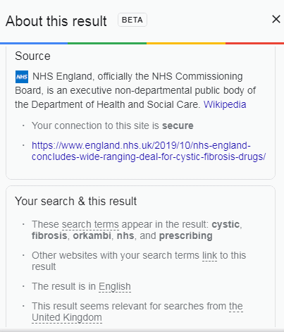
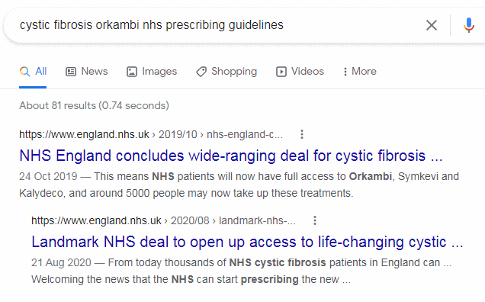
Google drops terms from your search
Google no longer tells you directly which terms have been dropped. Click on the three dots next to the URL for the pop-up “About this result”

Slide 5
intext: to force inclusion of a term
Can be used for a single term, multiple terms and phrases
cystic fibrosis orkambi nhs prescribing intext:guidelines
cystic fibrosis intext:orkambi nhs prescribing intext:guidelines
cystic fibrosis intext:orkambi nhs intext:"prescribing guidelines“
If multiple terms required, can be quicker to use Verbatim

Slide 6
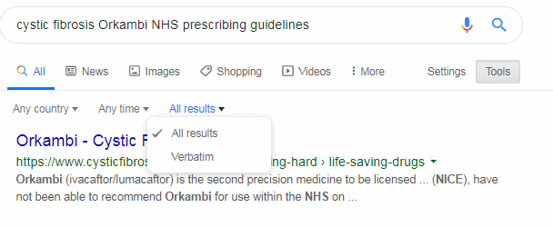
Google Verbatim
Google Verbatim tells Google to run your search without dropping terms or looking for variations on your terms. Words can be in any order unless a phrase is specified within double quote marks.
Run your search then click on Tools, All results and select Verbatim
Or add &tbs=li:1 to the URL of your search

Slide 7
Google commands
GOOGLE DOES NOT DO BOOLEAN!!!
(chocolate OR confectionery OR candy) AND (production OR manufacture) AND (belgium OR switzerland) NOT austria
Google will do an OR (sort of) but parentheses are ignored, NOT and AND are treated as search terms.
Use the minus sign before a term instead of NOT to exclude documents containing that term.
Google limits query length to 32 terms

Slide 8
Google commands
minus sign (-) to exclude a term, site or filetype
ailsa craig potato -tomato -onion
ailsa craig potato -site:youtube.com
ailsa craig potato -tomato –onion -filetype:pdf
OR to specify alternatives
ailsa craig potato OR tomato
It is sometimes better to run separate searches because Google may give preference in the results to just one of the OR-ed terms, and will only show you 100-200 results even if you have several thousand hits. You may miss important results for your other OR-ed terms.

Slide 9
Think file format - works in most web search engines
In Google, you have to specify both pre and post Office 2007 extensions e.g. filetype:doc OR filetype.docx.
filetype:pdf for research papers, conference presentations, industry reports, government reports
electric vehicles particulate matter filetype:pdf
filetype:ppt, filetype:pptx for presentations
electric vehicles particulate matter filetype:ppt
electric vehicles particulate matter filetype:pptx
filetype:xls, filetype:xlsx, filetype:csv for data
electric vehicles particulate matter filetype:xlsx OR filetype:xls

Slide 10
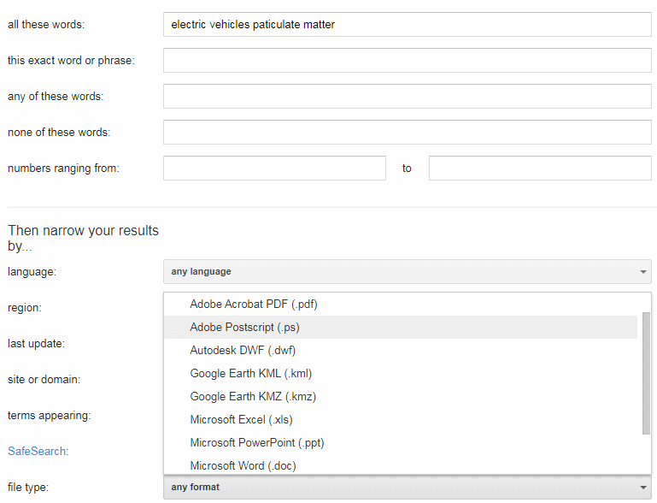
File format Advanced Search screen
file format on Google’s Advanced Search screen will only search for pre-2007 Office extensions e.g. ppt, doc, xls

Slide 11
site: command (also works in most other general search engines)
site: to search inside an individual site or types of site
covid vaccination rates site:gov.uk
covid vaccination rates site:www.gov.uk
covid vaccination rates site:gov.wales
covid vaccination rates site:gov.scot
covid vaccination rates site:nhs.uk
covid vaccination rates site:ac.uk
covid vaccination rates site:ovg.ox.ac.uk
covid vaccination rates site:de

Slide 12
intitle: and inurl: commands
intitle: for terms/phrases you want in the title of the page and to be the main focus of the article
public transport intitle:"zero emissions” [just “zero emissions” in the title]
allintitle:public transport "zero emissions" [all of the terms in the title]
inurl: and allinurl: for terms in the URL
Many applications - see “In Praise of inurl:”
https://researchbuzz.me/2018/07/10/in-praise-of-inurl/

Slide 13
Google numeric range search
Anything to do with numbers – years, prices, weights, scientific measurements
Syntax: search terms first number..second number units [units are optional]
For example:
UK healthcare spending forecasts 2023..2030 will search for any numbers between and including 2023 to 2030

Slide 14
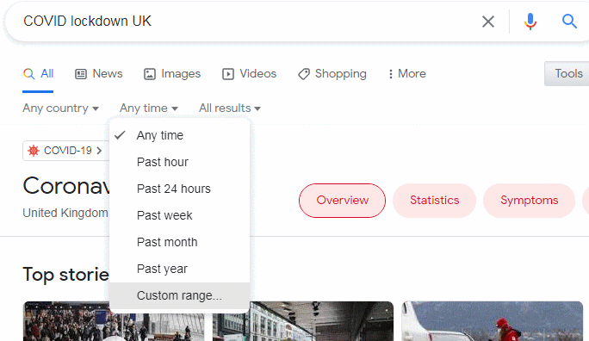
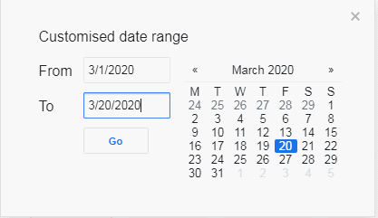
Date range in Google (cannot be used with Verbatim)
Restrict your results to information that has been published within the last hour, day, week, month, year or your own date range (Note: Custom range not available for mobile users)
Tools, Any time and select an option

Slide 15
New Google date commands - can be used with Verbatim
before: after: limit your search to documents published before or after a certain year or date.
Syntax is
before:YYYY/MM/DD or
before:YYYY-MM-DD
before: and after: can be used on their or own or combined for a date range search
COVID lockdown UK after:2020/03/01 before:2020/03/20
Results may be different to those found using the Tools, Anytime option
Google Adds Two New Syntax for Date Search – ResearchBuzz
https://researchbuzz.me/2019/04/10/google-adds-two-new-syntax-for-date-search/

Slide 16
Course materials
Slides available at http://www.rba.co.uk/ukeig/
Table of Selected Google Commands http://www.rba.co.uk/search/SelectedGoogleCommands.html
Search Tools Summary and Comparison Table. Summarises and compares a selection of the advanced search commands that are available in Google, Bing and DuckDuckGo. http://www.rba.co.uk/search/compare.html

