Slide 1

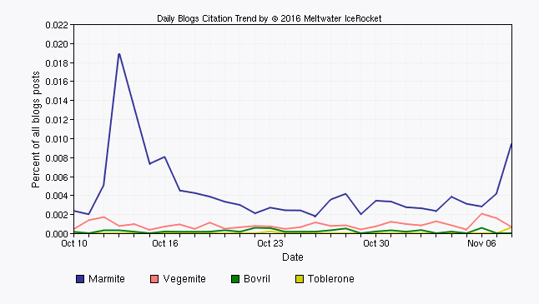
Using the Right Business Information to Research Your Idea
Loughborough University Student and Graduate Enterprise, 9th November 2016
Facilitator: Karen Blakeman
RBA Information Services
Karen.Blakeman@rba.co.uk
http://www.rba.co.uk/
twitter.com/karenblakeman
Presentation available for a short time at: http://www.rba.co.uk/bi/

Slide 2
Business information
Industry sector data, markets, statistics
Companies
    competitors, suppliers, customers, potential partners, potential employer, joint venture, takeover target, investment
R&D, Intellectual Property (IP), M&A
Legal and regulatory environment
News, social media, rumour, gossip
Anything that is needed to conduct business

Slide 3
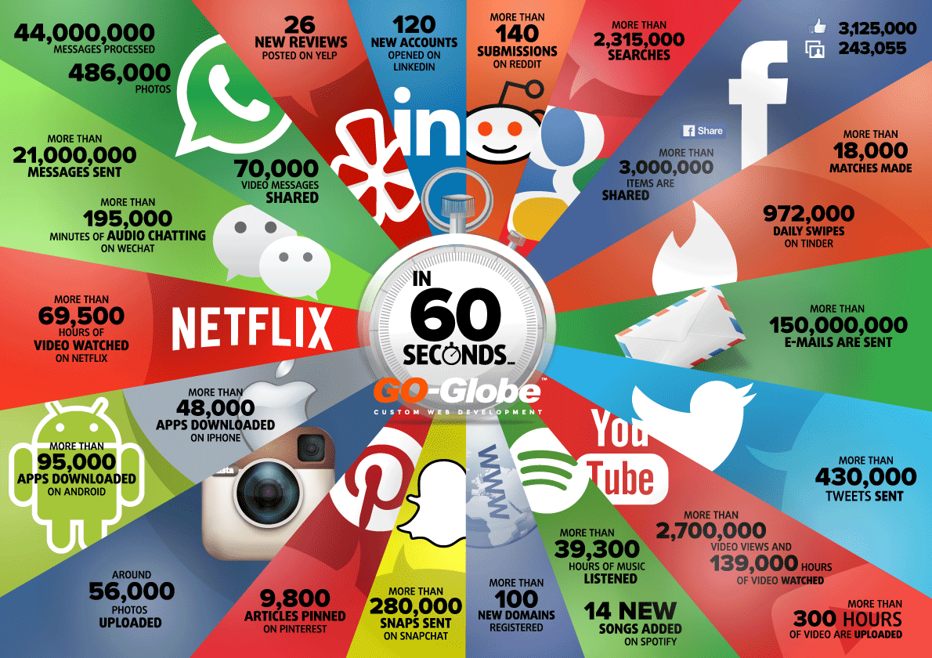
Things that Happen on Internet Every 60 Seconds | Visual.ly http://visual.ly/things-happen-internet-every-60-seconds

Slide 4
Images, videos, sound files for...
Photos, charts, graphs, diagrams, sketches
News footage - current and archived
Interviews
Presentations, lectures
Corporate communications
Literary readings
TV and radio programmes
“How to...”
Interactive maps
Infographics
And lots more!

Slide 5
Social media and professional networks
Where people and organisations share, discuss, comment and ask questions
It is where many interactions between companies and customers are happening
It is where a lot of marketing takes place
Use for research, competitor intelligence, reputation monitoring, how are companies presenting themselves and interacting with customers
Increasingly used by companies as the default for marketing, providing product information and customer support

Slide 6
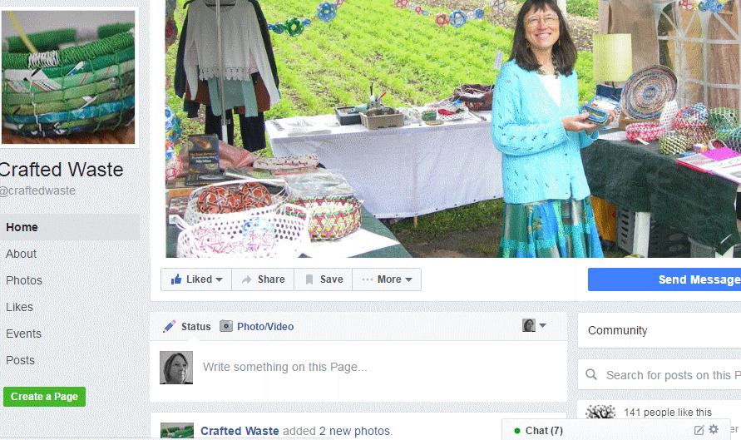
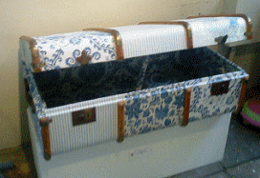

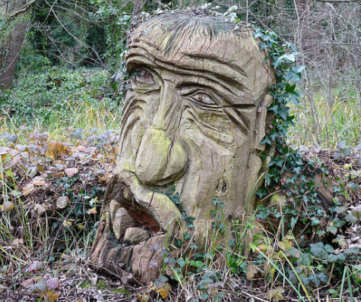

Slide 7
Current issues
BREXIT!
More government sites and information being moved to and buried in www.gov.uk
Changes to the UK Companies Act – small and micro companies
Google knows best! Major changes to how it analyses and runs your search, rewriting your search is standard, results increasingly device dependent

Slide 8
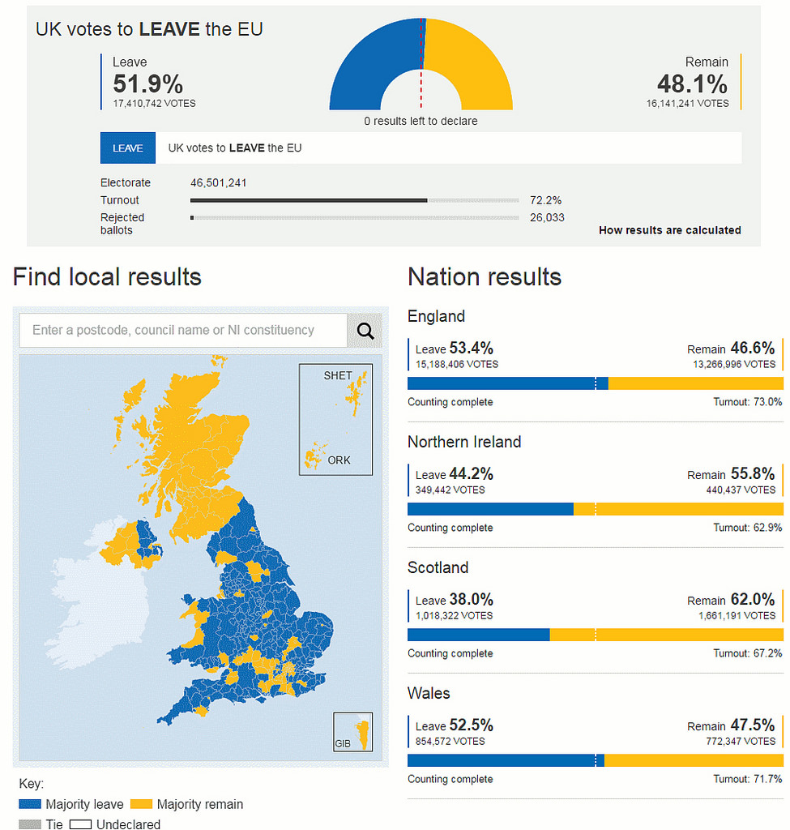

Slide 9
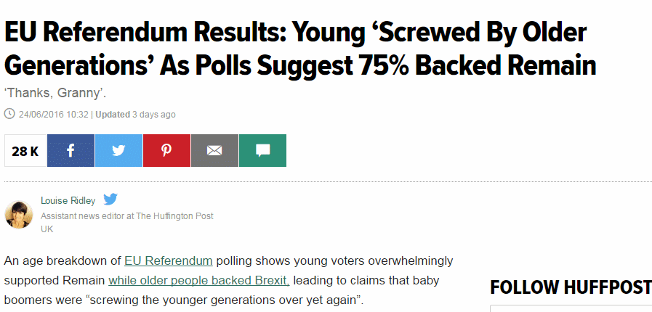
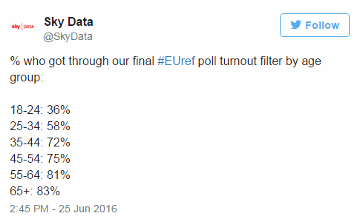
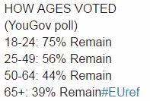
EU Referendum Results: Young 'Screwed By Older Generations' As Polls Suggest 75% Backed Remain http://www.huffingtonpost.co.uk/entry/eu-referendum-results-age-data-young_uk_576cd7d6e4b0232d331dac8f

Slide 10
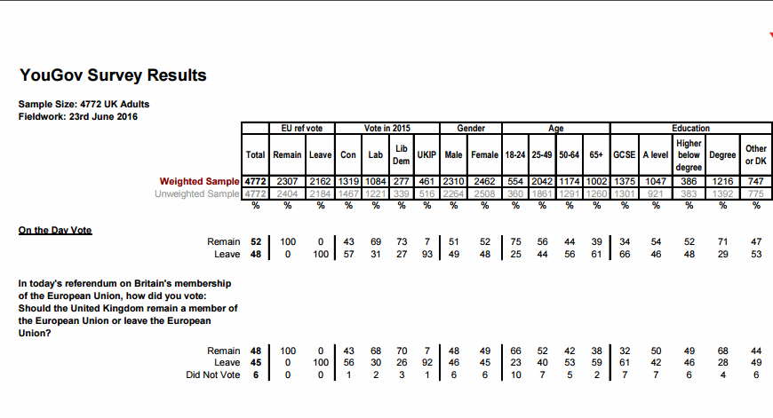
http://d25d2506sfb94s.cloudfront.net/cumulus_uploads/document/640yx5m0rx/On_the_Day_FINAL_poll_forwebsite.pdf

Slide 11
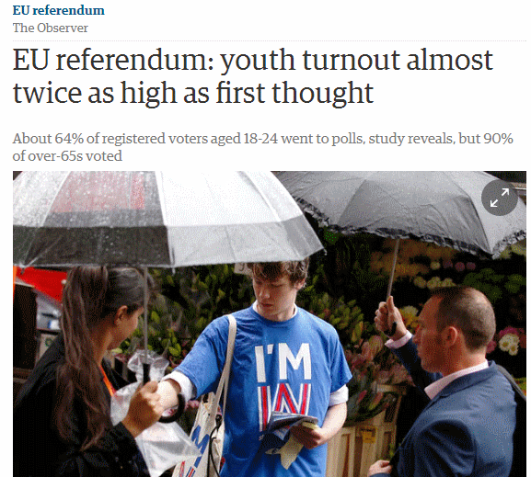
EU referendum: youth turnout almost twice as high as first thought | Politics | The Guardian http://www.theguardian.com/politics/2016/jul/09/young-people-referendum-turnout-brexit-twice-as-high
Poll conducted by
Opinion
http://opinium.co.uk/
Based on a sample of 2002!

Slide 12
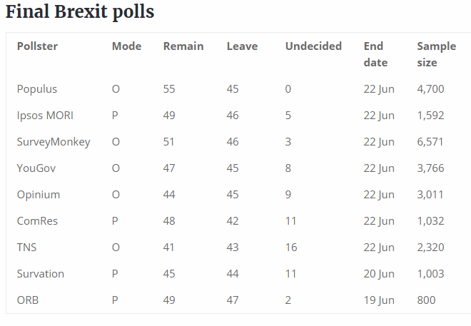
UK EU referendum – Number Cruncher Politics http://www.ncpolitics.uk/uk-eu-referendum/

Slide 13
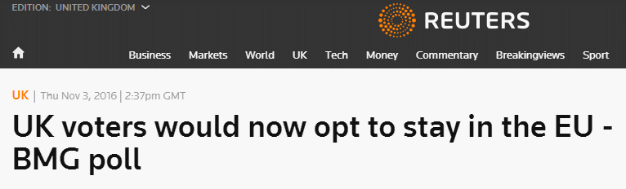

Slide 14
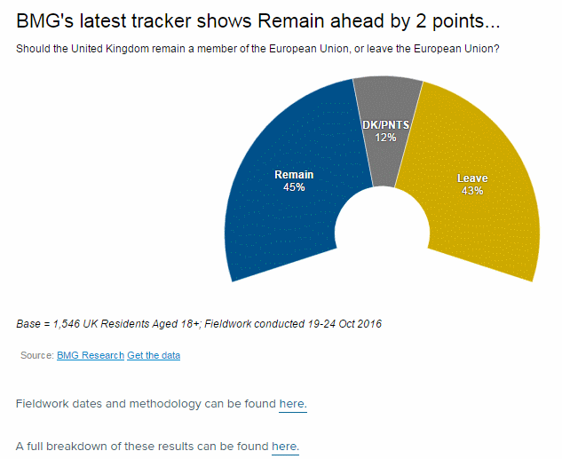
BMG Poll: Tories best party to handle Brexit & Remain leads by 2points - BMG Research http://www.bmgresearch.co.uk/tories-best-party-handle-brexit/

Slide 15
Evaluating information – CRAAP test
http://www.informationliteracy.org.uk/wp-content/uploads/2015/10/evaluating_info_new1_20-1-16.pdf
Currency When was it published, updated? Is up to date information important?
Relevance Does it fit in with the needs of your project
Authority Who has published the information - individual/organisation? Do you trust them? What else have they written? Further information about them? Who is behind the website?
Accuracy Is the information correct? Check with an independent source (may not be easy or even possible)
Purpose Why does the page/site exist? Political agenda? Activist site? Selling a product/service? Revenue from advertising?

Slide 16
Evaluating information
Methodology How is/has the information been gathered or respondents selected? How has the data been processed?
Sample size Weightings? Extrapolations?
Time period Not just when the report was written or published but also the time period that data/statistics refer to
Geographical coverage
Definitions and scope What technologies, services, products are covered by the terms?

Slide 17
Or Kipling’s six honest serving men
I keep six honest serving-men
(They taught me all I knew);
Their names are What and Why and When
And How and Where and Who
From The Elephant’s Child, by Rudyard Kipling

Slide 18
Type of web site and who owns it
Government gov.uk, gov.wales, assembly.wales, gov.scot
Academic ac.uk, edu
nhs.uk, police.uk, sch.uk, mod.uk
org.uk can be bought and used by anyone
Check domain name ownership using DomainTools http://whois.domaintools.com/ or similar

Slide 19
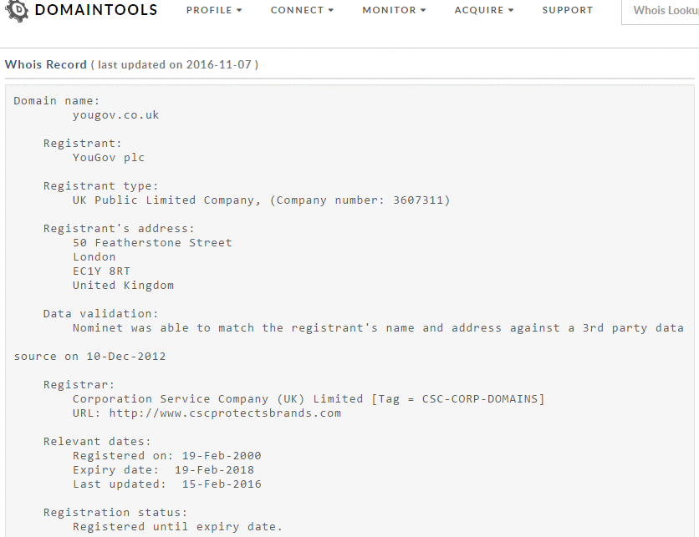

Slide 20
If/when we do leave the EU:
Market research and industry reports produced before the referendum/Brexit make assumptions based on the UK being part of the EU and in some cases that there is EU funding/support. All these reports will become obsolete.
UK will no longer be included in some official Europe-wide sources such as Eurostat (but will archival material still be included?)
All bets are off with respect to forecasts written before Brexit - manufacturing industry, research, economic growth, international trade etc.

Slide 21
Official information - main government sites
Welcome to GOV.UK https://www.gov.uk/
UK Parliament http://www.parliament.uk/
Welsh Government http://gov.wales/
National Assembly for Wales http://www.assembly.wales/
The Scottish Government http://www.gov.scot/
The Northern Ireland Assembly http://www.niassembly.gov.uk/

Slide 22
Where has the information gone?
List of departments, agencies and public bodies at https://www.gov.uk/government/organisations
“Home pages” on GOV.UK
Data and information may still be on the old websites
Data may have been moved to http://data.gov.uk/
Older information may have been sent to http://www.nationalarchives.gov.uk/webarchive/
Or information may have been “lost”
Don’t rely on just GOV.UK search – use Google/Bing site: command combined with filetype: if appropriate

Slide 23
Official statistics
OFFSTATS http://www.offstats.auckland.ac.nz/
UK National Statistics https://www.gov.uk/government/statistics/
Office for National Statistics http://www.ons.gov.uk/
Official Statistics in Scotland http://www.gov.scot/Topics/Statistics
Welsh Government Statistics & Research http://gov.wales/statistics-and-research/?lang=en
Welsh Assembly Government StatsWales http://statswales.wales.gov.uk/

Slide 24
Official statistics (2)
data.gov.uk http://data.gov.uk/
Eurostat http://ec.europa.eu/eurostat/
European Union Open Data Portal http://open-data.europa.eu/en/data/
International organisations such as the World Bank, ILO

Slide 25
Think file format
  PDF for research documents, government reports, industry papers
  ppt or pptx for presentations, tracking down an expert on a topic
  xls or xlsx for spreadsheets containing data
Use the advanced search screen or the filetype: command
  creative upcycling UK filetype:pdf
  creative upcycling UK filetype:ppt
  creative upcycling UK filetype:pptx
  creative upcycling UK filetype:xls
  creative upcycling UK filetype:xlsx
creative upcycling UK filetype:ppt
OR filetype:pptx

Slide 26
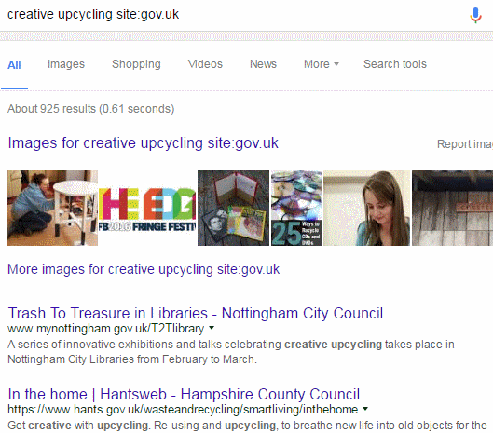
site: command
site: to search within an individual site or type of site
creative upcycling site:gov.uk

Slide 27
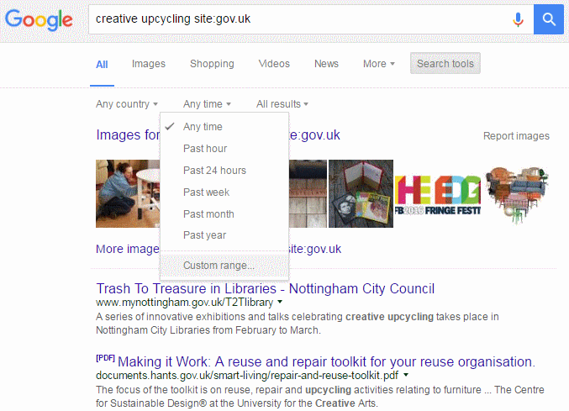
Date
Restrict your results to information that has been published within the last hour, day, week, month, year or your own date range
Search tools, Any time and select an option

Slide 28
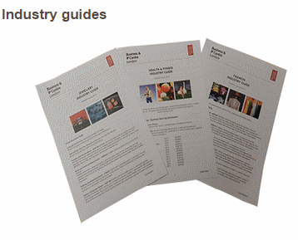
Industry guides - The British Library http://www.bl.uk/business-and-ip-centre/industry-guides
Downloadable PDFs
Resources include publications and databases at the BL but also freely accessible websites
Business and IP Centre National Network - The British Library https://www.bl.uk/business-and-ip-centre/national-network

Slide 29
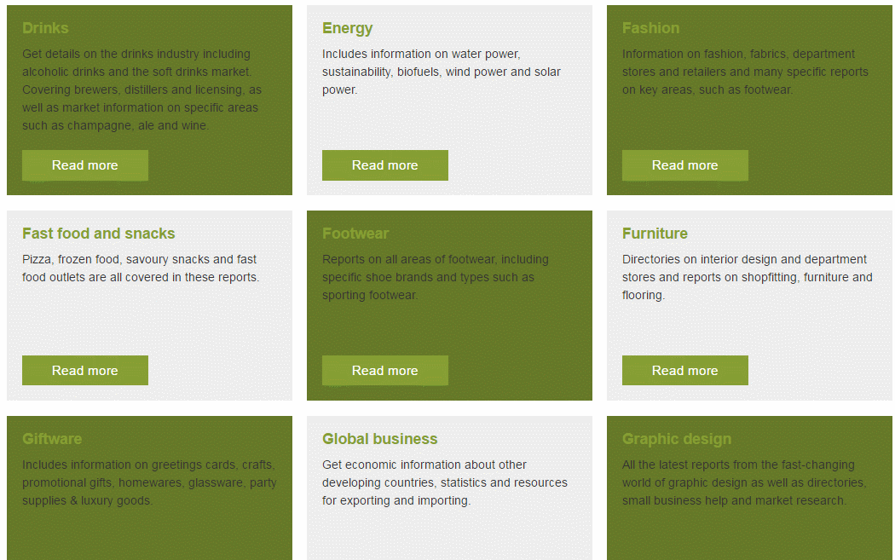

Slide 30
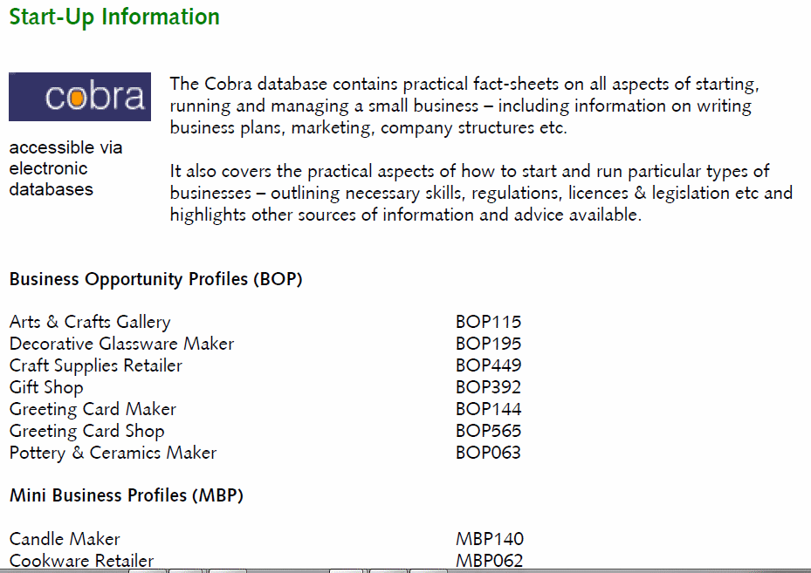
COBRA - Cobweb Information https://www.cobwebinfo.com/services/cobra/

Slide 31


Slide 32
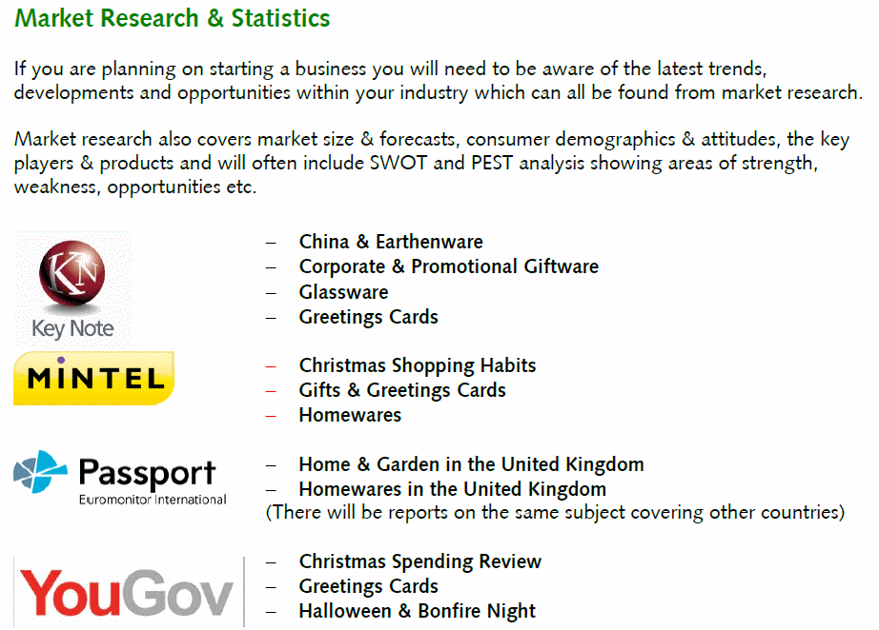

Slide 33
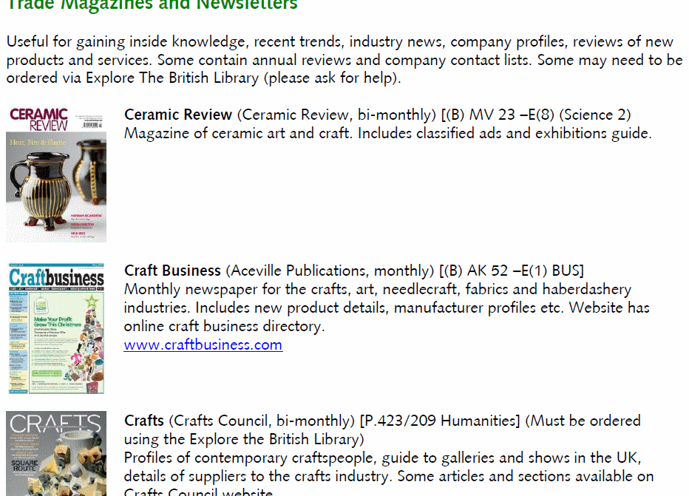

Slide 34


Slide 35
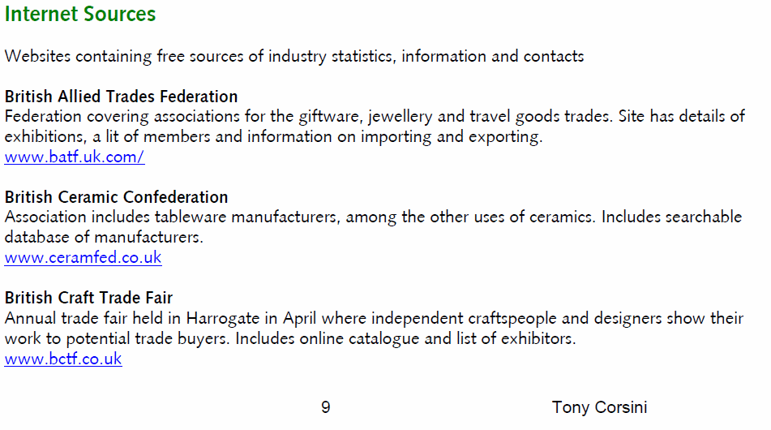

Slide 36
Market research & industry reports
Aggregators - pull together reports from many publishers and make them searchable through a single interface
Can purchase reports through the one service
Aggregators may not be comprehensive
  publishers may embargo reports for weeks or months
  publishers may withhold some reports from aggregators
  check the publisher’s own web site or email them to see if there is additional or more recent research available
  may get a better deal by going to the publisher direct
  use aggregators as an index to see who is publishing on your topic

Slide 37
Examples of market research aggregators
Marketresearch.com
  http://www.marketresearch.com/
Report Buyer
  http://www.reportbuyer.com/
Research and Markets
  http://www.researchandmarkets.com/
Profound - Market Intelligence
  http://www.profound.com/

Slide 38
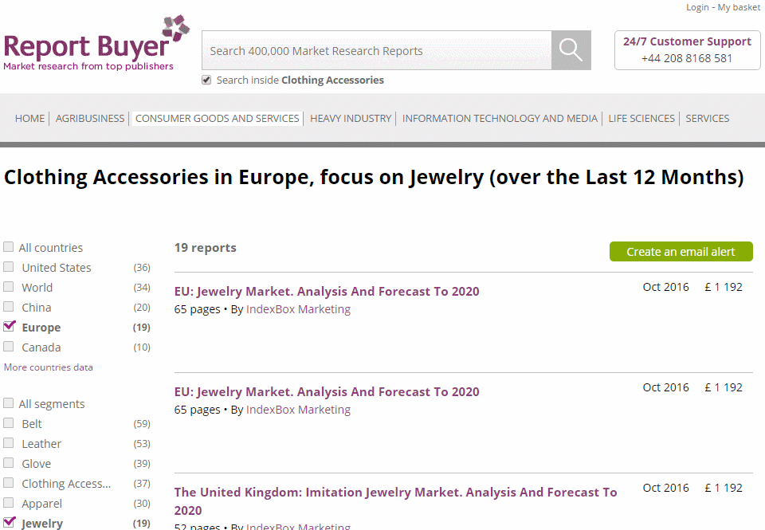
Reportbuyer.com

Slide 39
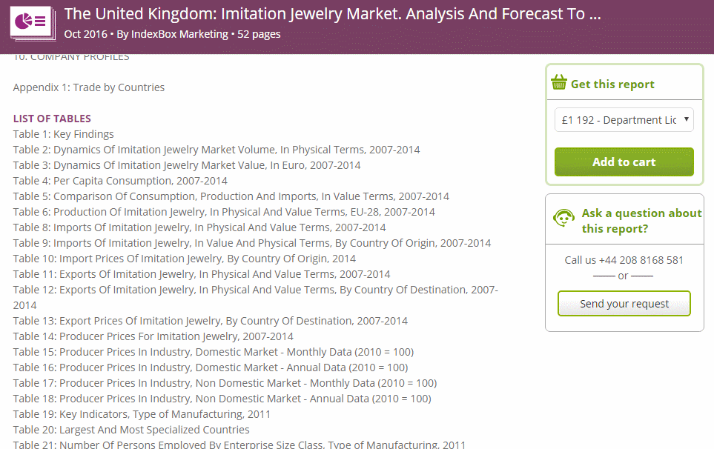
Reportbuyer.com

Slide 40
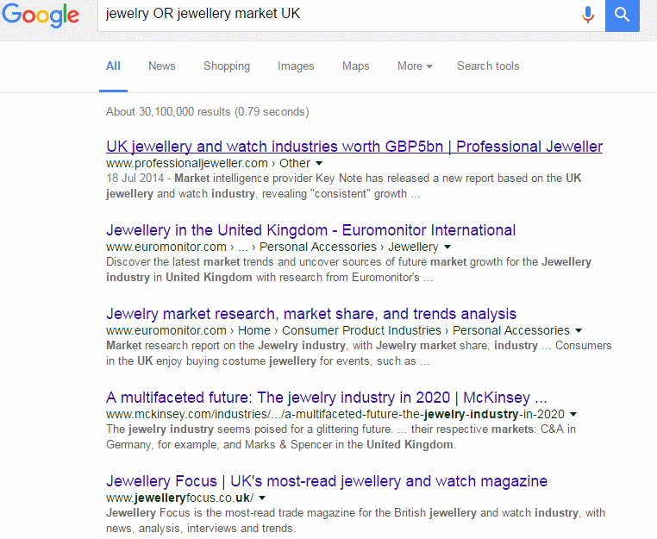

Slide 41
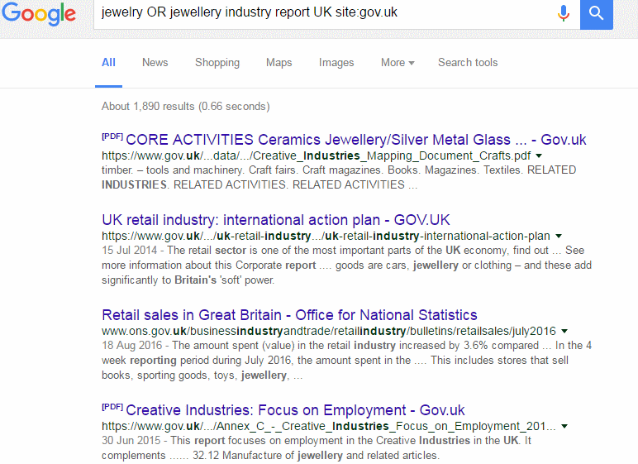

Slide 42
Company information
Ownership, directors, structure, accounts, activities, news
Availability depends on
  type of company
    sole trader
    partnership
    private
    limited liability e.g. Ltd, LLP
    companies with publicly traded shares e.g. PLC
  business size (large, medium, small)
  country
    state or region within the country

Slide 43
UK Companies Act 2006
Some of the main changes
  memorandum of association now only needs to state that the founders of the company wish to form a limited company
  directors no longer need to apply to withhold their private address, for example if they believe they may be targeted by activists. Can now choose to supply a “service address”
  requirement to have a company secretary removed
From 1 January 2016 new regulations regarding small businesses
  “small” businesses can be larger
  new category of “micro” business
  changes in reporting requirements
From 6 April 2016
  identify People with Significant Control (PSC)

Slide 44
Changes from 1 January 2016
Micros and small companies must meet at least two of the following criteria
Accounts advice for small companies | Companies House https://companieshouse.blog.gov.uk/2016/10/06/accounts-advice-for-small-companies/
Filing options under the new small companies regime | ICAEW http://www.icaew.com/-/media/corporate/files/technical/financial-reporting/factsheets/uk-gaap/small-company-filing-options-faqs-final.ashx
 | Micro | Small
Turnover not exceeding | £632,000 | £10.2m (was £6.5m)
Balance sheet total not exceeding | £316,000 | £5.1m (was £3.26m)
Average number of employees | Max. 10 | Max. 50

Slide 45
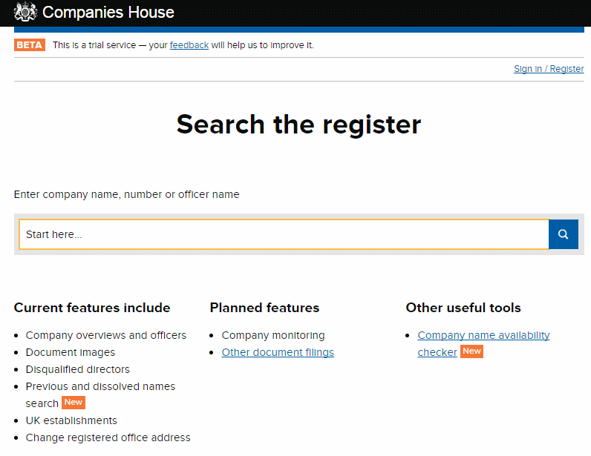
Companies House https://www.gov.uk/government/organisations/companies-house
Companies House service - search the register https://beta.companieshouse.gov.uk/

Slide 46
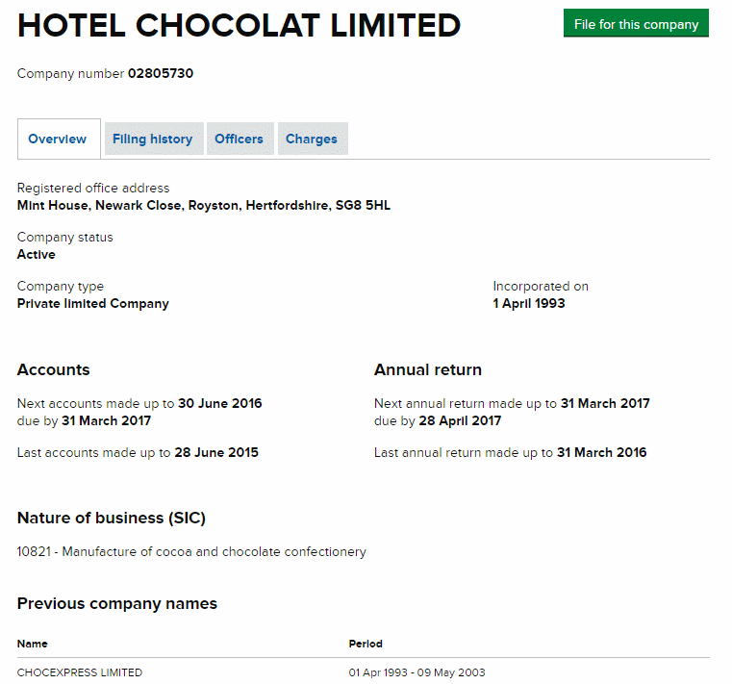
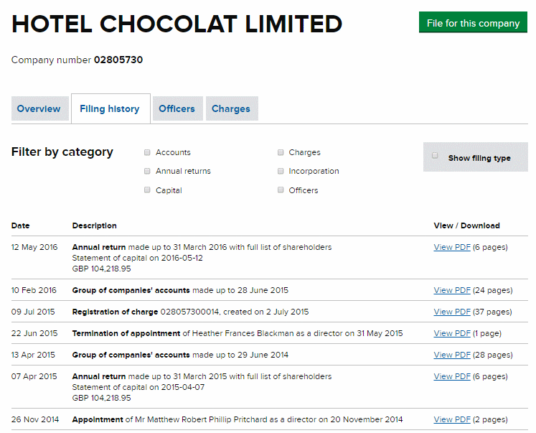
Companies House http://beta.companieshouse.gov.uk/

Slide 47
Company Check Free Companies House search and download http://companycheck.co.uk/
Repackages Companies House data and provides additional display options
Covers UK and some European countries
Search by company or director’s name
Can filter results by status, location, assets etc.
Registration (free of charge) required to make the most of the free options
Some information e.g. credit reports, CCJs are priced

Slide 48
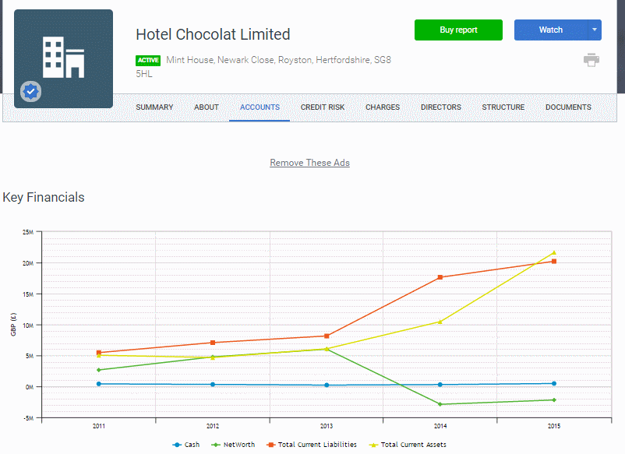
Company Check – Hotel Chocolat

Slide 49
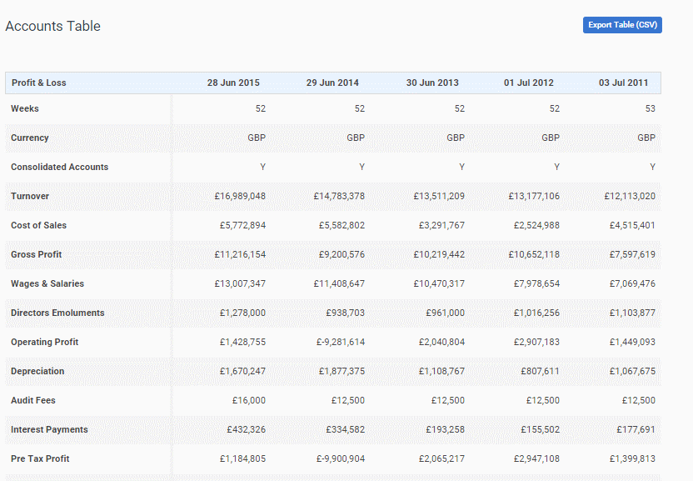
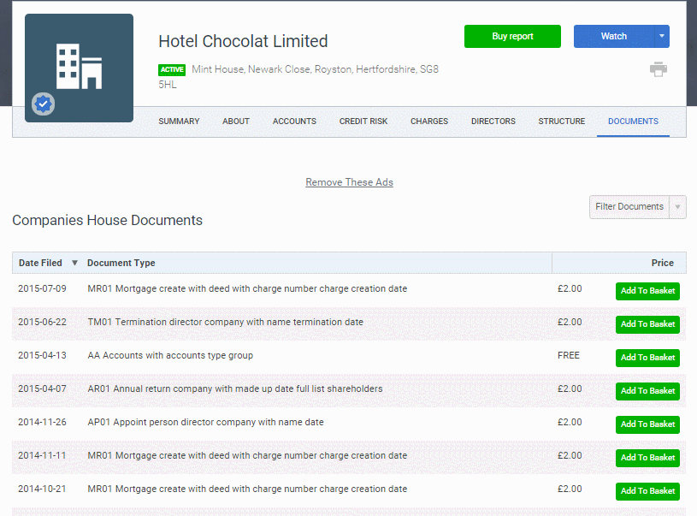
Company Check – Hotel Chocolat

Slide 50
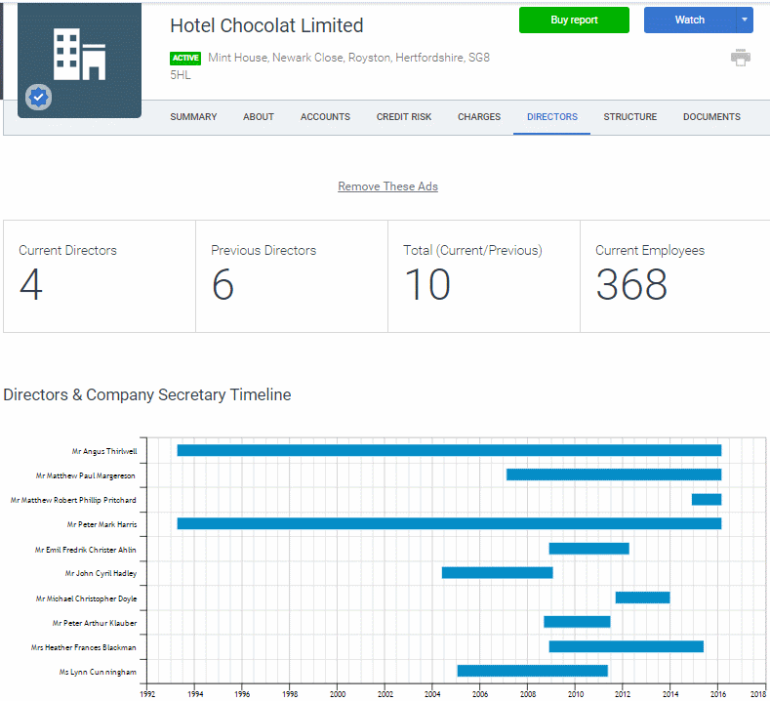
Company Check - directors

Slide 51
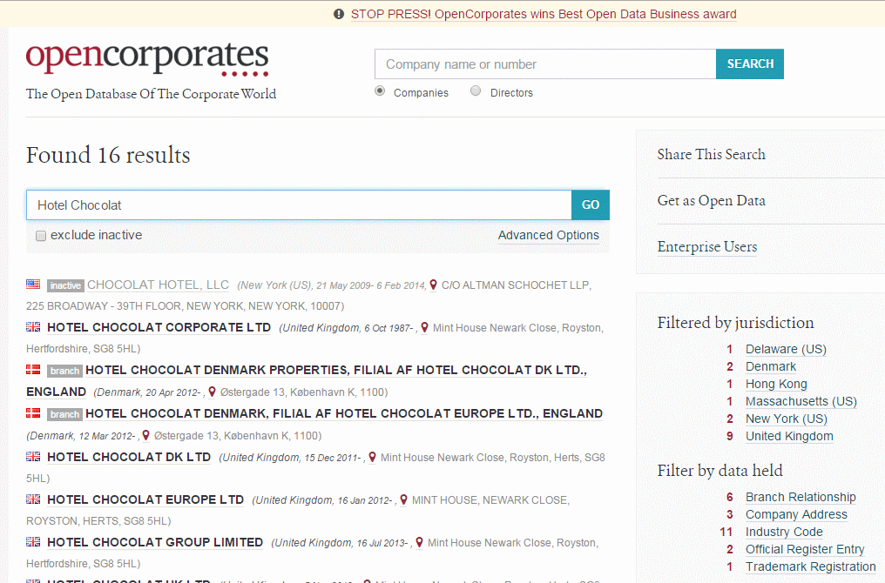
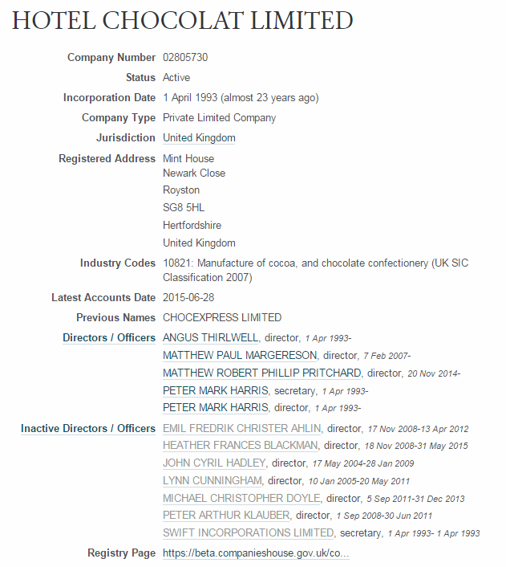
OpenCorporates http://opencorporates.com/

Slide 52
Google search
Google now using machine learning and artificial intelligence as part of search (RankBrain)
Tries to make “sense” of your search and put it into context, natural language queries, uses what others have searched and clicked
Often rewrites your search
How you ask your question is taken into account, device you are using is taken into account
Personalises results

Slide 53
Google
Google now tells you which terms it has ignored (some of the time)
“..” around terms, phrases, names, titles of documents does not always work
To force an exact match and inclusion of a term in a search prefix it with ‘intext:’
"memorial garden" "heritage trail" intext:penryn
Use Verbatim for an exact match search

Slide 54
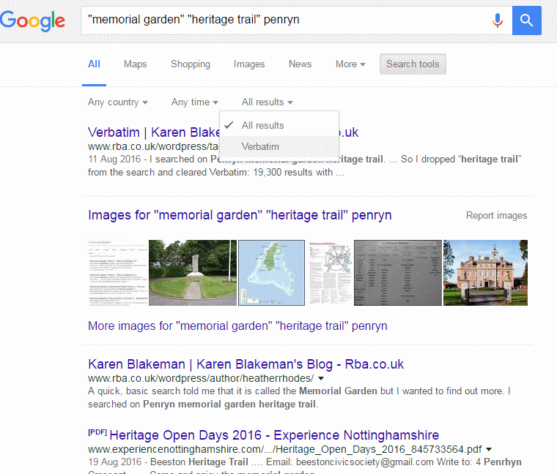
Google Verbatim

Slide 55
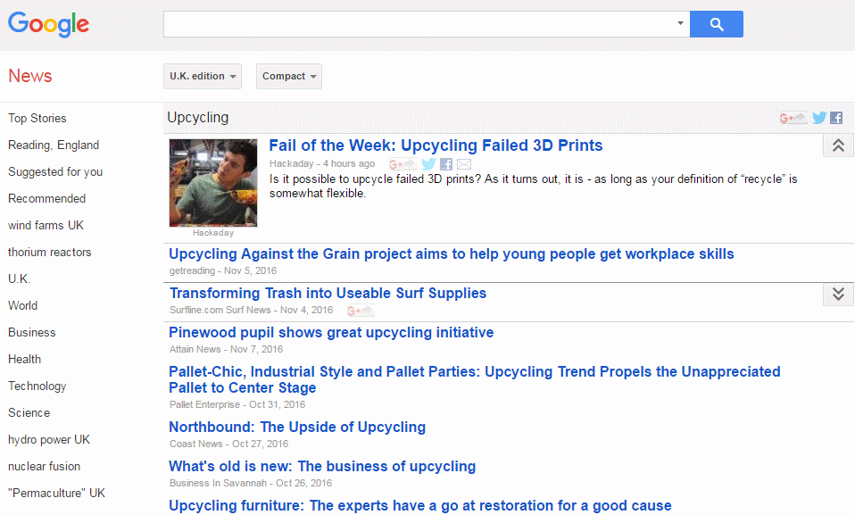
Google News

Slide 56
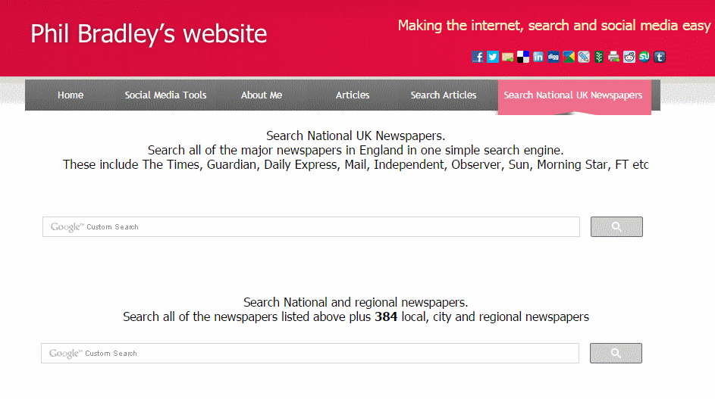
Search National UK Newspapers http://www.philb.com/nationaluknewspapers.html

Slide 57
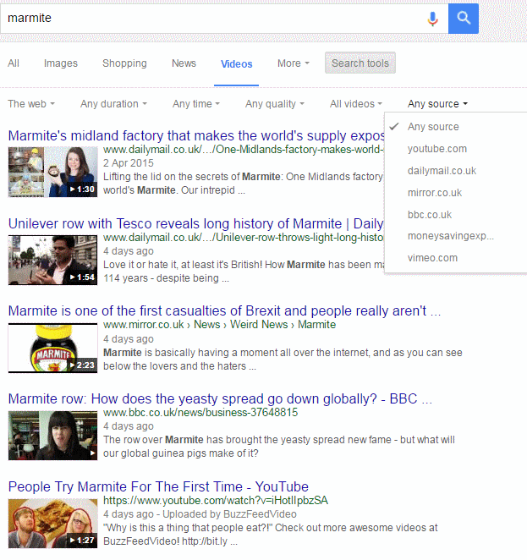
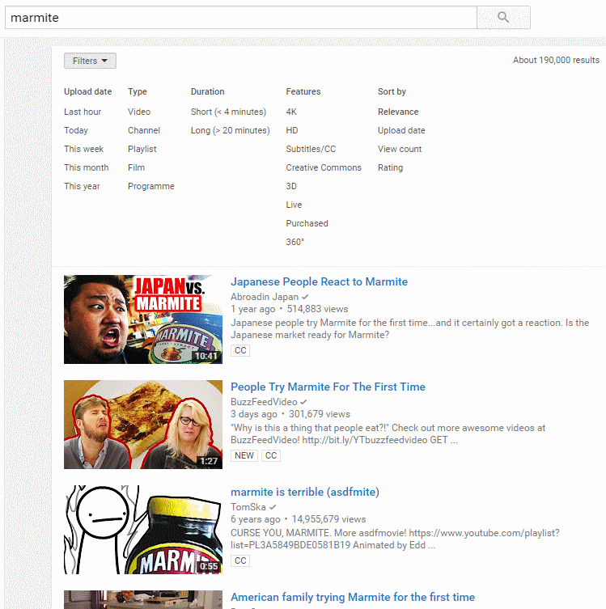
Google videos vs YouTube

Slide 58
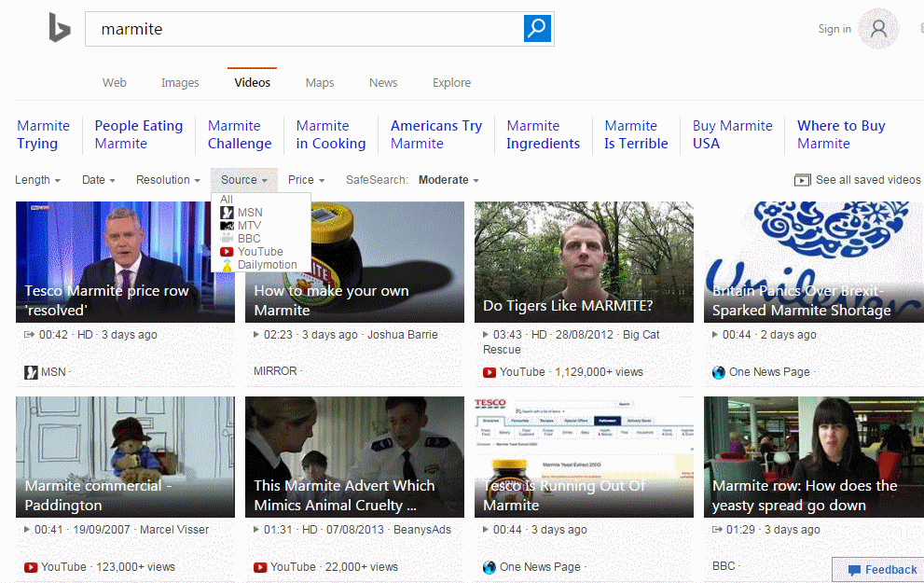
Bing videos

Slide 59
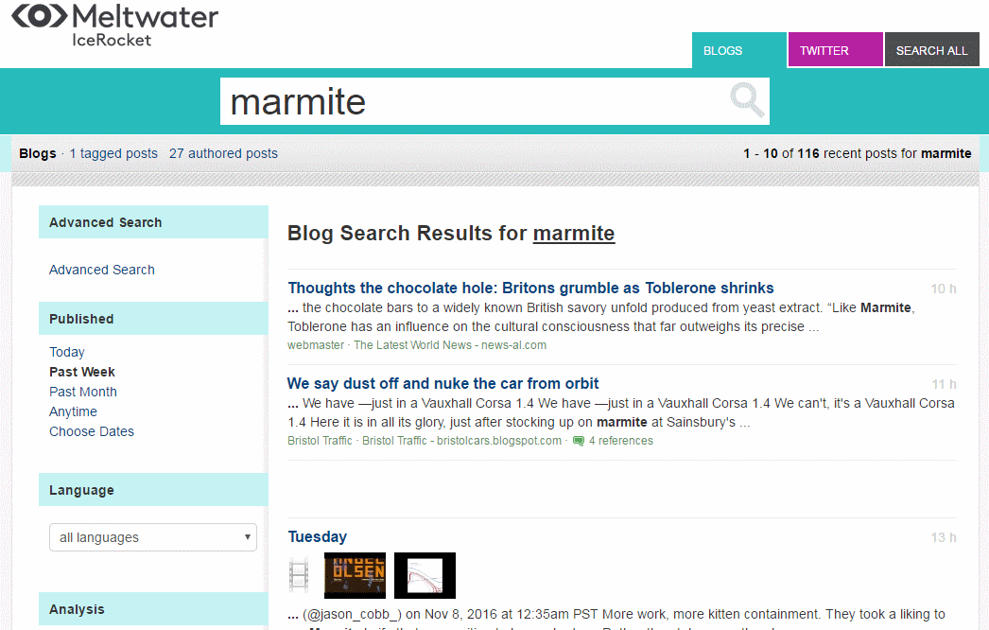
Meltwater IceRocket http://www.icerocket.com/

Slide 60
IceRocket trends

Slide 61
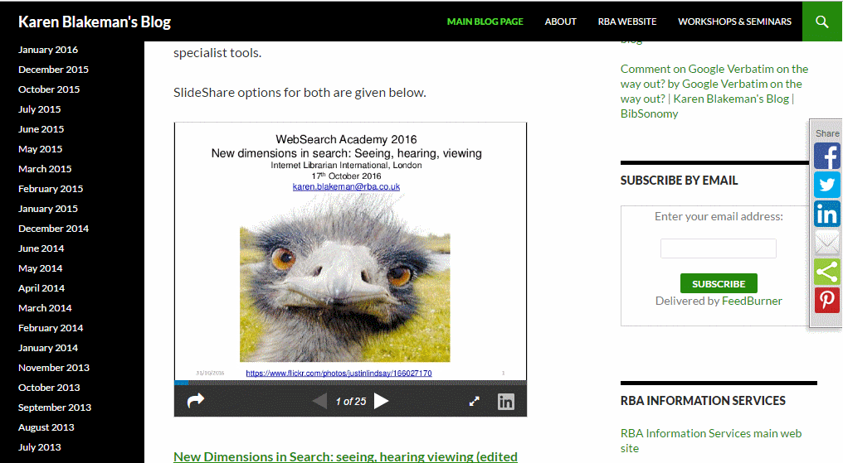
Karen Blakeman's Blog | News and comments on search tools and electronic resources for research http://www.rba.co.uk/wordpress/

Slide 62
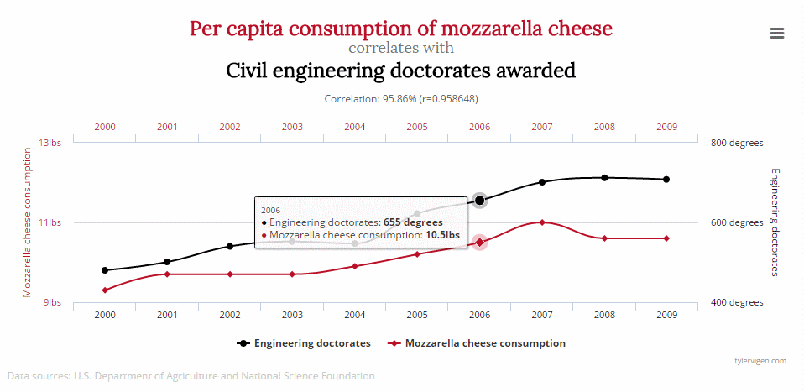
And finally.....
Spurious Correlations http://tylervigen.com/spurious-correlations

