Slide 1
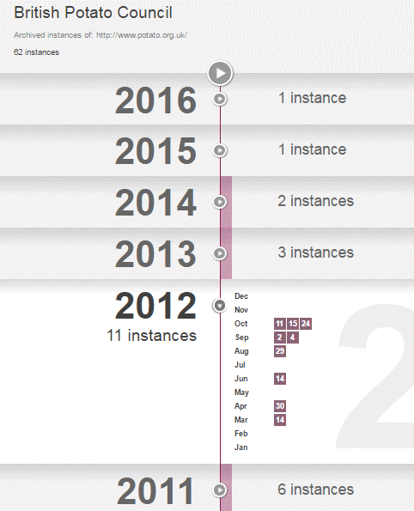
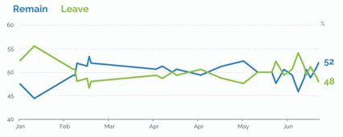
Business Information: key web resources and search strategies
Falmouth University, 20 July 2016
Facilitator: Karen Blakeman
RBA Information Services
Karen.Blakeman@rba.co.uk
http://www.rba.co.uk/
twitter.com/karenblakeman
Presentation available for a short time at: http://www.rba.co.uk/bi/

Slide 2
Current issues
BREXIT
Legislation - EU “right to be forgotten”, link taxes
More government sites and information being moved to and submerged in www.gov.uk
Changes to the UK Companies Act – small and micro companies, PSC register
More official data being made available as open data - possible quality and accessibility issues
Google knows best!
major changes to how it analyses and runs your search, rewriting your search is standard results increasingly device dependent

Slide 3
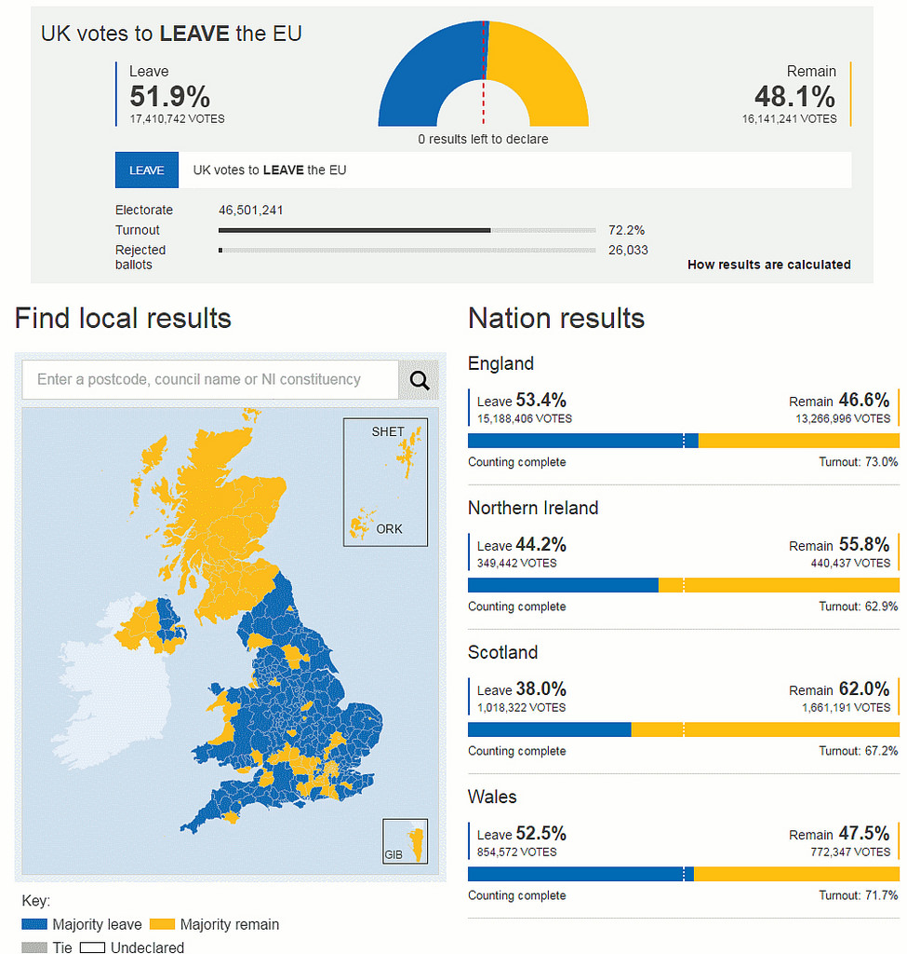

Slide 4
EU Referendum – before and immediately after
Much of the information provided before and after the vote, poll results and analyses fail the CRAAP test. Good exercise in applying critical thinking and seeking out reliable sources of information.
If we do leave the EU
Stating the obvious: EU funding will cease and is unlikely to be replaced by UK government funding to the same extent.
Existing market research and industry reports for the UK make assumptions based on the UK being part of the EU. All will become obsolete.
UK will no longer be included in some official sources such as Eurostat (but will archival material still be included) and the European Business Register.
All bets are off with respect to forecasts: manufacturing industry, research, economic growth, international trade etc.
VAT will be even more of a mess, especially for small businesses.

Slide 5
Evaluating information – CRAAP test
http://www.informationliteracy.org.uk/wp-content/uploads/2015/10/evaluating_info_new1_20-1-16.pdf
Currency When was it published, updated? Is up to date information important?
Relevance Does it fit in with the needs of your project
Authority Who has published the information - individual/organisation? Do you trust them? What else have they written? Further information about them? Who is behind the website?
Accuracy Is the information correct? Check with an independent source (may not be easy or even possible)
Purpose Why does the page/site exist? Political agenda? Activist site? Selling a product/service? Revenue from advertising?

Slide 6
Or Kipling’s six honest serving men
I keep six honest serving-men (They taught me all I knew); Their names are What and Why and When And How and Where and Who
From The Elephant’s Child, by Rudyard Kipling

Slide 7
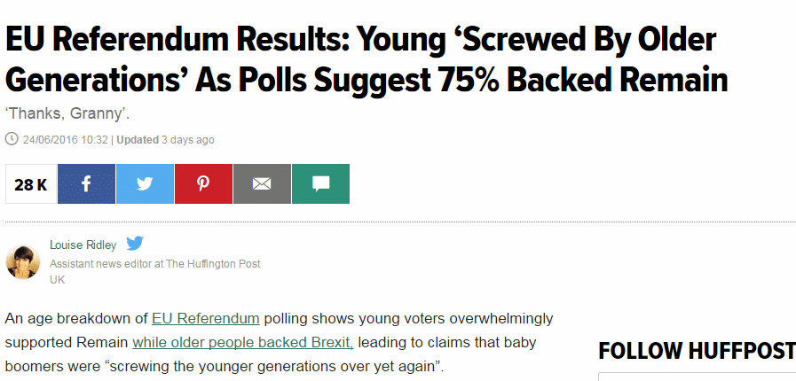
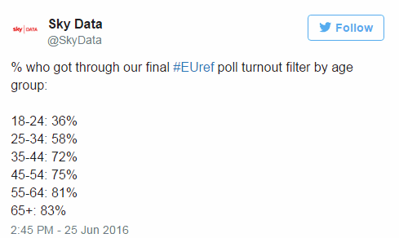
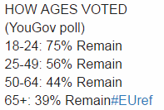
EU Referendum Results: Young 'Screwed By Older Generations' As Polls Suggest 75% Backed Remain http://www.huffingtonpost.co.uk/entry/eu-referendum-results-age-data-young_uk_576cd7d6e4b0232d331dac8f

Slide 8
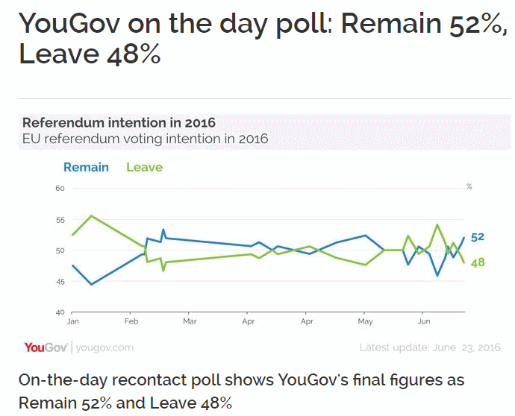
YouGov | YouGov on the day poll: Remain 52%, Leave 48% https://yougov.co.uk/news/2016/06/23/yougov-day-poll/

Slide 9
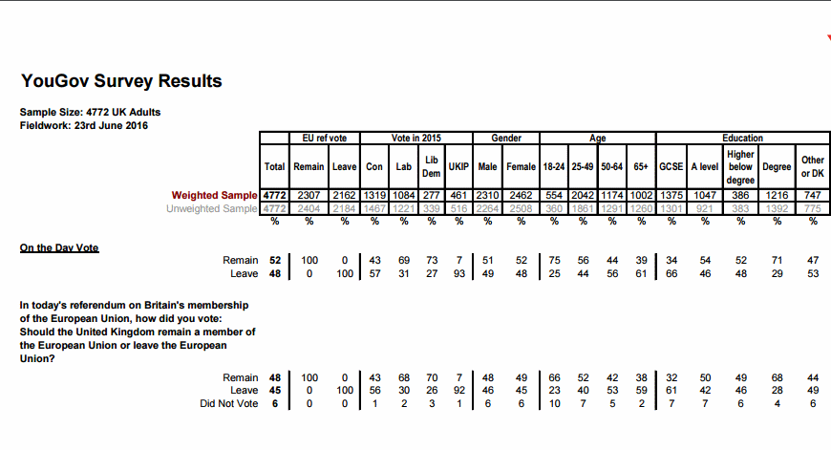
http://d25d2506sfb94s.cloudfront.net/cumulus_uploads/document/640yx5m0rx/On_the_Day_FINAL_poll_forwebsite.pdf

Slide 10
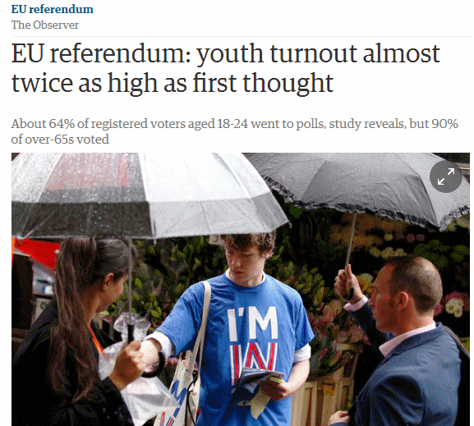
EU referendum: youth turnout almost twice as high as first thought | Politics | The Guardian http://www.theguardian.com/politics/2016/jul/09/young-people-referendum-turnout-brexit-twice-as-high
Based on a sample of 2002!

Slide 11
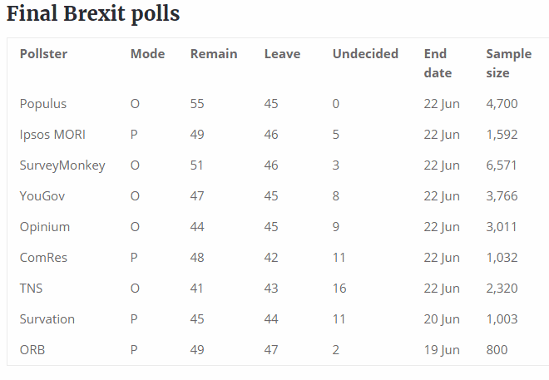
UK EU referendum – Number Cruncher Politics http://www.ncpolitics.uk/uk-eu-referendum/

Slide 12
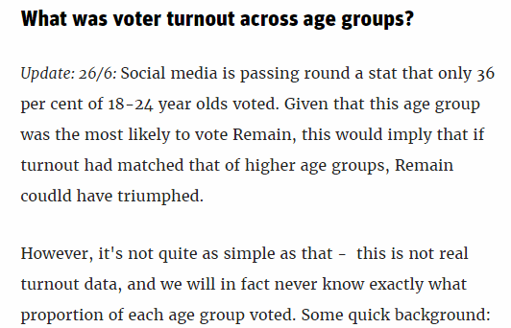
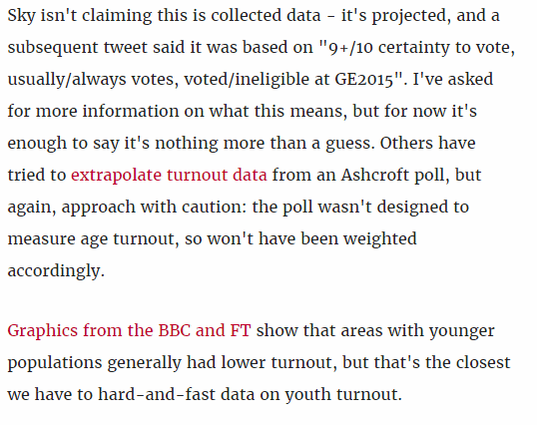
How did different demographic groups vote in the EU referendum? http://www.newstatesman.com/politics/staggers/2016/06/how-did-different-demographic-groups-vote-eu-referendum

Slide 13
EU - Austria, Belgium, Bulgaria, Croatia, Republic of Cyprus, Czech Republic, Denmark, Estonia, Finland, France, Germany, Greece, Hungary, Ireland, Italy, Latvia, Lithuania, Luxembourg, Malta, Netherlands, Poland, Portugal, Romania, Slovakia, Slovenia, Spain, Sweden, UK
EEA – European Economic Area European Union + Iceland, Norway, Liechtenstein
EFTA - European Free Trade Association Iceland, Liechtenstein, Norway, Switzerland http://www.efta.int/
Greenland – included as one of the Overseas Countries and Territories (OCT) which has special relations with the EU https://en.wikipedia.org/wiki/Greenland%E2%80%93European_Union_relations
Special member state territories and the European Union Wikipedia
https://en.wikipedia.org/wiki/Special_member_state_territories_and_the_European_Union

Slide 14
What is business information?
Companies
competitors, suppliers, customers, potential partners, potential employer, joint venture, takeover target, investment
Industry sector data, markets, statistics
R&D, Intellectual Property (IP), M&A
Legal and regulatory environment
News, social media, rumour, gossip
Anything that is needed to conduct business

Slide 15
Social media and professional networks
Where people and organisations share, discuss, comment and ask questions
It is where many interactions between companies and customers are happening
It is where a lot of marketing takes place
Use for research, competitor intelligence, reputation monitoring, how are companies presenting themselves and interacting with customers
Increasingly used by companies as the default for marketing, providing product information and customer support

Slide 16
Free vs. Fee
Free
Fee
Basic company information, contact details, sometimes full accounts, search for companies by name/number one at a time, simple print out
Anonymous statistics, total market/industry figures
Current news - free text searching so difficult to focus search [many key industry publications not free]
May be limited in coverage, time span
Full company accounts, historical data, search by multiple criteria, analysis and report features
Detailed market share by company name, product/brand
Indexed content, easier to search for historical information by event type, more flexible search and print options
More likely to be comprehensive and have more extensive archives

Slide 17
Why not just Google?
Heavy personalisation, aimed at consumer market, advertising main revenue earner
It automatically looks for variations on your terms and drops terms from your search without telling you (Bing also does this)
Google does not automatically search everything it has
Google cannot search password protected sites or databases
Machine learning and artificial intelligence increasingly used to provide “facts” and quick answers – error

Slide 18
Right to be forgotten
EU Data Protection
Information is NOT removed from the web, only the link to information in the search results
Not automatic – subject has to apply to have links that point to specific information about themselves removed from the results. application may be rejected.
Applies to all search engines with an EU/EEA presence, not just Google
Links hidden from anyone who can be identified as being physically located in Europe (IP address)

Slide 19
Right to be forgotten
Google Europe Blog: Adapting our approach to the European right to be forgotten http://googlepolicyeurope.blogspot.co.uk/2016/03/adapting-our-approach-to-european-right.html
CNIL (French data protection regulator) wants it applied across the world – Google resisting
Google Europe Blog: A principle that should not be forgotten http://googlepolicyeurope.blogspot.co.uk/2016/05/a-principle-that-should-not-be-forgotten.html

Slide 20
Right to be forgotten
Google adds removal statement from all results for searches on personal names even if nothing has been removed. (Does not apply to public figures, famous people or celebrities)
Avoid the ruling by faking your location? VPNs, anonymous browsing/networks, Tor?
Know the sources that may have the information you need e.g. company and directors databases, insolvency sites, social media, professional/trade networks, news sites (but see next slide)

Slide 21
Possible EU “link tax”
Ancillary Rights, or the Link Tax - Haden Interactive http://www.hadeninteractive.com/ancillary-rights-link-tax/
The Spanish experience
doesn’t allow publishers to opt out as did German and Belgian legislation
Google closed down Google News Spain http://googlepolicyeurope.blogspot.co.uk/2014/12/an-update-on-google-news-in-spain.html
publishers lost traffic and revenue http://arstechnica.com/tech-policy/2015/07/new-study-shows-spains-google-tax-has-been-a-disaster-for-publishers/
Researchers have to locate and search sources individually

Slide 22
Official information - main government sites
Welcome to GOV.UK https://www.gov.uk/
UK Parliament http://www.parliament.uk/
Welsh Government http://gov.wales/
National Assembly for Wales http://www.assembly.wales/
The Scottish Government http://www.gov.scot/
The Northern Ireland Assembly http://www.niassembly.gov.uk/

Slide 23
Where’s the information gone?
List of departments, agencies and public bodies at https://www.gov.uk/government/organisations
“Home pages” on GOV.UK
Data and information may still be on the old websites
Data may have been moved to http://data.gov.uk/
Information may have been sent to http://www.nationalarchives.gov.uk/webarchive/
Or information may have been “lost”
Don’t rely on just GOV.UK search – use Google/Bing site: command combined with filetype: if appropriate

Slide 24
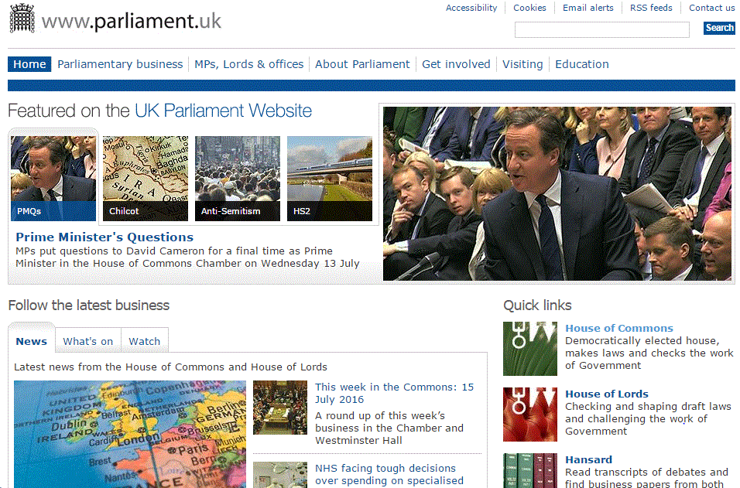
UK Parliament http://www.parliament.uk/

Slide 25
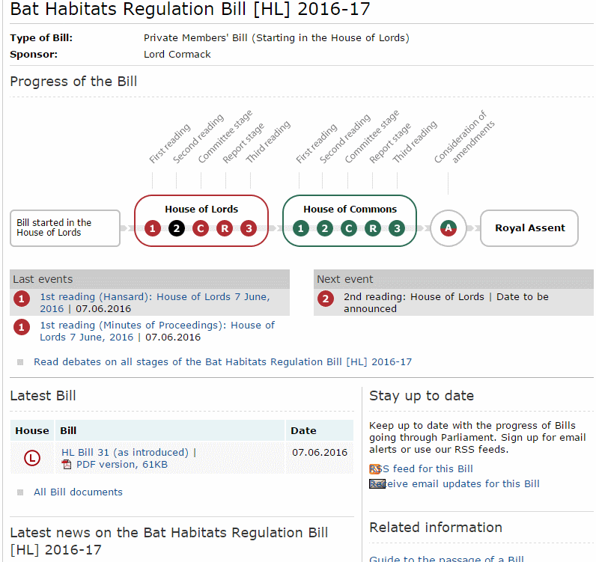
Monitoring the progress of legislation http://services.parliament.uk/bills/2016-17/bathabitatsregulation.html

Slide 26
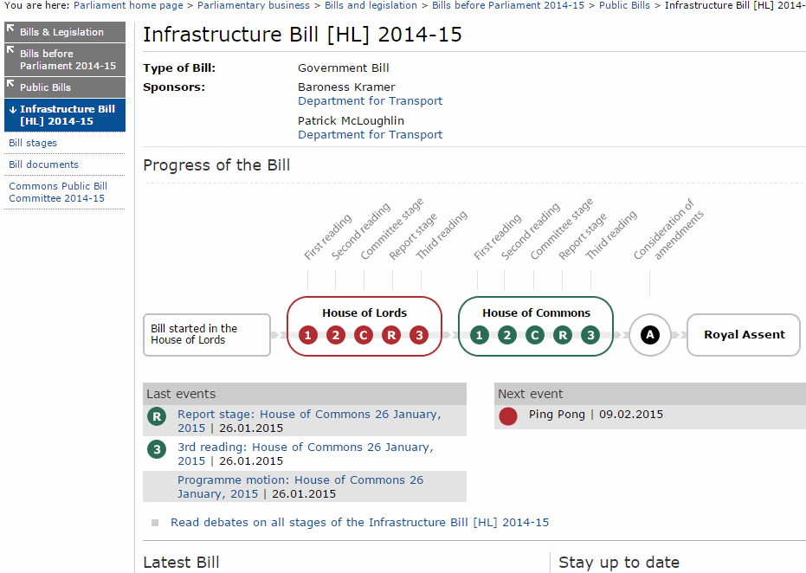
Monitoring the progress of legislation http://services.parliament.uk/bills/2014-15/infrastructure.html

Slide 27
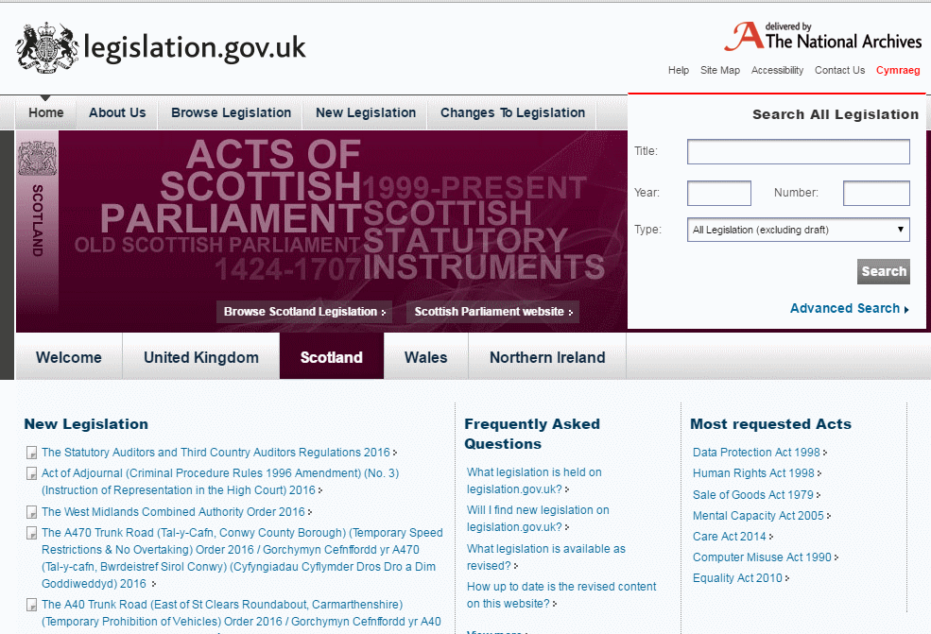
http://www.legislation.gov.uk/
Launched in 2010 - not all legislation has been updated

Slide 28
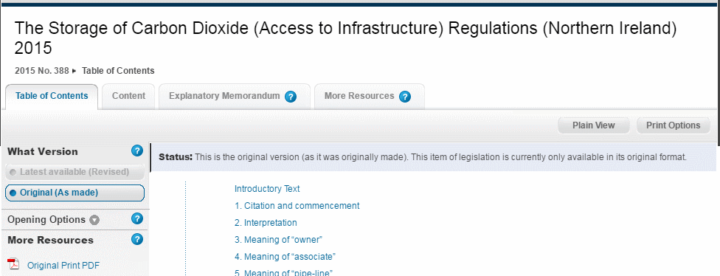
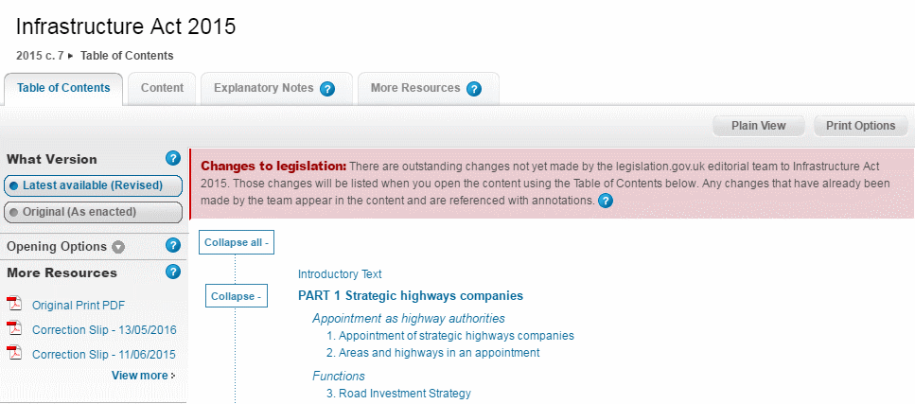
http://www.legislation.gov.uk/
Original, as enacted:
Outstanding changes

Slide 29
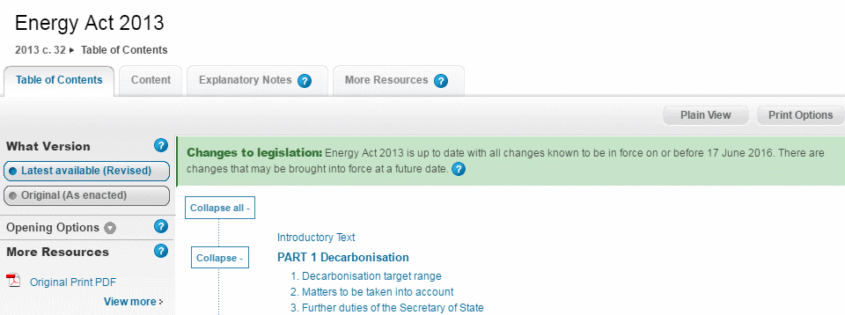
http://www.legislation.gov.uk/

Slide 30
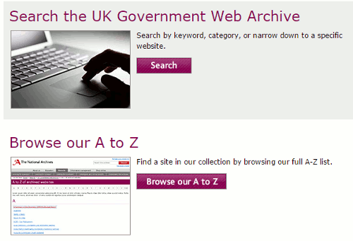
http://www.nationalarchives.gov.uk/webarchive/

Slide 31
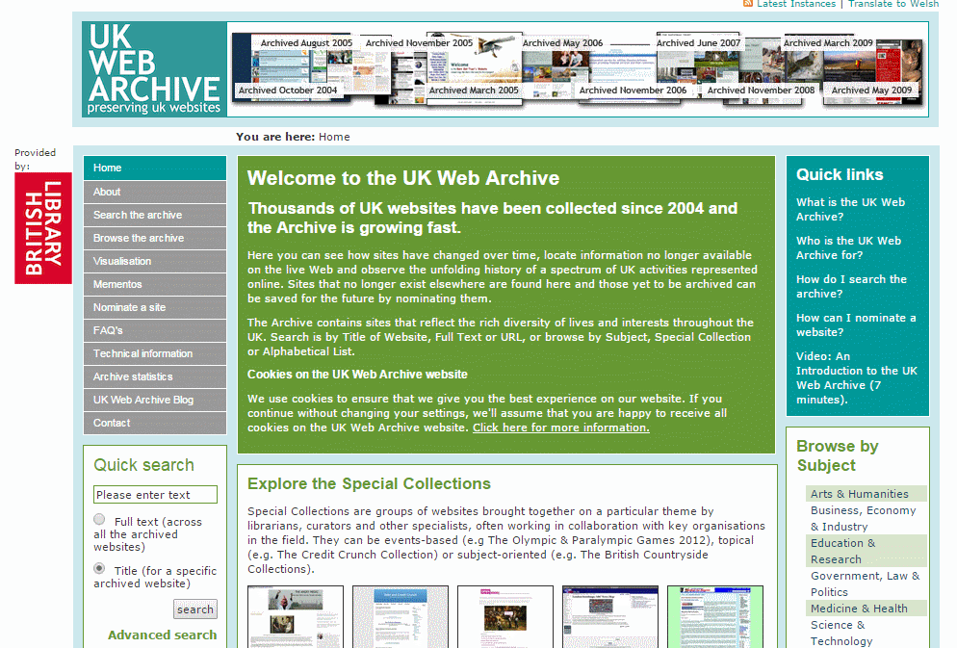
http://www.webarchive.org.uk/ukwa/

Slide 32
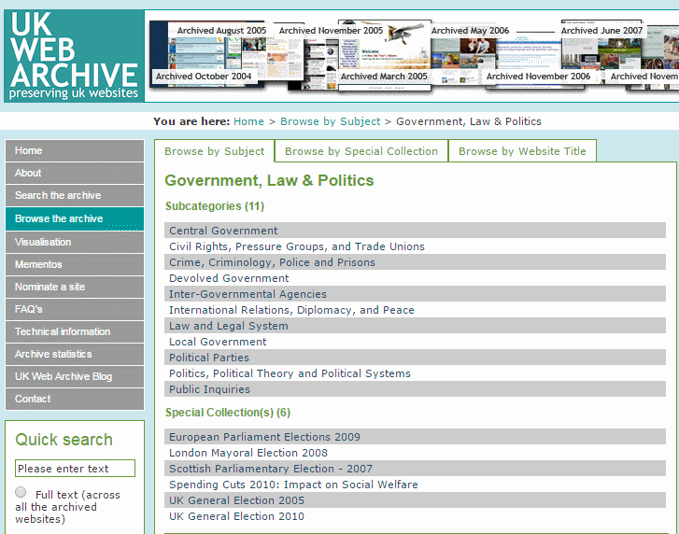
http://www.webarchive.org.uk/ukwa/subject/85/page/1

Slide 33
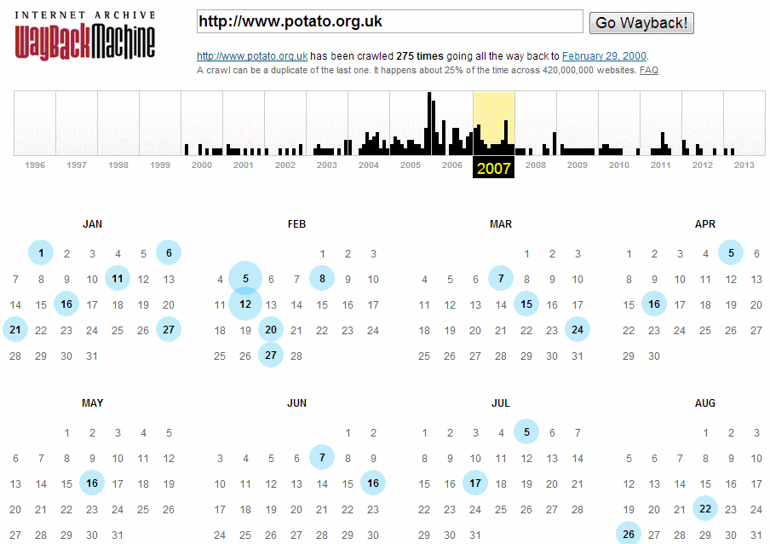
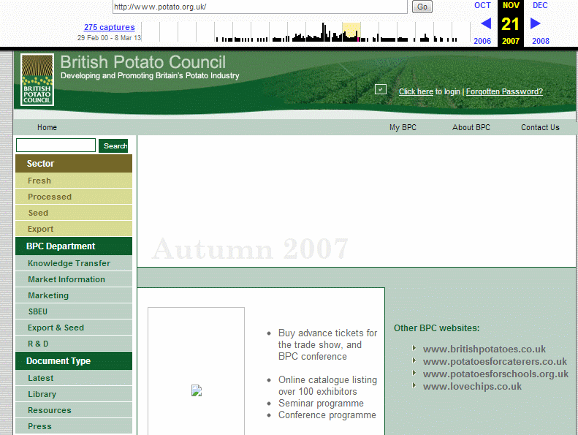
Wayback Machine http://www.archive.org/

Slide 34
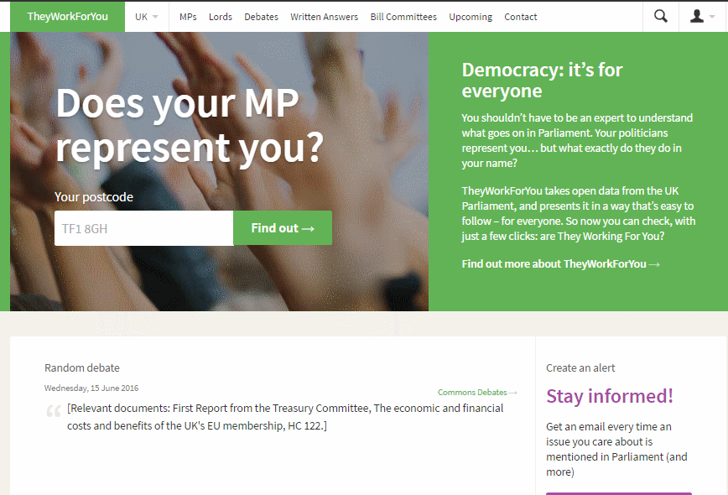
They work for you http://www.theyworkforyou.com/

Slide 35
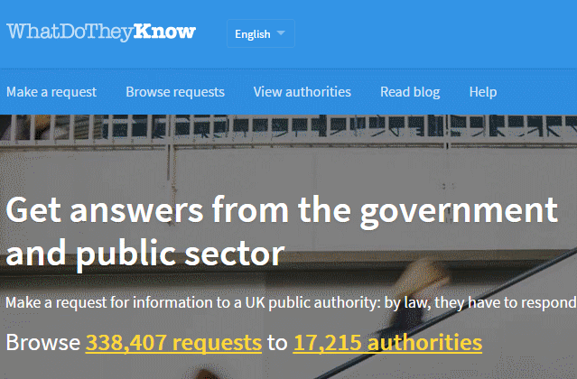
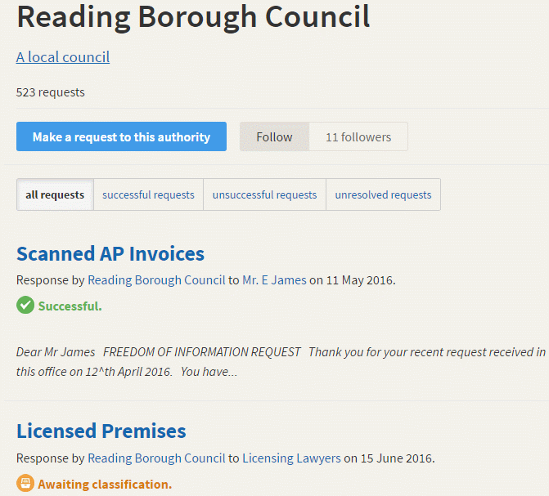
WhatDoTheyKnow - Freedom of Information (FOI) requests https://www.whatdotheyknow.com/

Slide 36
Business information - general starting points
Business Sources (RBA Information Services) http://www.rba.co.uk/sources/
Business and IP Centre - The British Library http://www.bl.uk/business-and-ip-centre
Industry guides - The British Library http://www.bl.uk/business-and-ip-centre/industry-guides
Library & Information Service ICAEW http://www.icaew.com/en/library (some information restricted to members)
SCOTBIS (Scottish Business Information Service) http://scotbis.nls.uk/
Buslib-L – discussion list for business librarians and researchers
http://list1.ucc.nau.edu/archives/buslib-l.html (login required)
FAQs at https://sites.google.com/site/busliblistserv/

Slide 37
Company Information

Slide 38
Company information
Ownership, directors, structure, share price, accounts, activities, news
Availability depends on
type of company
sole trader
partnership
private
limited liability e.g. Ltd, LLP
companies with publicly traded shares e.g. PLC
business size (large, medium, small)
country
state or region within the country

Slide 39
Company information
Free
Priced
Search one company at a time usually by name only
Display/report options limited, service defined chart options
No peer group/sector analysis
Foreign company information usually in the local language
Search for groups of companies multi-criteria search
Usually a range of reporting and charting options
Peer group/sector analysis sometimes available
Translation services may be available

Slide 40
UK Companies Act 2006
Some of the main changes
memorandum of association now only needs to state that the founders of the company wish to form a limited company
directors no longer need to apply to withhold their private address, for example if they believe they may be targeted by activists. Can now choose to supply a “service address”
requirement to have a company secretary removed
From 1 January 2016 new regulations regarding small businesses
“small” businesses can be larger
new category of “micro” business
changes in reporting requirements
From 6 April 2016
identify People with Significant Control (PSC)

Slide 41
Changes from 1 January 2016
Companies must meet at least two of the following criteria
Changes to accounting standards and regulations https://companieshouse.blog.gov.uk/2016/02/29/changes-to-accounting-standards-and-regulations/
The Micro-entities Regime | Companies act | ICAEW http://www.icaew.com/en/technical/financial-reporting/other-reporting-issues/companies-act/micro-entity-accounts-exemptions
 | Micro | Small
Turnover not exceeding | £632,000 | £10.2m (was £6.5m)
Balance sheet total not exceeding | £316,000 | £5.1m (was £3.26m)
Average number of employees | Max. 10 | Max. 50

Slide 42
Register of Persons with Significant Control (PSC)
“Beneficial owners” of a company
PSC requirements for companies and limited liability partnerships https://www.gov.uk/government/publications/guidance-to-the-people-with-significant-control-requirements-for-companies-and-limited-liability-partnerships
The new ‘people with significant control’ register | Companies House https://companieshouse.blog.gov.uk/2016/04/13/the-new-people-with-significant-control-register/
Beneficial ownership register opens on 6 April 2016 | BDO UK - BDO http://www.bdo.co.uk/services/tax/business-edge-2016/beneficial-ownership-register-opens-on-6-april-2016

Slide 43
Companies House. People with significant control (PSC) snapshot http://download.companieshouse.gov.uk/en_pscdata.html
Note: “This snapshot is provided free of charge and will not be supported.”

Slide 44
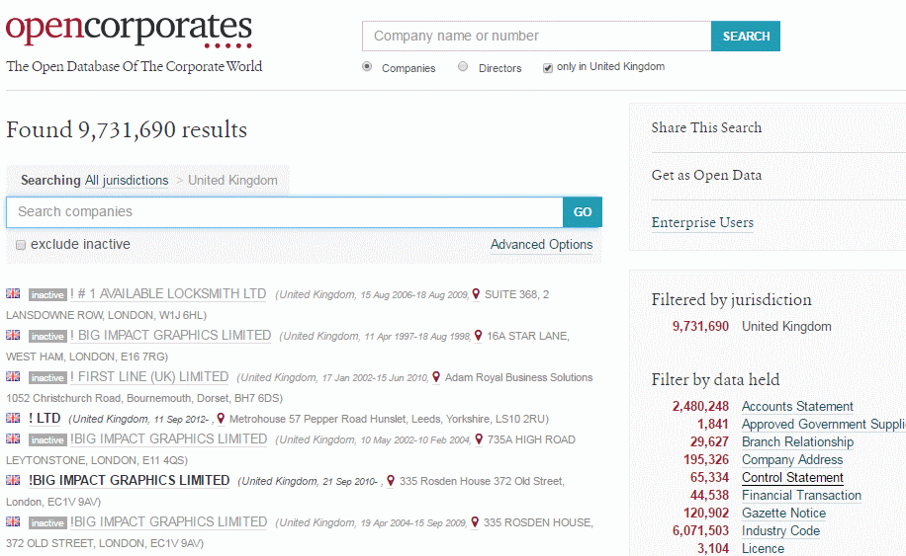
Opencorporates.com – from the home page select Browse all jurisdictions, and then the UK. From the right hand side filters select “Control Statement” to see all companies that have filed PSCs.

Slide 45
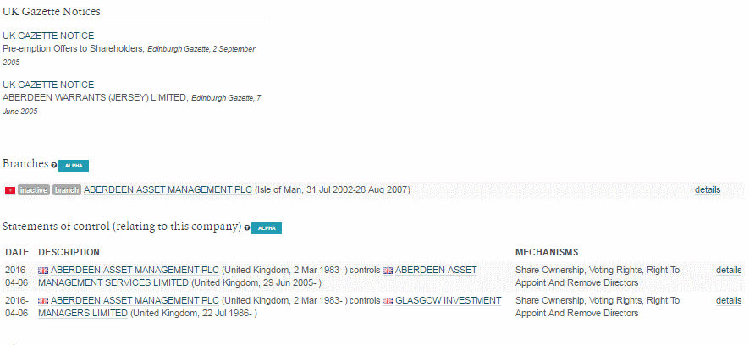
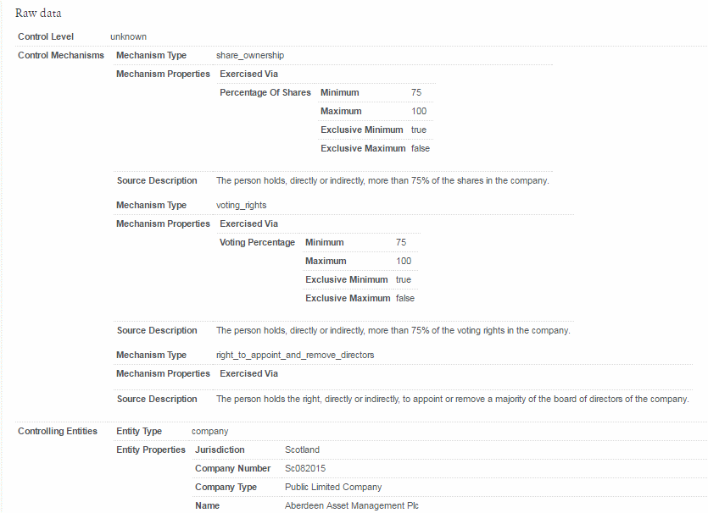

Slide 46
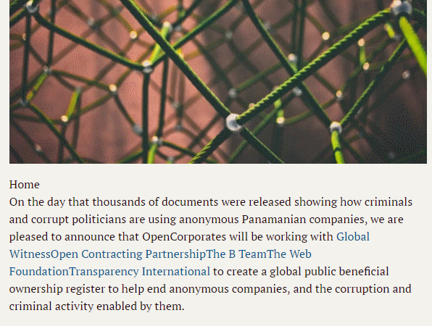
A Beneficial Ownership Register for the world: The first steps | OpenCorporates https://blog.opencorporates.com/2016/04/04/a-beneficial-ownership-register-for-the-world-the-first-steps/

Slide 47
Legal Forms & Company Extensions
A Guide to Legal Forms for Social Enterprise https://www.gov.uk/government/uploads/system/uploads/attachment_data/file/31677/11-1400-guide-legal-forms-for-social-enterprise.pdf
A Guide to Legal Forms for Business https://www.gov.uk/government/uploads/system/uploads/attachment_data/file/31676/11-1399-guide-legal-forms-for-business.pdf
CorporateInformation.com - Company Extensions and Security Identifiers http://www.corporateinformation.com/Company-Extensions-Security-Identifiers.aspx [does not appear to be updated]
Types of business entity http://en.wikipedia.org/wiki/Types_of_business_entity
Company Formation Survey http://www.offshoreinvestment.com/
Doing Business - Measuring Business Regulations - World Bank Group http://www.doingbusiness.org/

Slide 48
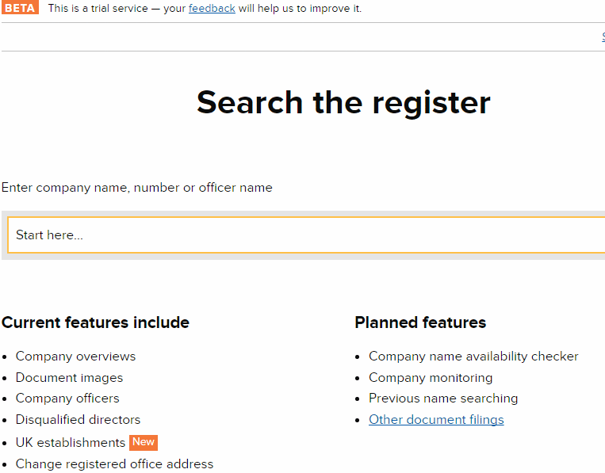
UK Companies House http://beta.companieshouse.gov.uk/

Slide 49
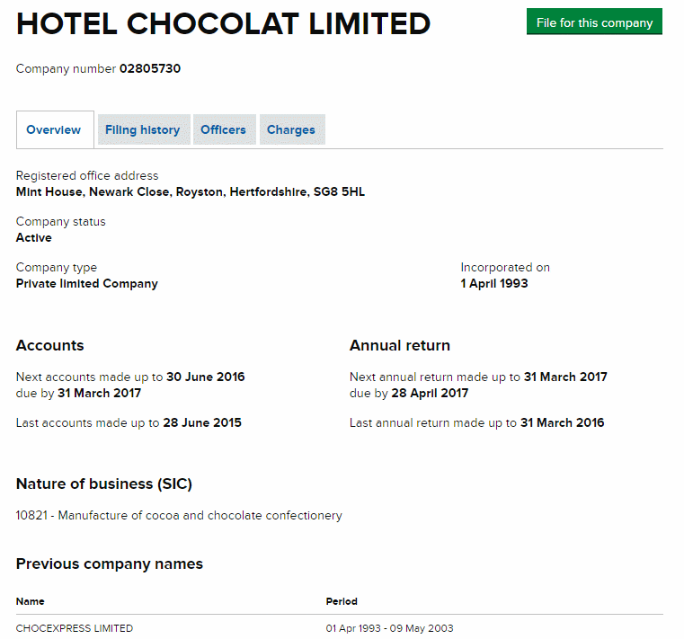
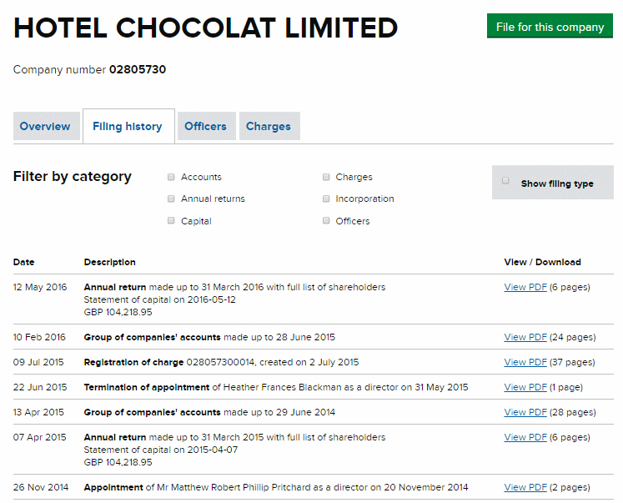
UK Companies House http://beta.companieshouse.gov.uk/

Slide 50
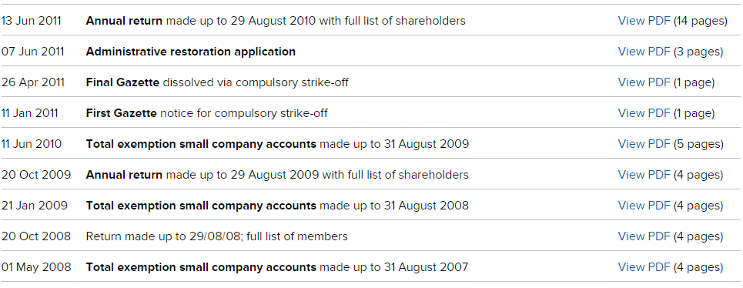
Companies House History

Slide 51
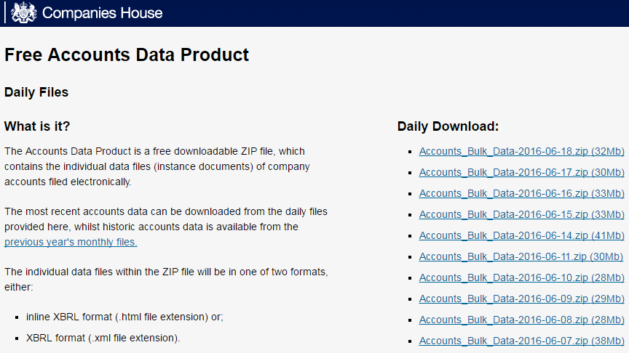
Companies House daily bulk data files
http://download.companieshouse.gov.uk/en_accountsdata.html
Bulk data - large daily files available as zipped files
No support provided – you’re on your own!

Slide 52
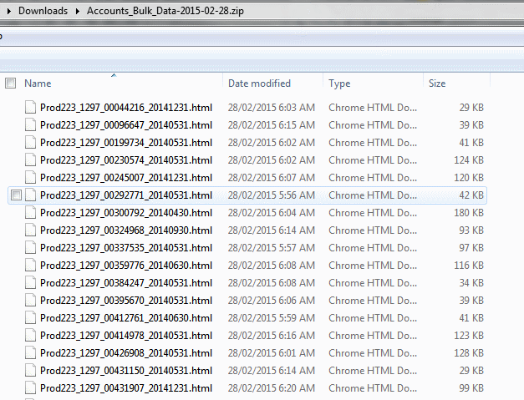
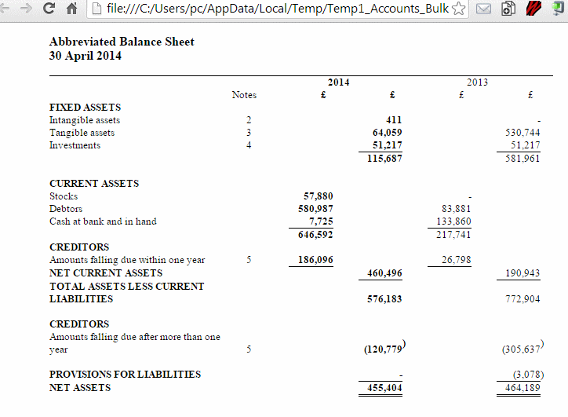
Companies House free data
Each file within the zipped file is a separate document. Note the uninformative file names!

Slide 53
Company Check Free Companies House search and download http://companycheck.co.uk/
Repackages Companies House data and provides additional display options
Covers UK and some European countries
Search by company or director’s name
Easy to follow the directors
Can filter results by status, location, assets etc.
Registration (free of charge) required to make the most of the free options
Some information e.g. credit reports, CCJs are priced

Slide 54
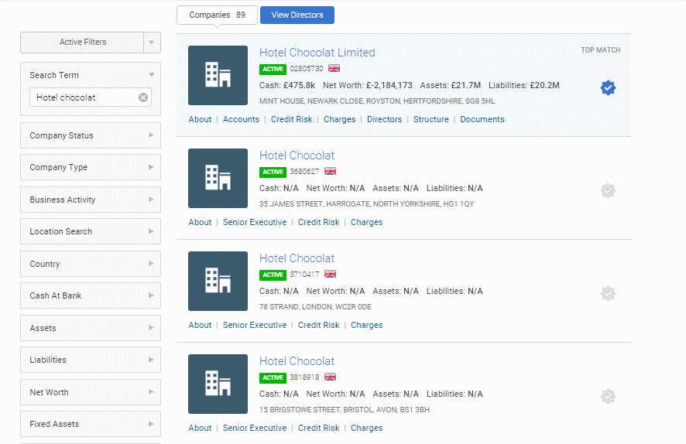
Company Check – Hotel Chocolat

Slide 55
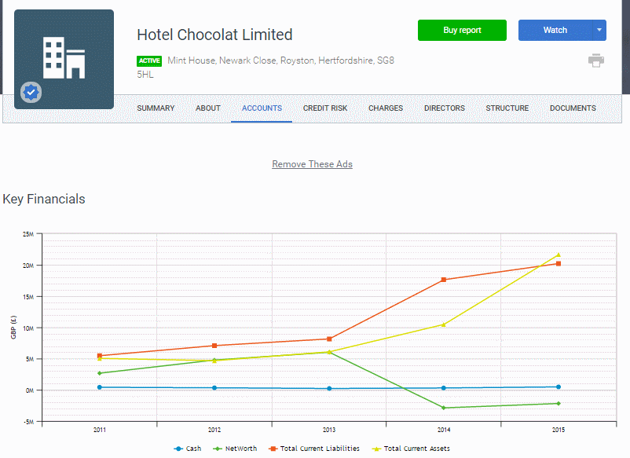
Company Check – Hotel Chocolat

Slide 56
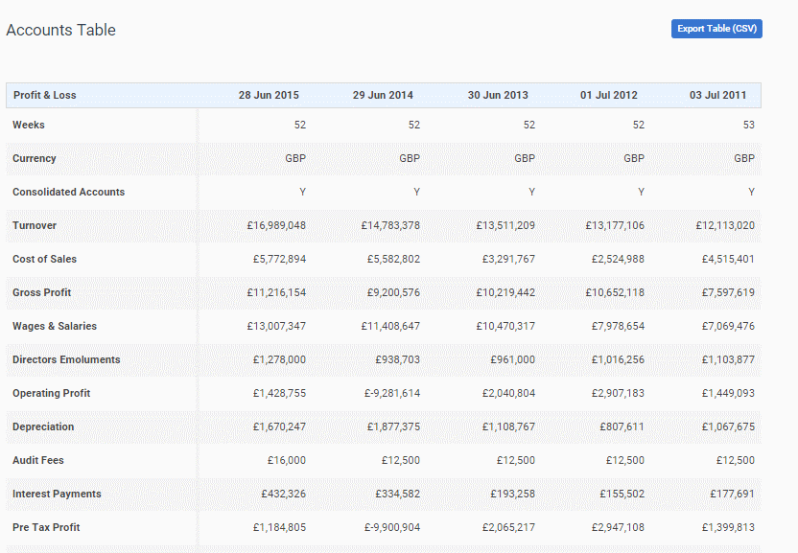
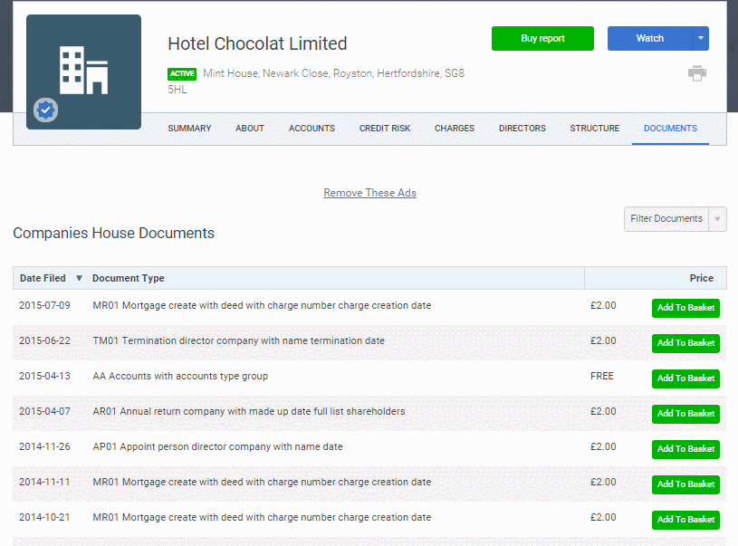
Company Check – Hotel Chocolat

Slide 57
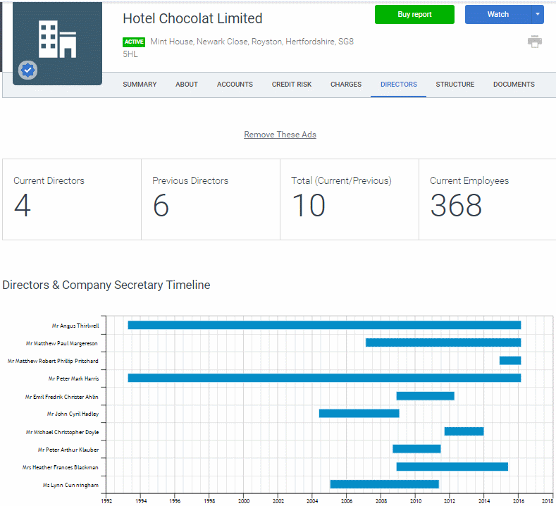
Company Check - directors

Slide 58
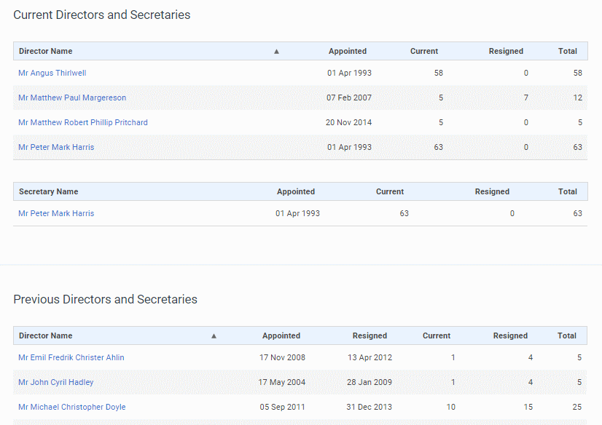
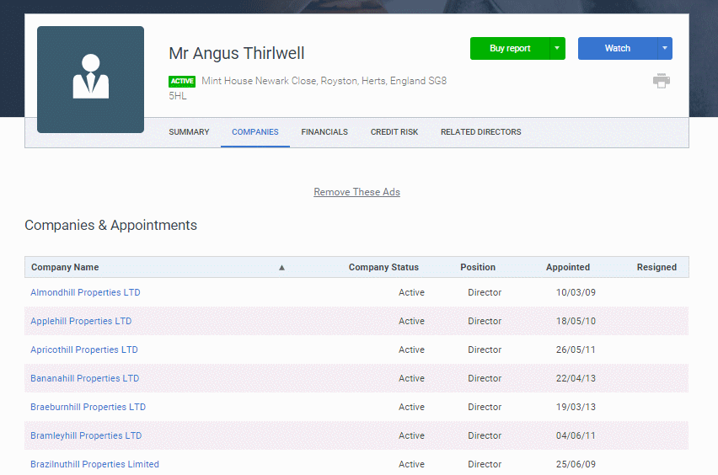
Company Check - directors

Slide 59
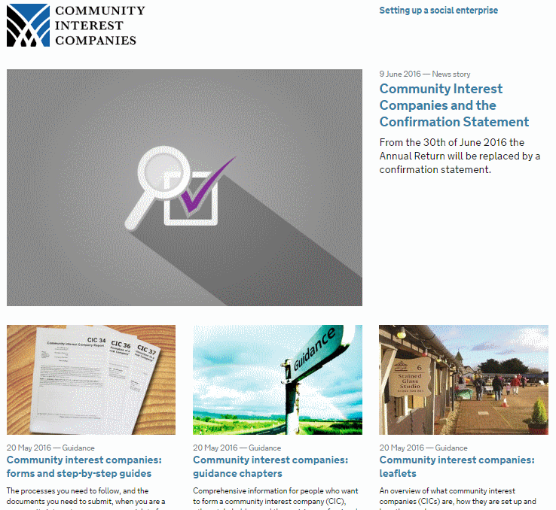
Office of the Regulator of Community Interest Companies https://www.gov.uk/government/organisations/office-of-the-regulator-of-community-interest-companies

Slide 60
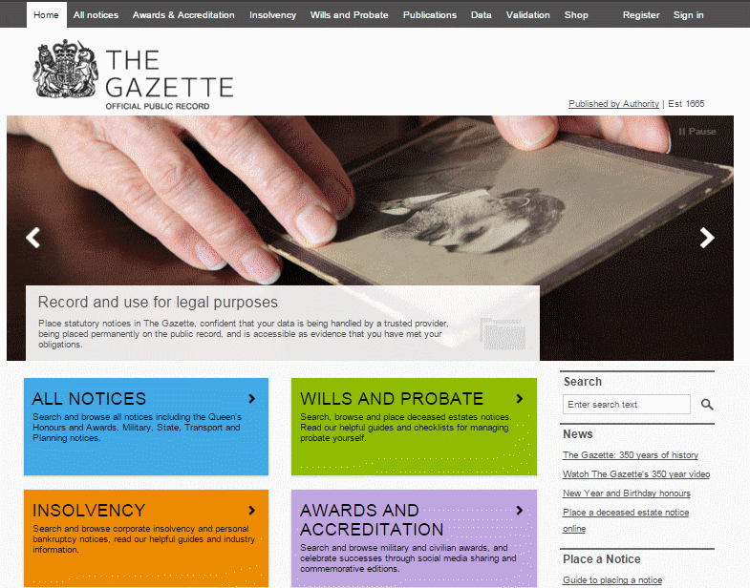
The Gazette | Official Public Record https://www.thegazette.co.uk/

Slide 61
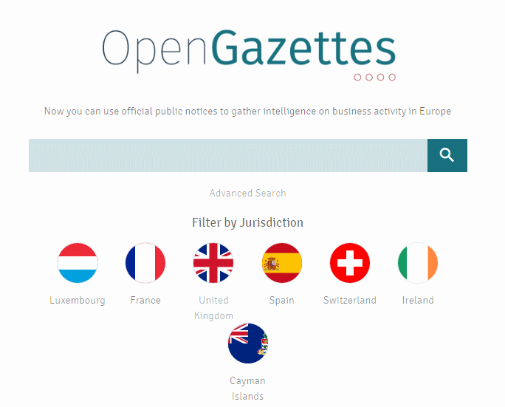
OpenGazettes http://opengazettes.com/

Slide 62
Official company information – other countries
Lists of official company registers
Official Company Registers http://www.rba.co.uk/sources/registers.htm
Company registration around the world http://www.commercial-register.sg.ch/home/worldwide.html
Companies House Overseas registries links http://www.gov.uk/government/publications/overseas-registries#reg
US – listed companies
SEC Edgar IDEA – Interactive Date Electronic Applications http://www.sec.gov/edgar.shtml
Canada - listed companies
SEDAR http://www.sedar.com/

Slide 63
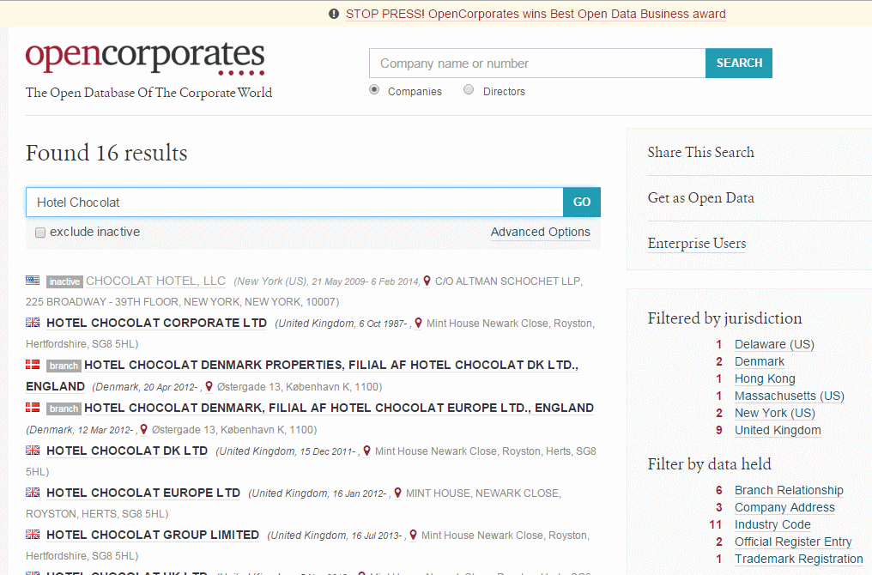
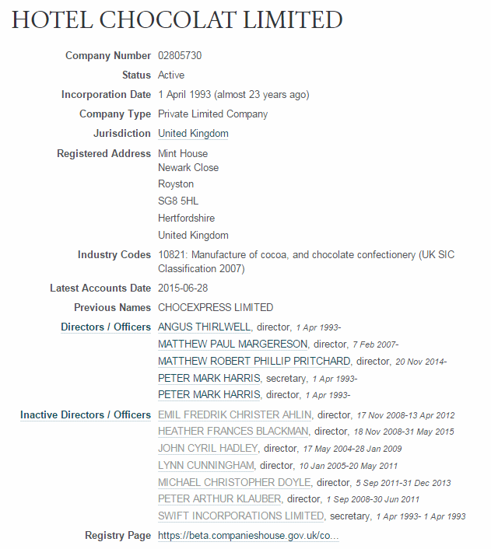
OpenCorporates http://opencorporates.com/

Slide 64
OpenCorporates http://opencorporates.com/

Slide 65
European Business Register http://www.ebr.org
Gateway to official company information in 27 European countries (24 online via EBR)
Different suppliers depending on country of residence - see http://www.ebr.org/index.php/information-distributors/
For the UK the suppliers are Kompany http://www.kompany.com and Kyckr (formerly GBRDirect) http://portal.kyckr.eu/

Slide 66
kompany http://www.kompany.com/
Covers 50 million companies in 80 countries and jurisdictions
Official registry information plus credit reports
Need to sign in to view all of the free information

Slide 67
Kompany.com

Slide 68
Kompany.com – subscription service

Slide 69
Kyckr (formerly GBRDirect) http://portal.kyckr.com/

Slide 70
Kyckr (formerly GBRDirect) http://portal.kyckr.com/

Slide 71
Legalinx 7side http://home.legalinx.co.uk/
Priced service
UK companies and documents, directors information, insolvency reports
Credit reports
International registry and documents service
1 hour registry and documents service http://home.legalinx.co.uk/products-services/international-company-information
translation service available
have agents "on the ground", can quickly tell you what is available in that country and what may not be available

Slide 72
Company information – some additional priced services
Bureau van Dijk (BvD) http://www.bvdinfo.com/
Dun and Bradstreet http://www.dnb.co.uk/
Experian UK http://www.experian.co.uk/
Factiva http://www.factiva.com/
LexisNexis http://www.lexisnexis.com/
Perfect Information - http://www.perfectinfo.com/
Thomson Reuters - http://thomsonreuters.com/

Slide 73
Examples of problem areas for the researcher
Switzerland
only banks, insurance companies and companies traded on the Swiss stock exchange are required to provide financial statements
Cayman Islands
“The Registrar of Companies can only release the name and type of company, its date of registration, the address of the registered office and the company’s status. Disclosing any other information is prohibited unless requested by a law enforcement agency.”
British Virgin Islands
“A company is not required to file its register of directors, register of members, register of charges or an annual return with the BVI Registrar of Corporate Affairs.”

Slide 74
Publicly traded companies – share prices
Free
current share prices delayed by 15-30 minutes
real-time prices if you have a share dealing account with a broker e.g. TD Direct Investing (http://www.tddirectinvesting.co.uk/)
only cover companies currently listed on the exchange
some historical data as charts or figures (e.g. Yahoo Finance and Google Finance)
Yahoo and Google cover major stock markets
go direct to the stock exchange web site
Priced
for more detailed analysis
full historical data
stocks no longer traded or merged with another company

Slide 75
Share prices
Yahoo Finance (major stock markets only)
http://uk.finance.yahoo.com/
Google finance (US, UK, Canada, some European stock markets, Australia, Hong Kong, China)
http://www.google.co.uk/finance
http://www.google.com/finance
FT.com – Markets, Equities section
Priced services – Reuters, Thomson Reuters DataStream, Bloomberg

Slide 76
Yahoo Finance

Slide 77
Google Finance

Slide 78
Google Finance

Slide 79
Companies on social media

Slide 81
Google search options and commands for business research

Slide 82
Google now using artificial intelligence as part of search - RankBrain
Tries to make “sense” of your search and put it into context, natural language queries, uses what others have searched and clicked
Constantly changing – all bets are off when it comes to predicting what your results will look like
How you ask your question is taken into account, device you are using is taken into account
Personalises results
Providing Quick Answers and “facts”, extracts from websites giving you the “answer”

Slide 83
Private browsing - quickest way “un-personalise”search
Chrome - New Incognito window Ctrl+Shift+N
FireFox Ctrl+Shift+P
Internet Explorer Ctrl+Shift+P
Opera Ctrl+Shift+N
Does NOT hide your IP address, will not remove country personalisation
Not search engine specific, built into the browser

Slide 84
Google rewrites your search
Google now tells you which terms it has ignored (some of the time)
“..” around terms, phrases, names, titles of documents does not always work
To force an exact match and inclusion of a term in a search prefix it with ‘intext:’ intext:agricultural occupational asthma
Use Verbatim for an exact match search

Slide 85
Google – missing terms

Slide 86
Google – using intext:

Slide 87
Google Verbatim

Slide 88
Think file format
PDF for research documents, government reports, industry papers
ppt or pptx for presentations, tracking down an expert on a topic
xls or xlsx for spreadsheets containing data
Use the advanced search screen or the filetype: command
UK waste vegetable oil energy generation regulations filetype:pdf
UK waste vegetable oil energy generation regulations filetype:ppt
UK waste vegetable oil energy generation regulations filetype:pptx
UK waste vegetable oil energy generation filetype:xls
UK waste vegetable oil energy generation filetype:xlsx

Slide 89
Google site:
site: to search within a site or type of site
waste vegetable oil energy generation site:gov.uk
waste vegetable oil energy generation site:www.gov.uk
waste vegetable oil energy generation site:assembly.wales
waste vegetable oil energy generation site:ac.uk
Can exclude sites using -site:
agricultural occupational asthma UK site:gov.uk
–site:hse.gov.uk
Does NOT search inside databases or protected areas
Can combine with filetype:
waste vegetable oil energy generation site:wales filetype:pdf

Slide 90
Date
Restrict your results to information that has been published within the last hour, day, week, month, year or your own date range
Search tools, Any time and select an option

Slide 91
daterange:
Date/Any time menu option cannot be used with Verbatim
Use daterange: command instead
Uses Julian date format (fractions omitted)
Julian Date Converter, and information on Julian date format) is at http://aa.usno.navy.mil/data/docs/JulianDate.php/
Convert your dates to the Julian format and then, omitting the fractions, copy and paste them into your search
Syntax: for example articles between 1st January 2015 and 30th June 2015 stem cell therapy diabetes daterange:2457023-
2457203
Then apply Verbatim to the results page

Slide 92
Run your daterange search and then apply Verbatim

Slide 93
Statistics, Industry and Market Data

Slide 94
Statistics, industry and market data
Free
Priced
Government statistics and reports
Anonymous aggregated data
Industry overviews
Executive summaries of market research
Press releases, news stories, local news
Local trade bodies, professional associations
Trade press - possibly
Detailed information on trends and market shares
Forecasts
Named companies
Brand names and market share
Detailed rankings

Slide 95
Bits and pieces from everywhere?
Is there a problem?
Not necessarily but...
must be aware of the context
why and how was the original research conducted, what sources were used, when was the data gathered
free resources may take information out of context
press releases and news articles focus on single issues, background and methodology often missing, may be several times removed from original research or data collection
Multiple free sources are often used to build a picture of a market piece by piece
Not comparing like with like

Slide 96
Industry guides - The British Library http://www.bl.uk/business-and-ip-centre/industry-guides
PDFs
Number of sectors covered
Resources include publications and databases at the BL but also freely accessible websites

Slide 97
Official statistics
OFFSTATS http://www.offstats.auckland.ac.nz/
Google Public data Explorer http://www.google.com/publicdata
UK National Statistics https://www.gov.uk/government/statistics/
Office for National Statistics http://www.ons.gov.uk/
Official Statistics in Scotland http://www.gov.scot/Topics/Statistics

Slide 98
Official statistics (2)
Welsh Government Statistics & Research http://gov.wales/statistics-and-research/?lang=en
Welsh Assembly Government StatsWales http://statswales.wales.gov.uk/
data.gov.uk http://data.gov.uk/
Eurostat http://ec.europa.eu/eurostat/
European Union Open Data Portal http://open-data.europa.eu/en/data/
International organisations such as the World Bank, ILO

Slide 99
http://www.offstats.auckland.ac.nz/

Slide 100
Google Public Data Explorer
http://www.google.com/publicdata/
One of Google's best kept secrets!
Public data sets made available by Eurostat, World Bank, IMF, CSO Ireland, OECD, ITU, some national statistics offices (but not ONS), and many more.
Source and date updated given.
Charts and charting options can highlight oddities and missing data
Look at the charts to see if there is a sudden change in the trends.

Slide 101
http://www.google.com/publicdata/ Google Public Data Explorer - minimum wage Europe

Slide 102
uktradeinfo https://www.uktradeinfo.com/Pages/Home.aspx

Slide 103
Potential problems with open data, data aggregators and visualisations
Definitions and scope may differ
Harmonising and processing of data
For example:
location of a crime may be mapped some distance away from the actual location
minimum wages within Europe converted to Euros may make some countries data seem to fluctuate wildly
Data entries may go missing or be absent
may not exist
information may not be collected or made available
data entry error?
deliberate suppression?
interface and chart generation may cause errors
legal issues, privacy and data protection
Format of the data files, lack of charting options

Slide 104
Finding market research - aggregators
Pull together reports from many publishers and make them searchable through a single interface
Can purchase reports through the one service
Aggregators may not be comprehensive
publishers may embargo reports for weeks or months
publishers may withhold some reports from aggregators
check the publisher’s own web site or email them to see if there is additional or more recent research available
may get a better deal by going to the publisher direct
use aggregators as an index to see who is publishing on your topic

Slide 105
Examples of market research aggregators
Marketresearch.com
http://www.marketresearch.com/
Report Buyer
http://www.reportbuyer.com/
Research and Markets
http://www.researchandmarkets.com/
Profound - Market Intelligence
http://www.profound.com/

Slide 106
News

Slide 107
Free news
For tracking down individual newspapers
http://www.abyznewslinks.com/
World Newspaper Directory http://www.onlinenewspapers.com/
Google News
advanced search options limited and not always reliable
no source list and sources frequently change
key industry publications may not be included and definitely not included if subscription
legislation may restrict access to publications
Use Google news and web search to identify specialist news portals or aggregators for your subject and monitor those direct

Slide 108
Search National UK Newspapers http://www.philb.com/nationaluknewspapers.html

Slide 109
British Newspaper Archive http://www.britishnewspaperarchive.co.uk/

Slide 110
British Newspaper Archive http://www.britishnewspaperarchive.co.uk/

Slide 111
Priced services
The Times http://www.thetimes.co.uk/ £12 for 12 weeks then £6/week.
3 month minimum term
FT http://www.ft.com/ - Limited number of free articles/month. Subscription starts at £5.35/month
The Telegraph http://www.telegraph.co.uk/ Limited number of free articles/month. Subscription starts at £10/month (£100 annually)
Factiva Factiva - Dow Jones http://www.dowjones.com/products/product-factiva/
Nexis | LexisNexis Business Insight Solutions http://bis.lexisnexis.co.uk/products/nexis
Research - Articles - HighBeam Research https://www.highbeam.com/ $299.95 a year or $29.95 a month

Slide 113
Behind the headlines - Health News - NHS Choices http://www.nhs.uk/news/Pages/NewsIndex.aspx

Slide 114
Debunking Euromyths
European Commission in the UK – Euromyths and Letters to the Editor http://blogs.ec.europa.eu/ECintheUK/
Euromyths and Letters to the Editor A-Z index http://blogs.ec.europa.eu/ECintheUK/euromyths-a-z-index/

Slide 115
Video – Google video vs YouTube
Google video not the same as Youtube
Google Video
YouTube

Slide 116
Bing video

Slide 117
Free alerting services
Google email and RSS alerts are seriously broken
do not alert you to everything that is new
alerts sometimes ‘die’
often bring up old material that you’ve already seen
duplicate information
Email alerts becoming a rarity
RSS feeds on news sites often all or nothing
Need an RSS reader e.g. Netvibes, Feedly, FeedReader
Phil Bradley's weblog: 20 Alternatives to Google Reader
http://philbradley.typepad.com/phil_bradleys_weblog/2013/03/20-alternatives-to-google-reader.html

Slide 118
And finally..... Spurious Correlations http://tylervigen.com/spurious-correlations

