Slide 1
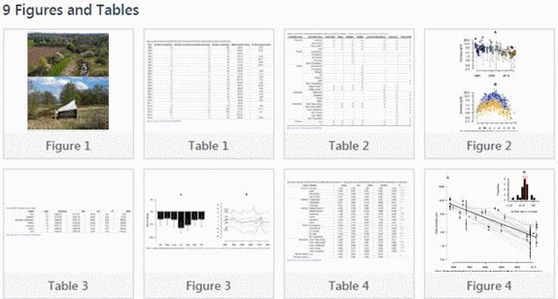
Scientific information
(The free stuff!)
ILI 2018
My topic of interest pollinator and insect biomass decline
Karen Blakeman, RBA Information Services Karen.Blakeman@rba.co.uk www.rba.co.uk twitter.com/karenblakeman

Slide 2
Reminder – advanced search commands are your friends in Google “All” web search
filetype: for file formats
filetype:pdf for research papers, conference presentations, industry reports, government reports
pollinator decline filetype:pdf
filetype:ppt, filetype:pptx for presentations
pollinator decline filetype:pptx OR filetype:ppt
filetype:xls, filetype:xlsx, filetype:csv for data
pollinator decline filetype:xlsx OR filetype:xls

Slide 3
site: to search inside an individual site or types of sites
pollinator decline site:gov.uk
pollinator decline site:ac.uk OR site:edu
pollinator decline site:ox.ac.uk
Combine with filetype:
pollinator decline filetype:pdf site:ec.europa.eu

Slide 4
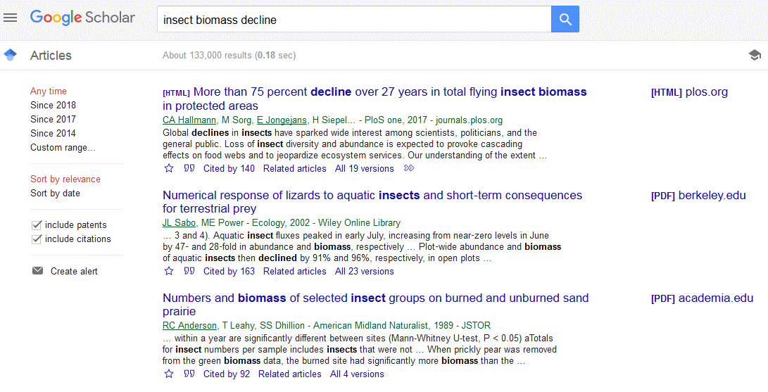
Google Scholar – https://scholar.google.com/

Slide 5
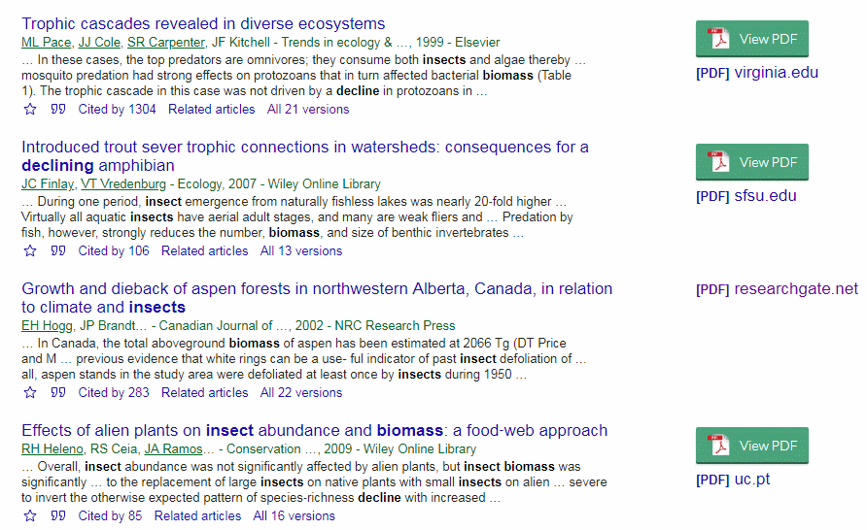
Google Scholar results with Kopernio installed as a Chrome extension

Slide 6
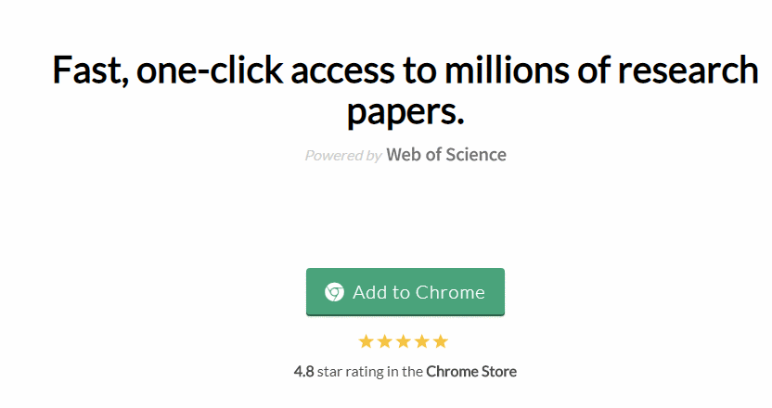
Kopernio - https://kopernio.com/
Search using Google Scholar, Web of Science, Science Direct or PubMed
If you do not have access to a subscription service then you will see just the free PDFs that are available.
Button appears in Google Scholar, PubMed and on publishers’ article pages

Slide 7
Google Scholar result
Save to Library
Cached copy
Citations
Cite
Related articles
Versions of this article available via Scholar

Slide 8
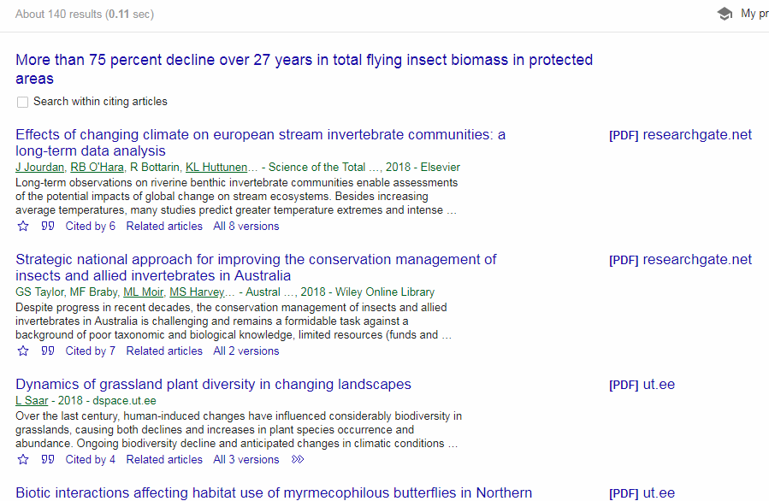
Google Scholar - citations

Slide 9
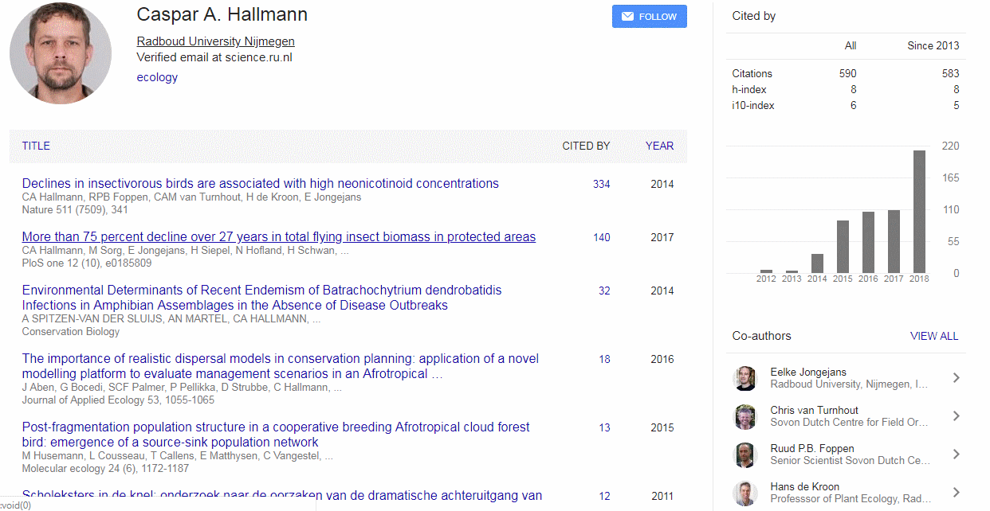
Google Scholar author profile

Slide 10
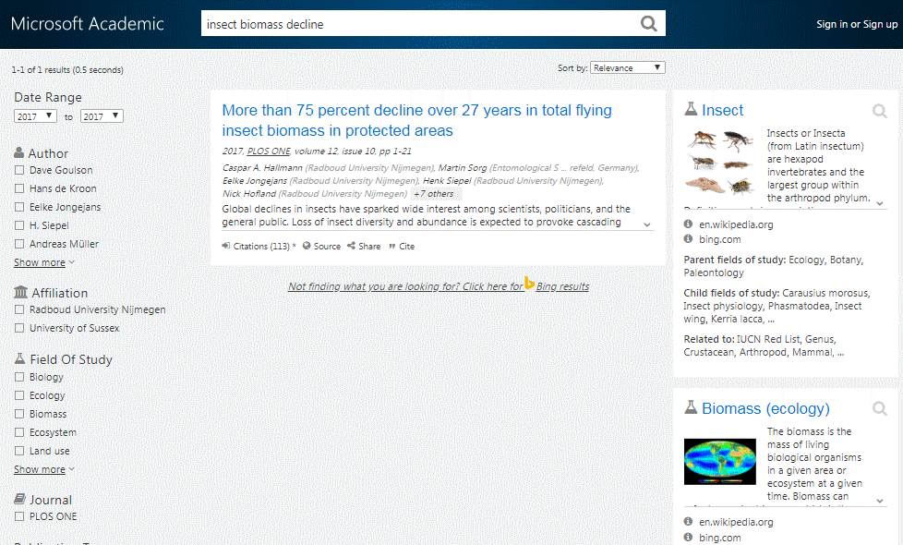
Microsoft Academic https://academic.microsoft.com/
Semantic search - a very different approach to searching and just one article on my insect biomass search, but highly relevant. 113 citations compared to Google Scholar’s 140

Slide 11
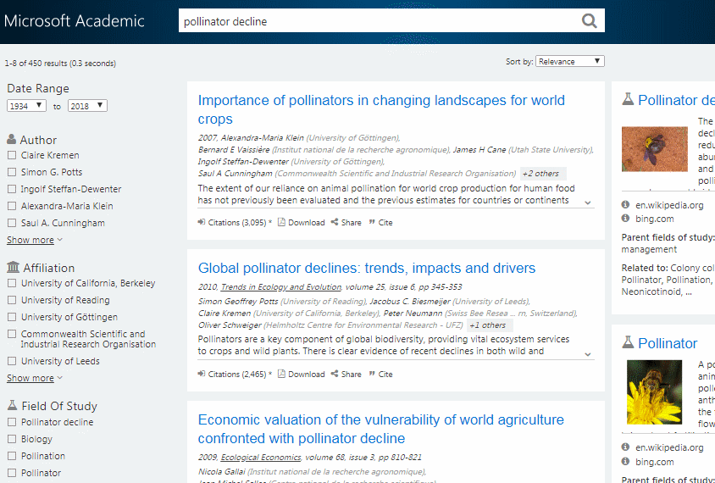
Microsoft Academic https://academic.microsoft.com/
Searching on pollinator decline gives me more

Slide 12
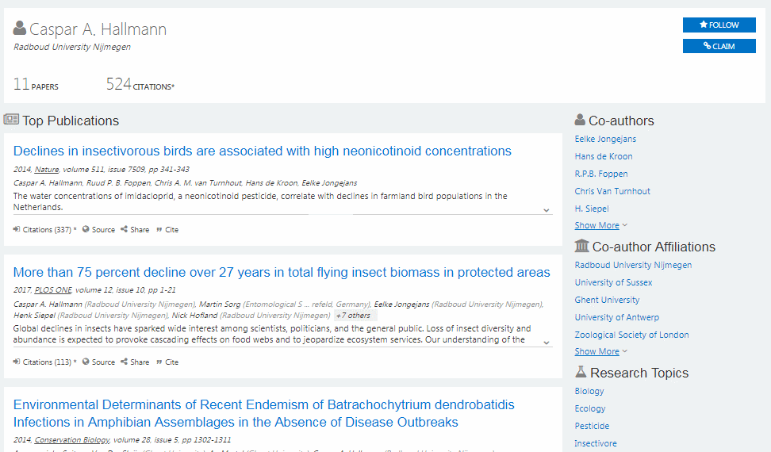
Microsoft Academic https://academic.microsoft.com/ Author profile

Slide 13
Semantic Scholar - An academic search engine for scientific articles https://www.semanticscholar.org/

Slide 14
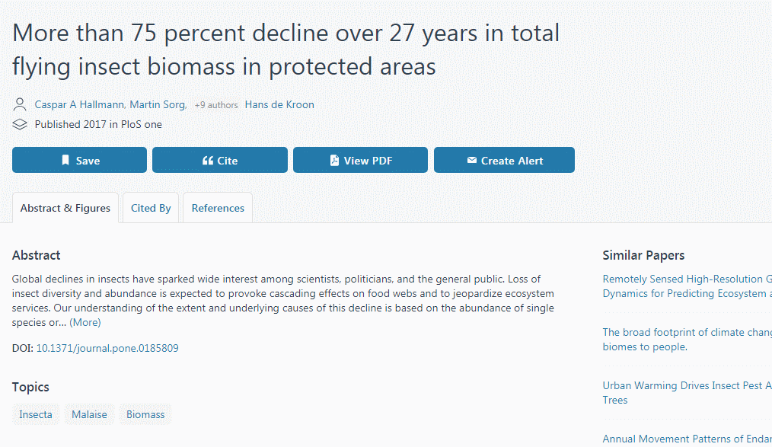
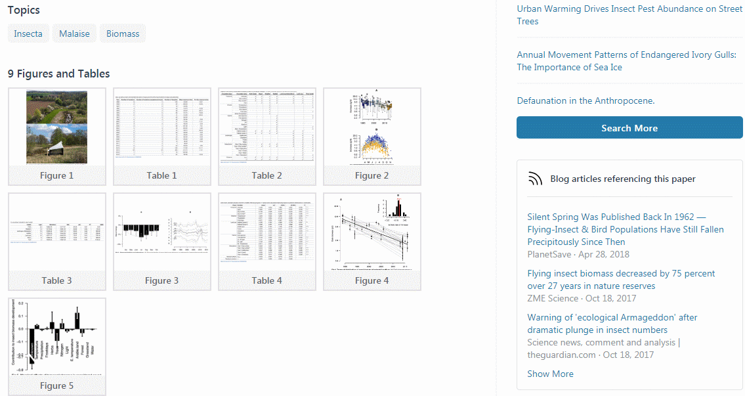
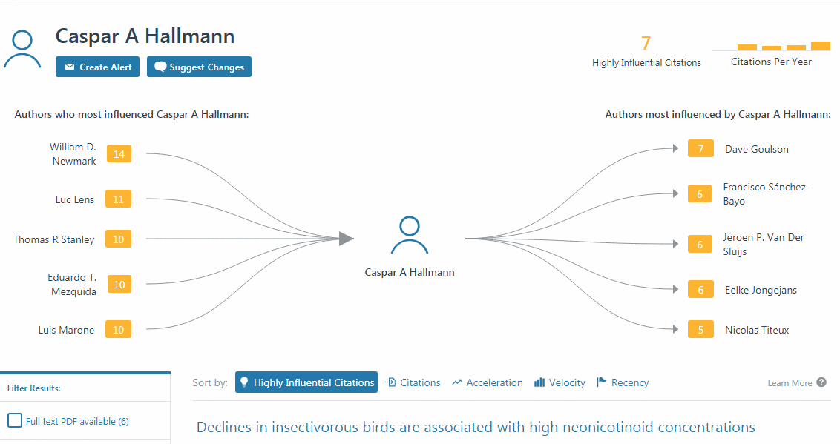
Semantic Scholar - An academic search engine for scientific articles https://www.semanticscholar.org/

Slide 15
What if I am having trouble finding a free copy of a paper?
First check the “versions” listed by Google Scholar
Run a search in Google and/or Bing Web search
Install the Unpaywall extension https://unpaywall.org/
View the information about the article on the publishers website and padlock appears on the right hand side of the article:
Gold tab for Gold OA articles available from a fully OA journal
Green tab for Green OA articles on a preprint server or institutional repository
Bronze tab for Bronze OA articles free to read on the current page, but published elsewhere behind a paywall

Slide 16
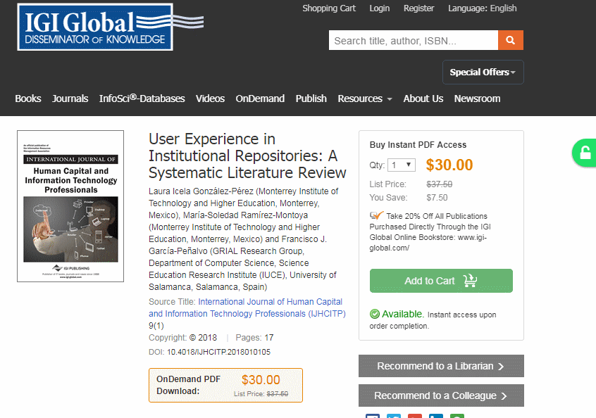
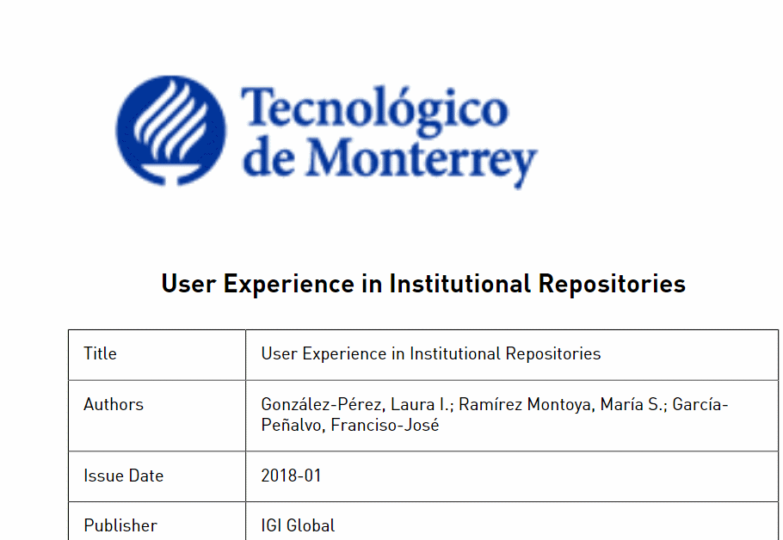
Unpaywall “An open database of 20 million free scholarly articles” https://unpaywall.org/

Slide 17
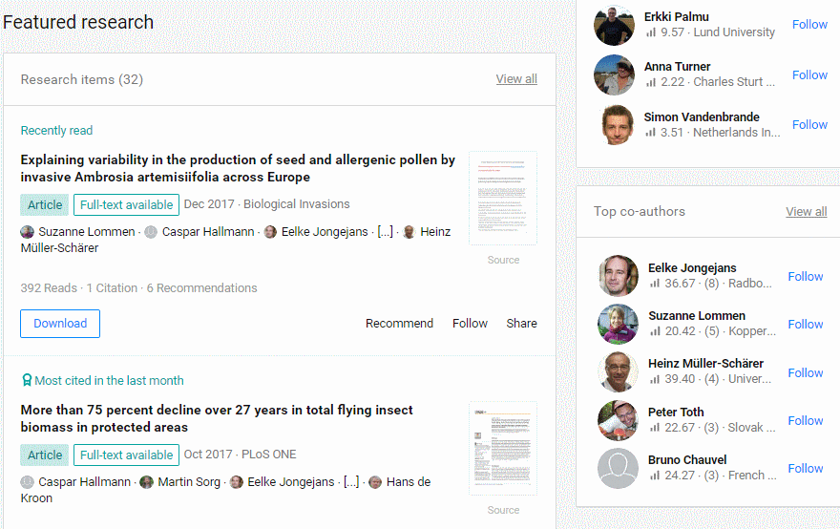
Contact the author ResearchGate - http://www.researchgate.net/

Slide 18
Sci-Hub
https://www.theguardian.com/higher-education-network/2018/may/21/scientists-access-journals-researcher-article
Possible reasons why some people use Sci-Hub:
Organisation does not subscribe to the journal, access via the institution’s service is unreliable or complex to navigate, off-site access difficult.
But major concerns and ethical issues over how paywalled articles are obtained by Sci-Hub

Slide 19
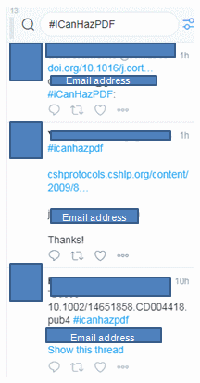
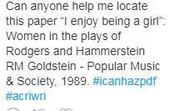
#ICanHazPDF
Tweet requests for articles, including
email address (or share using direct
messaging with person offering to supply), hash tag and reference details
Once the paper is received, original tweet is deleted
Potential for copyright violations

Slide 20
Discover the attention surrounding your research – Altmetric https://www.altmetric.com/ – mentions of research in the news and social media
Altmetric badge may be embedded in articles on a publisher’s website
Bookmarklet for Chrome, Firefox and Safari

Slide 21
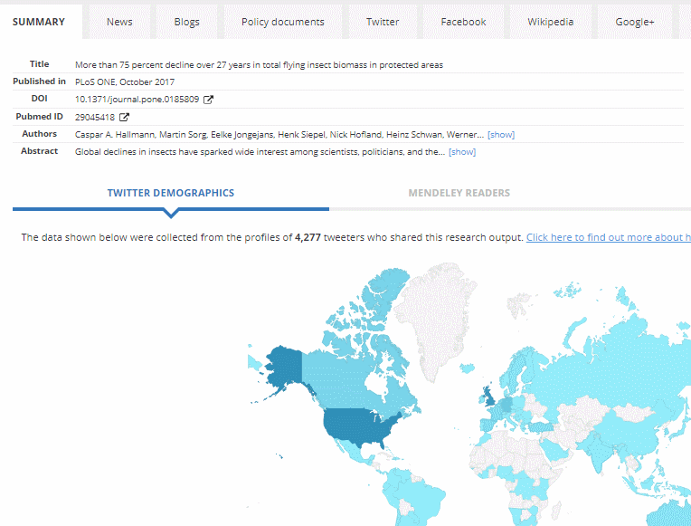
Altmetric for More than 75 percent decline over 27 years in total flying insect biomass in protected areas https://www.altmetric.com/details/27610705

Slide 22
Additional information - Google Scholar advanced search
Google Scholar is completely separate from Google’s general search
It has a slightly different set of commands and does not always look for so many synonyms or variations in the way that that Google web search does. Use the OR command to specify alternatives.
Google Scholar does not drop terms from your search
Google Scholar does not use the publishers’ metadata so searching, for example, by year can retrieve irrelevant papers. 2012 could be a publication year, a volume number or a page number.
There is an advanced search screen (see next slide) or you can use commands

Slide 23
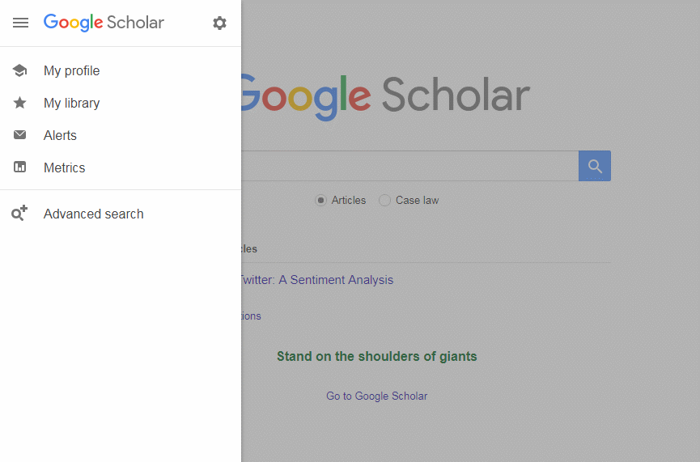
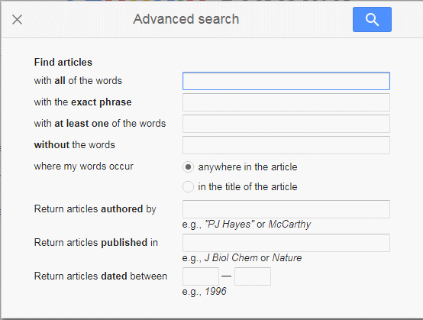
Google Scholar advanced search

Slide 24
Google Scholar advanced search commands
+ sign immediately before a search term to force an exact match [rarely needed]
minus sign immediately before a search term to exclude documents containing that term
“....” around phrases for example “emission control”
OR to search for alternative terms, for example
automotive OR automobile "emission control" catalyst OR catalysts
intitle: to search for a word or phrase in the title, for example
catalyst intitle:”emission control”
Note: advanced search screen uses allintitle: which cannot be combined with searching for terms elsewhere in the article

Slide 25
Google Scholar advanced search commands
author: to search on an author’s name, for example
“emission control” catalyst OR catalysts author:hardacre
site: to limit your search to a specific institution for example
“emission control” site:manchester.ac.uk
Note: this does not search for the affiliation of the author(s) but looks for documents that might be hosted on the specified site.
source: to search for articles in a specific publication platinum nanoparticles catalysis source:“nature materials”
Year of publication – use the advanced search screen or menu options on the left hand side of the results page

Slide 26
Links
Google Scholar, Web of Science, and Scopus: A systematic comparison of citations in 252 subject categories - ScienceDirect
https://www.sciencedirect.com/science/article/abs/pii/S1751157718303249
Accuracy of affiliation information in Microsoft Academic: Implications for institutional level research evaluation - STI2018_paper_177.pdf
https://openaccess.leidenuniv.nl/bitstream/handle/1887/65339/STI2018_paper_177.pdf
Musings about librarianship
http://musingsaboutlibrarianship.blogspot.com/
From Aaron Tay, Library Analytics Manager , Singapore Management University. Useful, detailed articles on various aspects of academic search.

