Slide 1
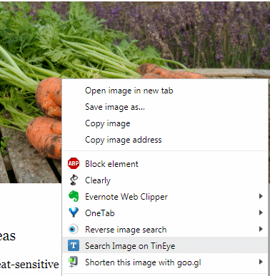
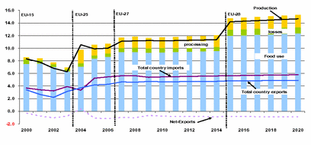
Non-textual Search: image, video, audio and datasets
ILI 2018
Karen Blakeman, RBA Information Services Karen.Blakeman@rba.co.uk www.rba.co.uk twitter.com/karenblakeman/

Slide 2
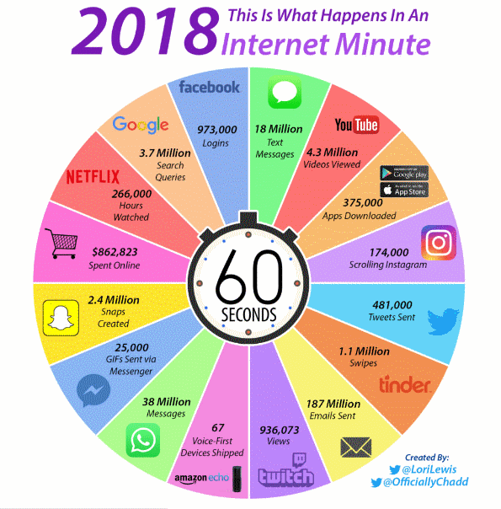
Infographic: What Happens in an Internet Minute in 2018? http://www.visualcapitalist.com/internet-minute-2018/

Slide 3
Images, sound, video, datasets for...
Photos, charts, graphs, diagrams, sketches
News footage - current and archived
Presentations, lectures, corporate communications
Literary readings
TV and radio programmes
“How to...”
Creating interactive maps, customised charts and
infographics
And lots more!

Slide 4
Copyright
Always assume photos, videos, podcasts, graphics are “all rights reserved” unless otherwise specified
Specialist search tools may find your infringing content e.g.PicScout (http://picscout.com) owned by Getty Images
License details in text associated with file
Copyright information in metadata – can be stripped out so don’t rely on its absence to confirm you can use a photo
Visual watermarks/license statements on images and videos
Digital watermarks on images e.g. Digimarc (https://www.digimarc.com/application/photography). Not obvious but can be tracked even if you alter the colours, size, crop it or take a screen shot

Slide 5
Copyright
Know your licenses
All rights reserved – contact the copyright owner
Creative Commons http://creativecommons.org/
Attribution
Noncommercial
No Derivative Works
Share Alike
Public Domain Dedication (CC0)
Public Domain Work

Slide 6
Select your search terms carefully
You are usually searching on the creator’s/publisher’s file name, title, tags, description and possibly the text just immediately surrounding the image or object
Some databases have minimal descriptions of the content if any
You won’t be using Google all of the time – most tools will not automatically search for variations and synonyms of a term
Not all media may be available in your location. You may have to find another tool, or use a VPN

Slide 7
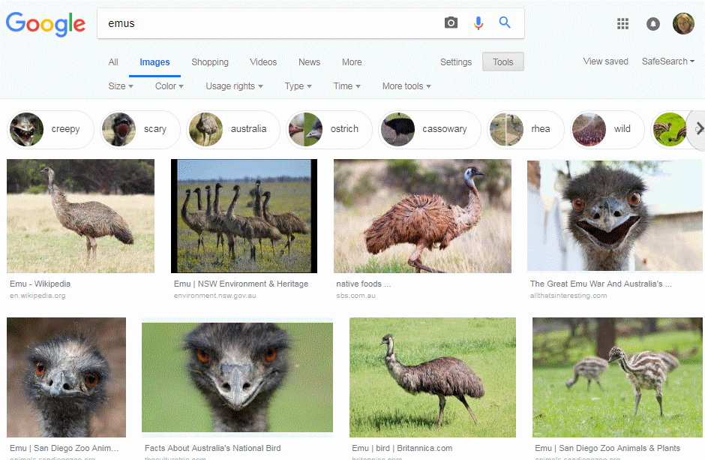
Changes to Google Images desktop layout
Making visual content more useful in Search
https://www.blog.google/products/search/making-visual-content-more-useful-search/

Slide 8
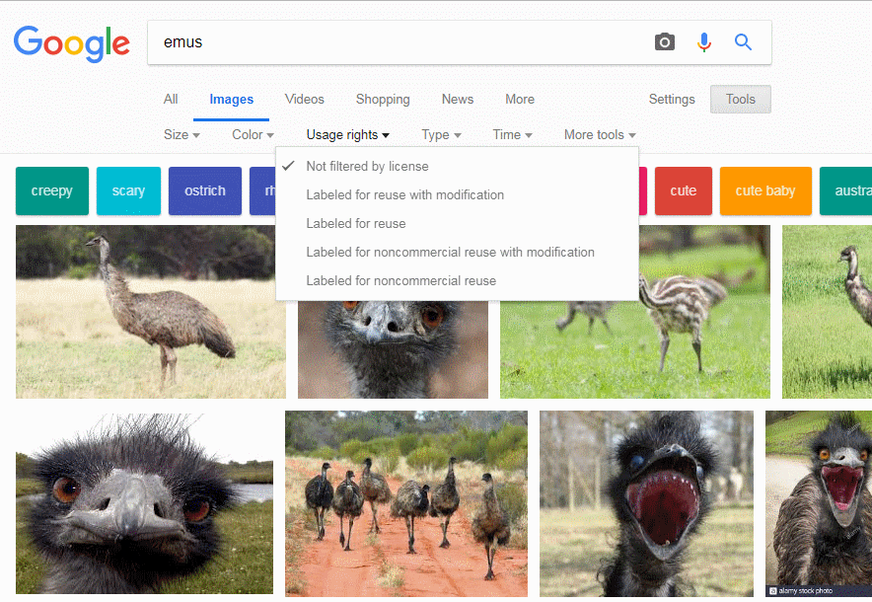
Old Google images layout

Slide 9
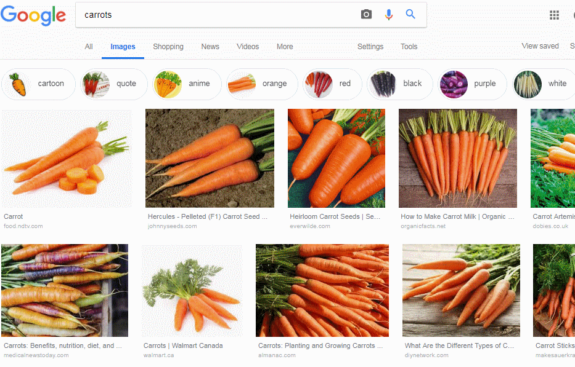
Google image search

Slide 10
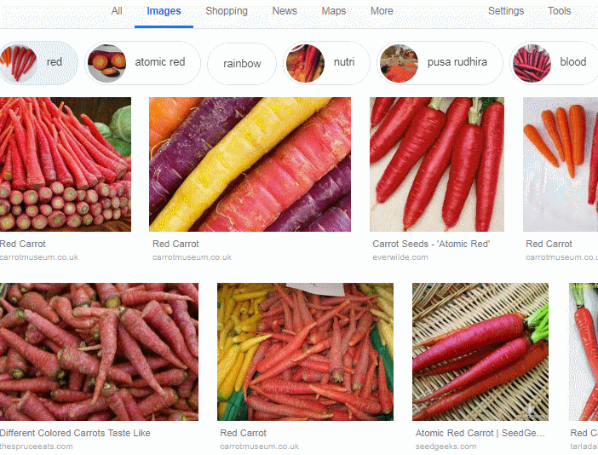
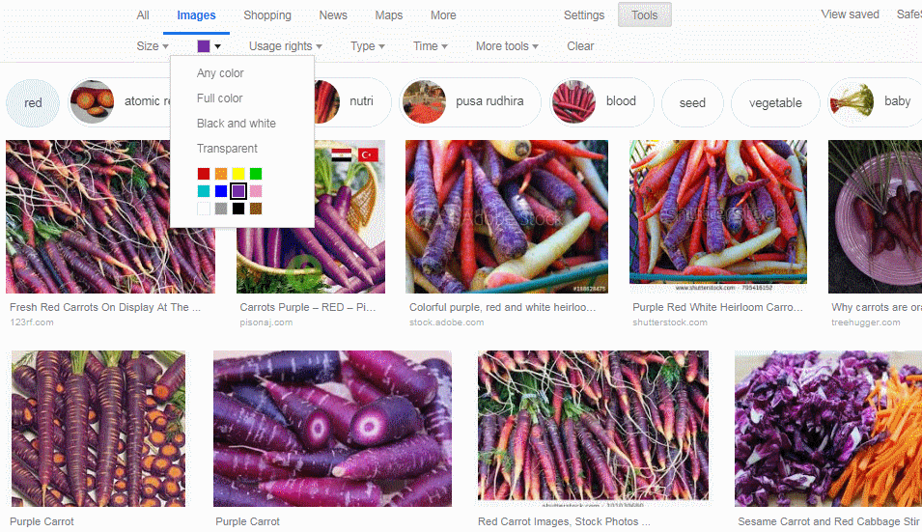
Google image search - colour

Slide 11
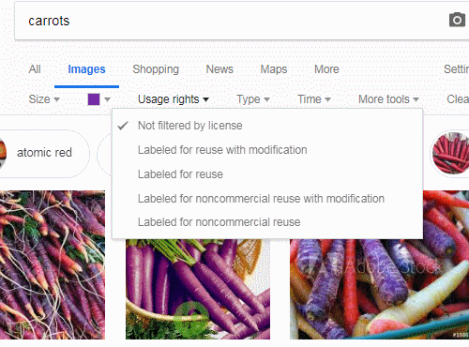
Google image search – usage rights

Slide 12
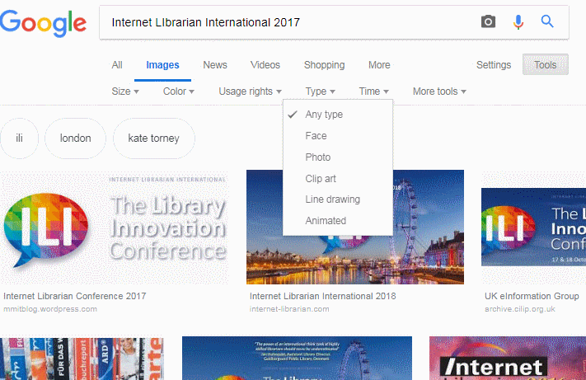
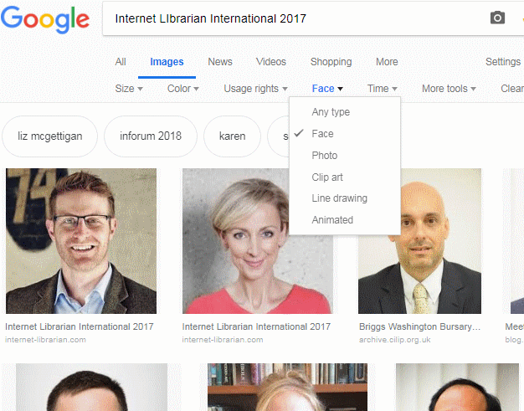
Google Image Search - type

Slide 13
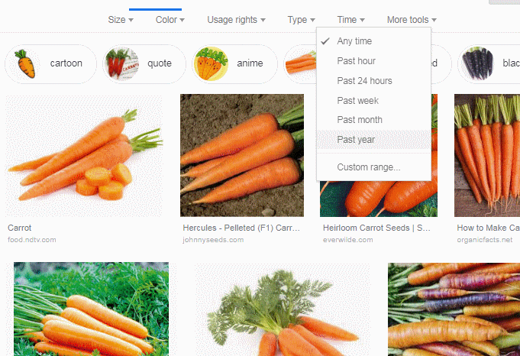
Google image search - Time

Slide 14
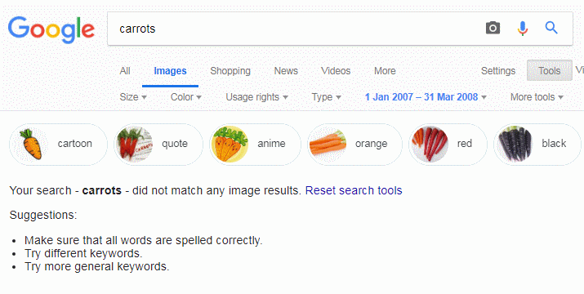
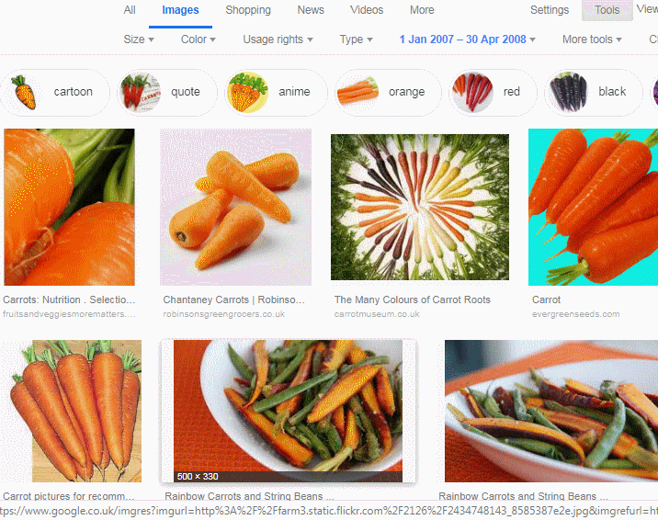
Google image search - time
Google won’t show images if you set a time before April 2008

Slide 15
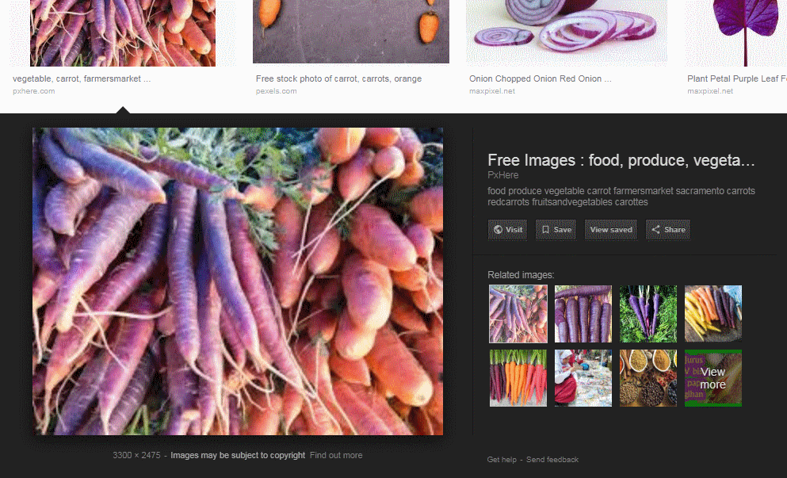
Google image search – selecting an image

Slide 16
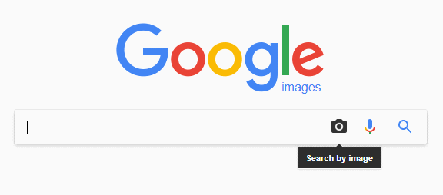
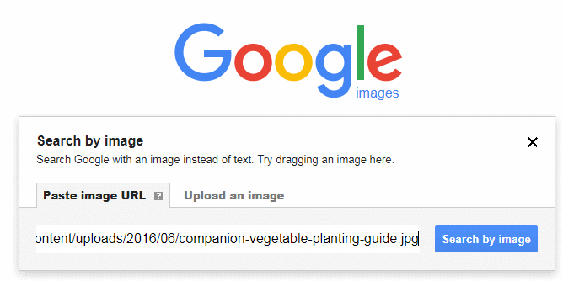
Google reverse image search
Click on the camera
Paste image URL into box or choose the ‘Upload an image’ option

Slide 17
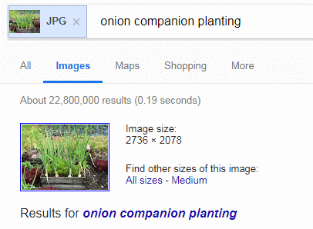
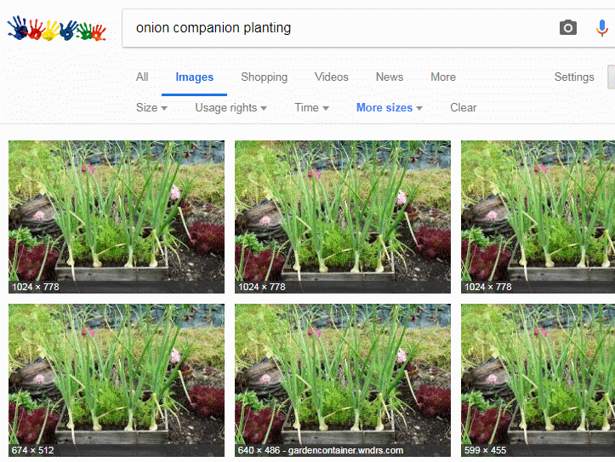
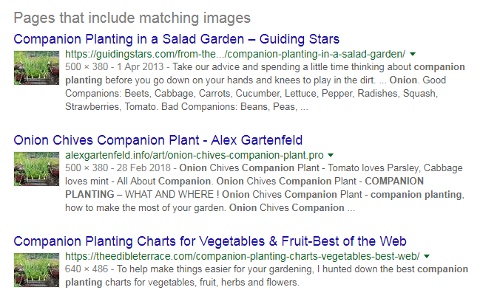
Google reverse image search - results
Click on All sizes
Scroll down to....

Slide 18
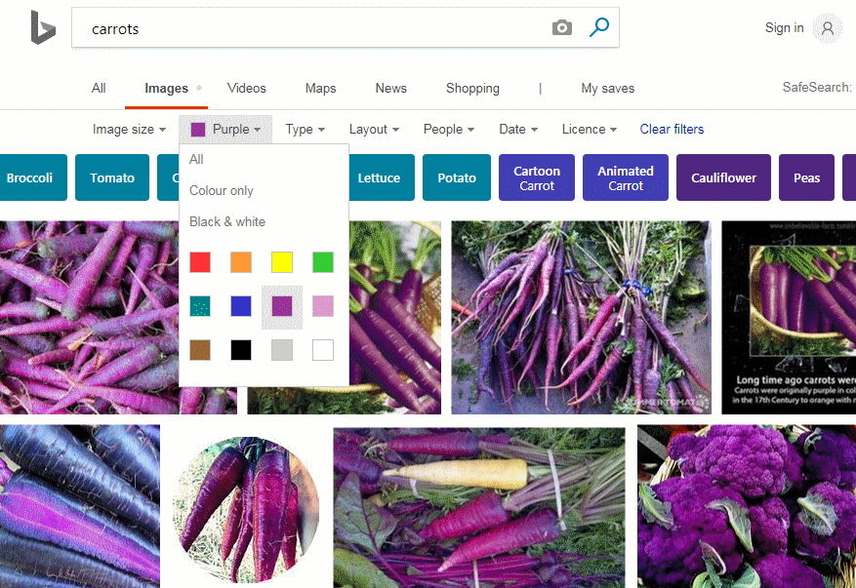
Bing image search

Slide 19
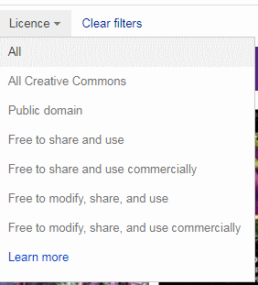
Bing image search
“Date” only offers All, Past 24 hours, Past week, Past month, Past year
Bing has a separate “People” tab and “License” has options for All Creative Commons and Public domain

Slide 20
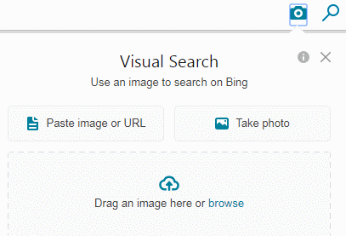
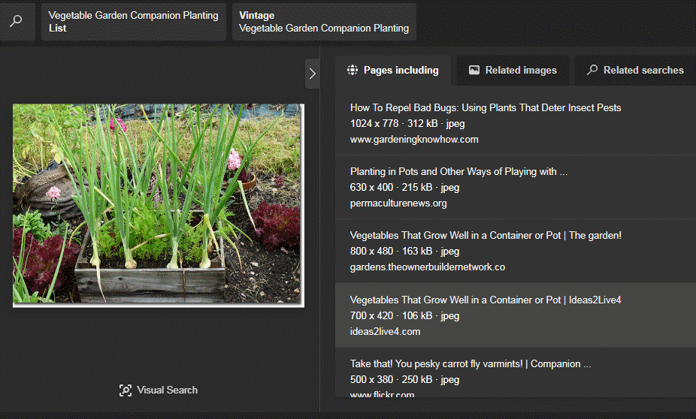
Bing reverse image search

Slide 21
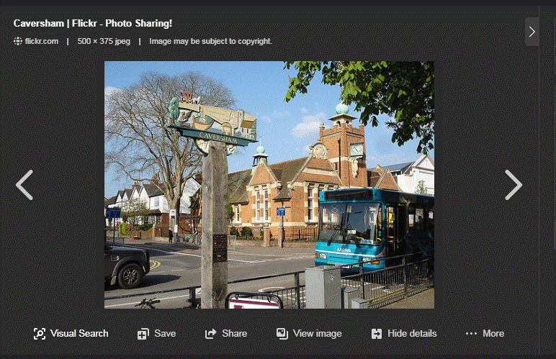
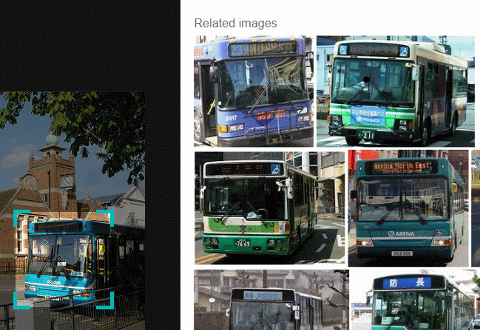
Bing Visual Search - search within an image
Click on Visual Search in the lower left hand area of the screen, then drag and resize box around the object you want to search for

Slide 22
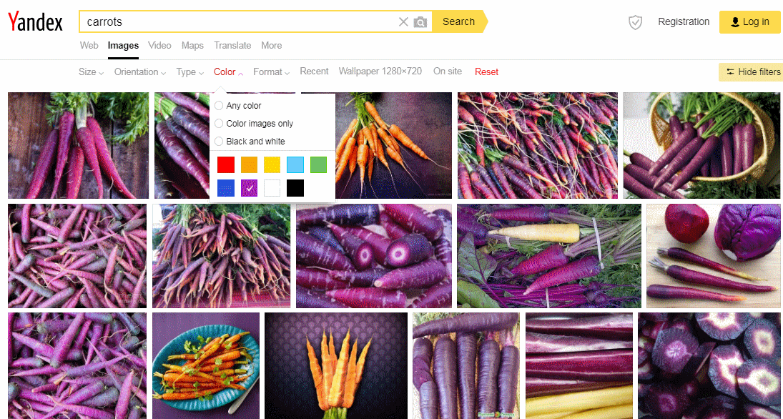
Yandex image search - https://yandex.com/images/
No License option and only “Recent” for date

Slide 23
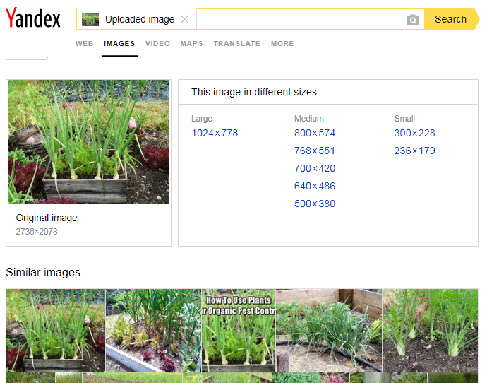
Yandex reverse image search

Slide 24
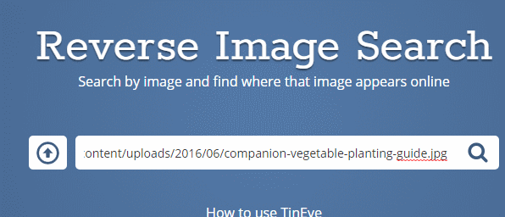
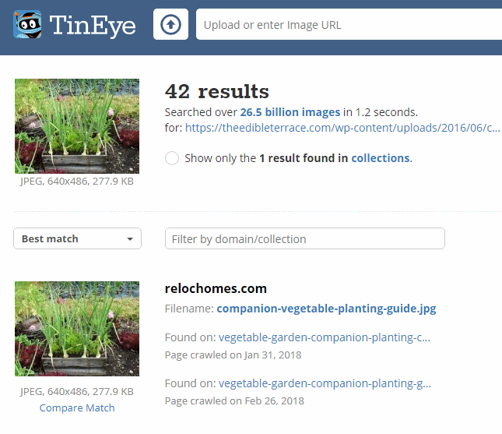
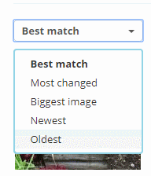
Tineye https://tineye.com/

Slide 25
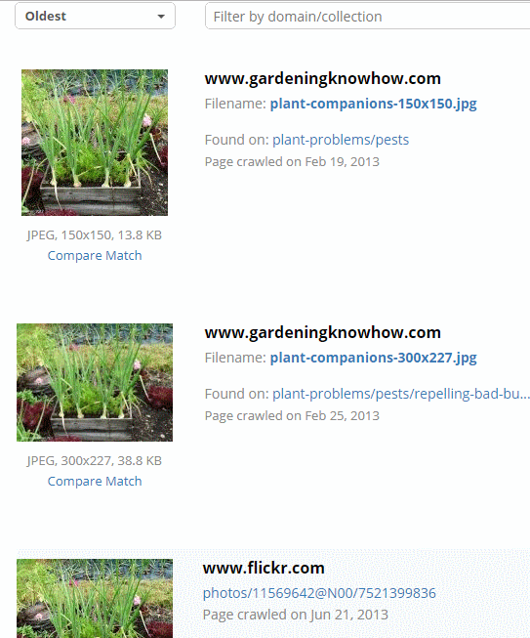
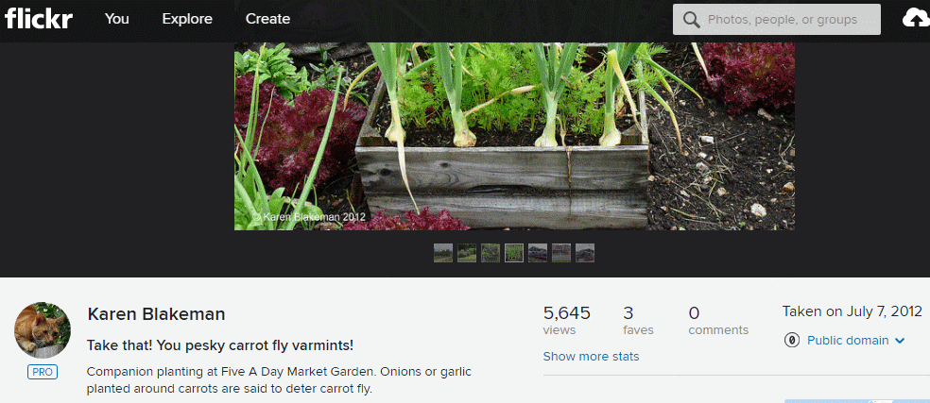
Tineye https://tineye.com/

Slide 26
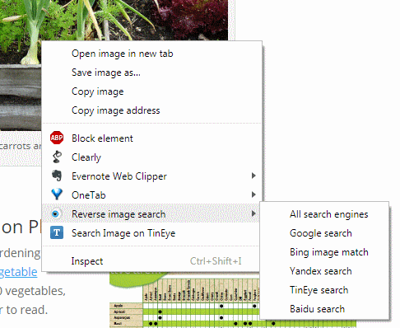
Various browser add-ons, extensions and apps

Slide 27
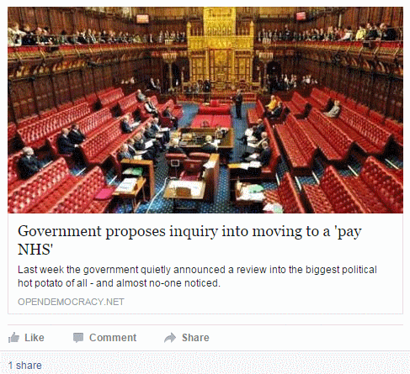
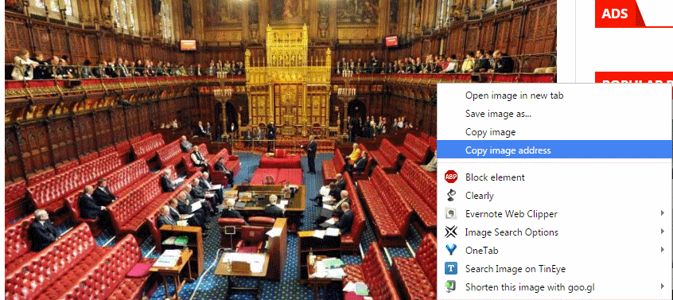
Is this really a photo of the UK House of Lords debating the future of the NHS?

Slide 28
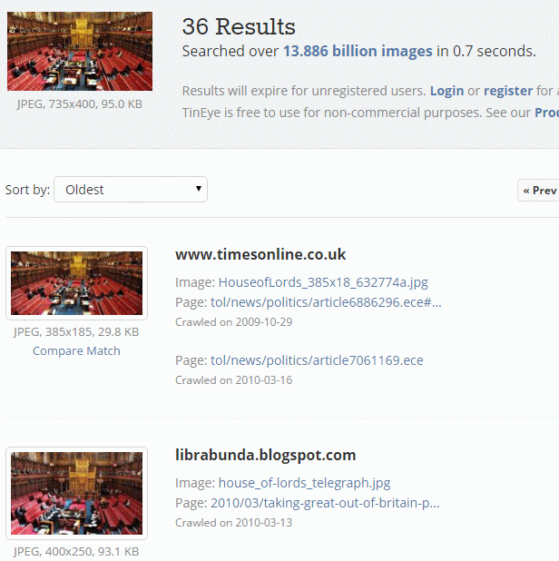
Tineye http://tineye.com/
Option to sort by oldest

Slide 29
Best Reverse Image Search Engines, Apps And Uses (2016) Updated 15 October 2017 http://beebom.com/reverse-image-search-engines-apps-uses/
The Best Ways to Perform a Reverse Image Search
https://lifehacker.com/how-to-perform-a-reverse-image-search-the-easy-way-1828385440

Slide 30
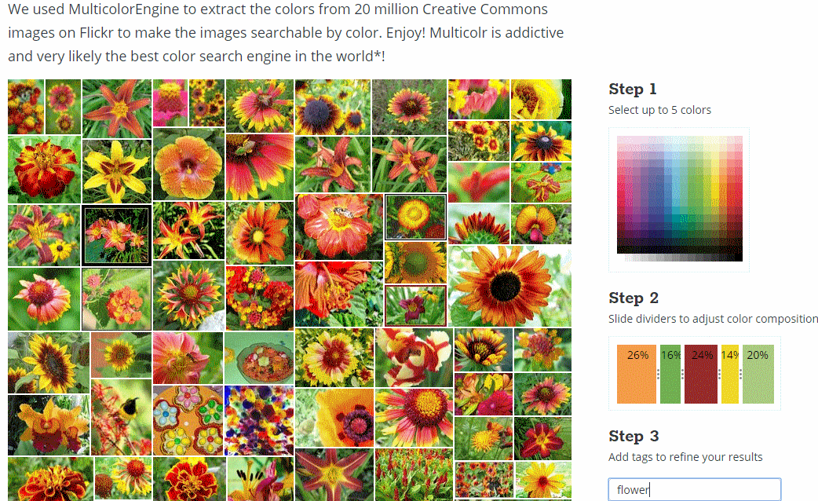
TinEye Multicolr http://labs.tineye.com/multicolr

Slide 31
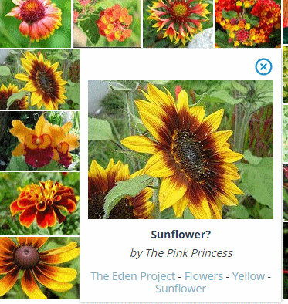
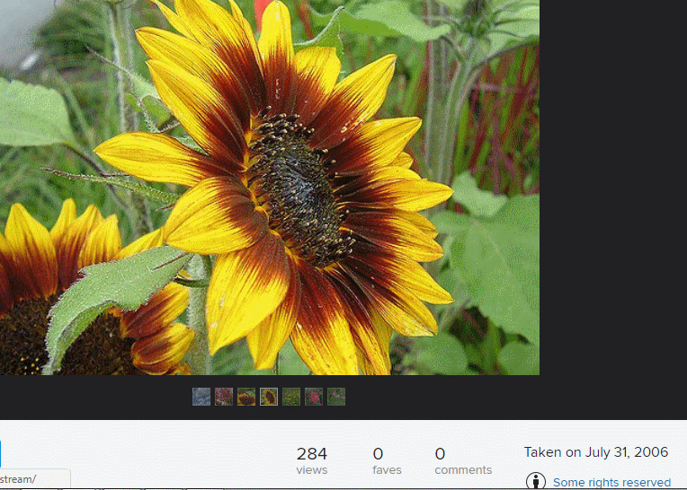
TinEye Multicolr http://labs.tineye.com/multicolr

Slide 32
Selected Creative Commons and public domain image databases
Wikimedia Commons http://commons.wikimedia.org/ (but double check)
MorgueFile.com http://www.morguefile.com/
Curated open source photos @openphoto.net https://openphoto.net/
Wellcome Collection Images (various Creative Commons – check details for each image) https://wellcomecollection.org/works
NASA https://www.nasa.gov/ (check usage quidelines at https://www.nasa.gov/multimedia/guidelines/index.html)

Slide 33
Selected Creative Commons and public domain image databases
Geograph https://www.geograph.org.uk/ “UK and Ireland photos of landmarks and buildings for every Ordnance Survey grid”
CC Search https://ccsearch.creativecommons.org/
Flickr: Creative Commons https://www.flickr.com/creativecommons/
Flickr: The Commons https://www.flickr.com/commons/institutions/

Slide 34
Selection of free photo sites
Free Images - Pixabay https://pixabay.com/ Watch out for the “sponsored images”
Unsplash https://unsplash.com/
Vintage and Modern Free Public Domain Images Archive Download http://publicdomainarchive.com/
Pexels https://www.pexels.com/

Slide 35
Pinterest https://www.pinterest.co.uk/
Not a service that I would personally use as part of my usual image research tool kit, but ...
Google and other search engines often give it as a “source” when searching for images
Sometimes picks up images and sources of an image not readily found by other tools
Human curated “boards” can have better “related” images than the search engines
Need to click through on image to verify source and content – Pinterest subscription required (free)

Slide 36
Audio and video search tools
Google Videos vs Youtube.com (NOT the same)
Bing Videos https://www.bing.com/videos/
Yandex Video https://yandex.com/video/search
Vimeo https://vimeo.com/
Dailymotion https://www.dailymotion.com/
Listen Notes: The best podcast search engine
https://www.listennotes.com/

Slide 37
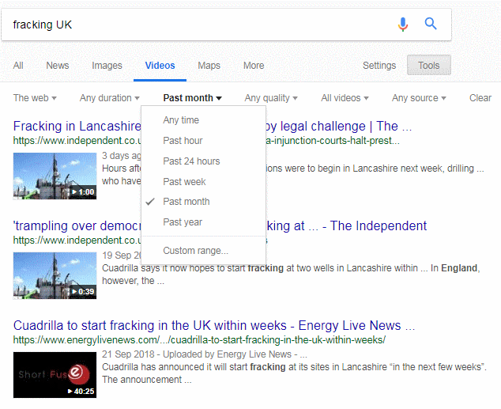
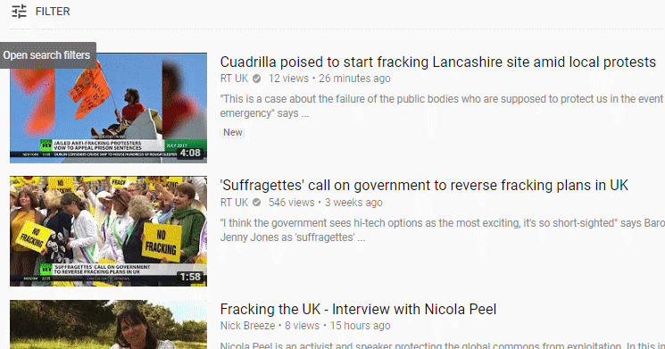
Google Video vs YouTube

Slide 38
Audio and video search tools
TED Talks https://www.ted.com/talks
Spotify https://www.spotify.com/uk/
BBC Radio, TV, iPlayer – https://www.bbc.co.uk/
BBC - Archive News https://www.bbc.co.uk/informationandarchives/archivenews
Internet Archive https://archive.org/details/movies, https://archive.org/details/audio

Slide 39
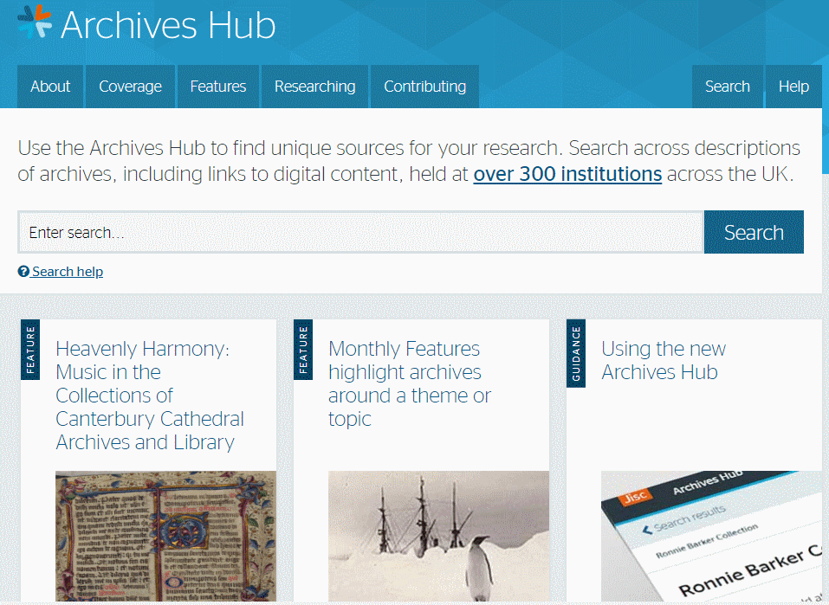
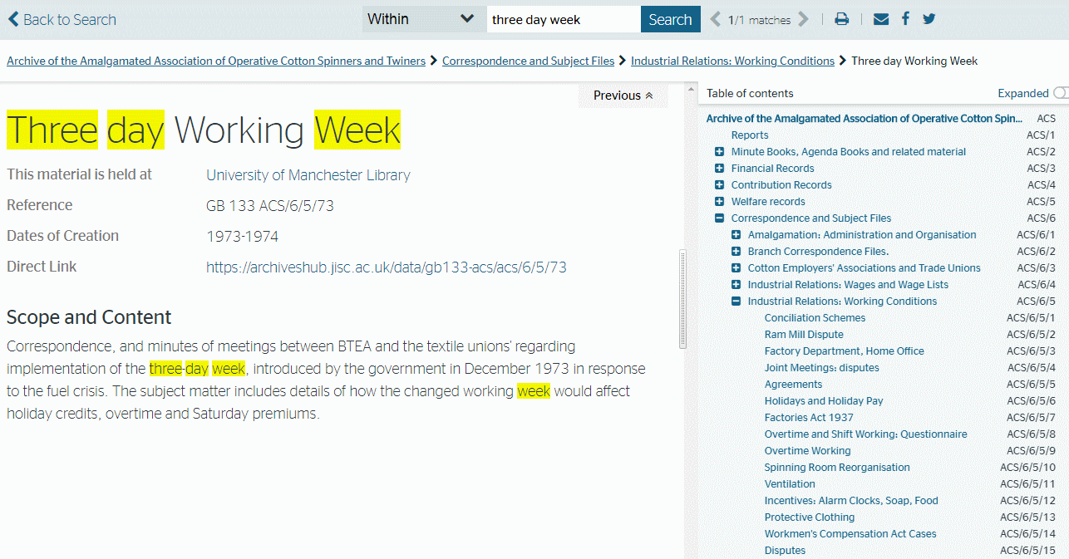
Archives hub – https://archiveshub.jisc.ac.uk/

Slide 40
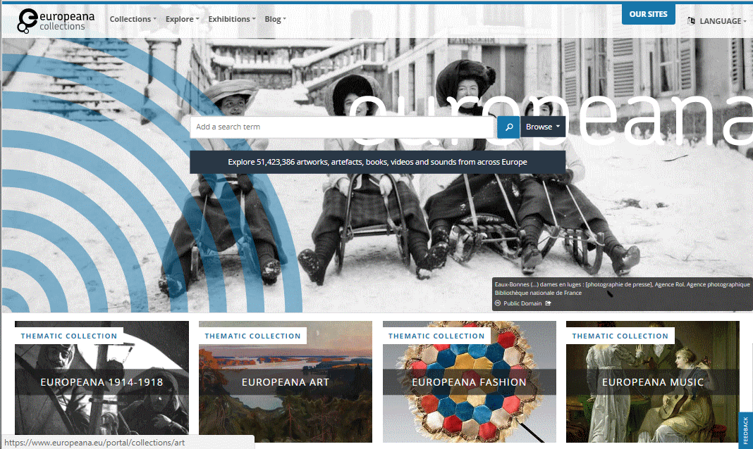
Europeana Collections https://www.europeana.eu/portal/en
Not all material CC or public domain – check individual items that you wish to use

Slide 41
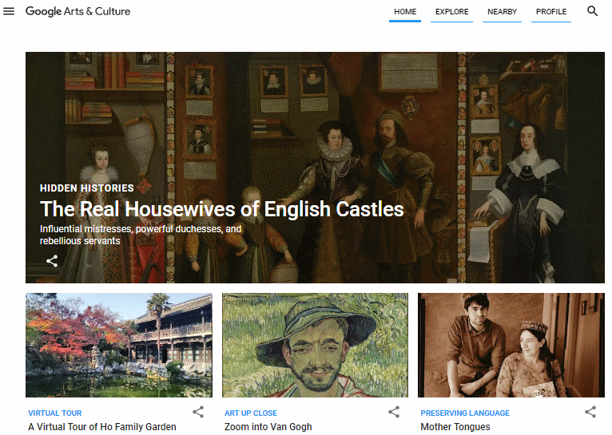
Google Arts & Culture https://artsandculture.google.com/

Slide 42
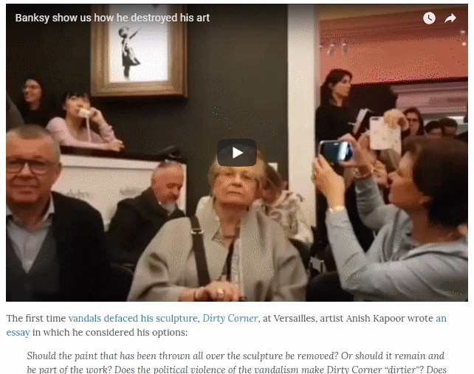
Open Culture http://www.openculture.com/
http://www.openculture.com/2018/10/banksy-adds-new-spin-rich-tradition-artists-destroying-art.html

Slide 43
Searching for numbers and datasets
Use the search engine’s filetype: command to locate spreadsheets, csv files etc
Identify and bookmark main sources of national, international and industry statistics that are likely to be useful to you
Use site: command to search inside large data repositories that are difficult to navigate
Use tools such as Statista, Google Public Data Explorer to identify potential sources of data

Slide 44
Selected data repositories
Registry of Research Data Repositories - re3data.org https://www.re3data.org/
Zenodo - Research. Shared. https://zenodo.org/
Open research data repository created by OpenAIRE and CERN and launched in 2013
Find open data - data.gov.uk https://data.gov.uk/
Data published by UK central government, local authorities and public bodies
EU Open Data Portal https://data.europa.eu/euodp/en/home
Research data repositories - The University of Sheffield https://www.sheffield.ac.uk/library/rdm/repositories
Scientific Data https://www.nature.com/sdata/

Slide 45
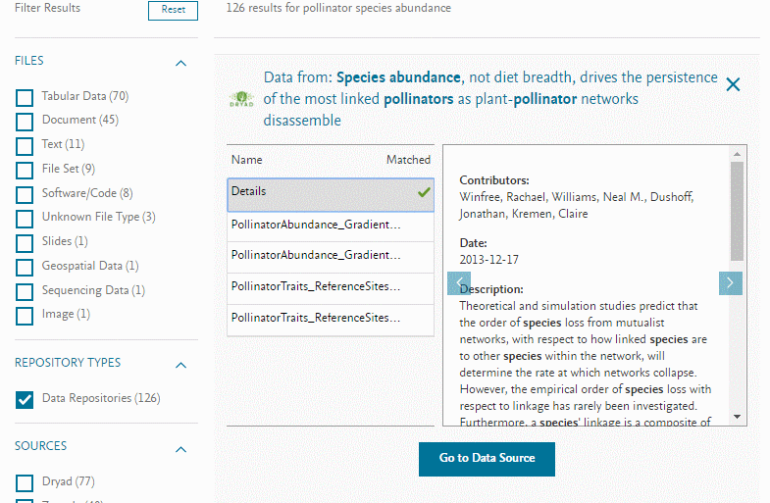
Mendeley Data https://data.mendeley.com/
Elsevier launches Mendeley Data to manage entire lifecycle of research data | STM Publishing News http://www.stm-publishing.com/elsevier-launches-mendeley-data-to-manage-entire-lifecycle-of-research-data/

Slide 46
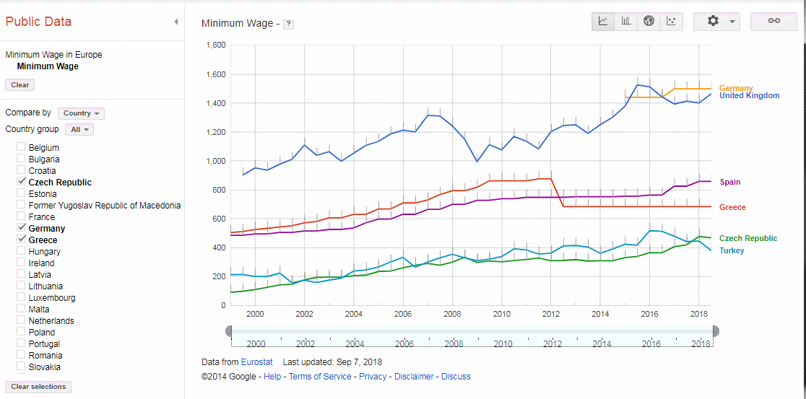
Google Data Explorer https://www.google.com/publicdata/

Slide 47
Google Dataset Search https://toolbox.google.com/datasetsearch/
Making it easier to discover datasets
https://www.blog.google/products/search/making-it-easier-discover-datasets/
Google Dataset search - first impressions
https://www.infotoday.eu/Articles/Editorial/Featured-Articles/Google-Dataset-search-first-impressions-127518.aspx

Slide 48
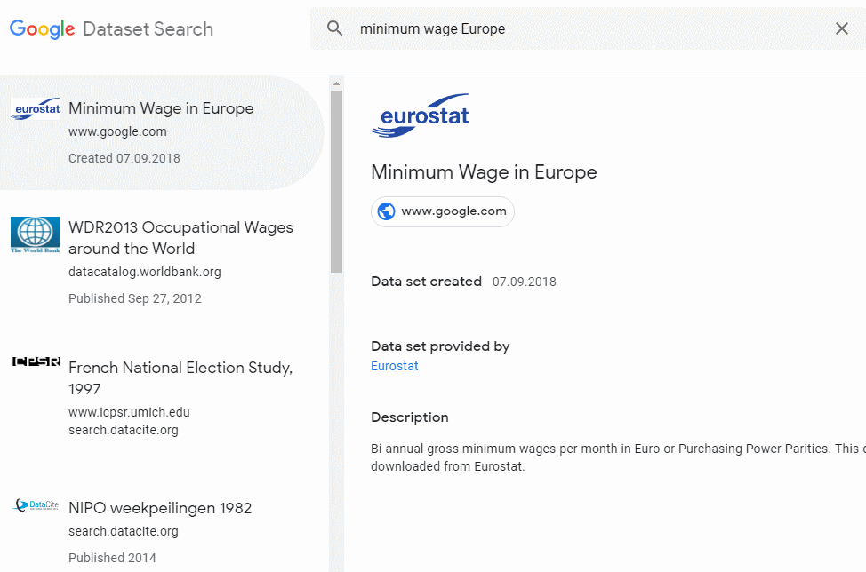
Google Dataset Search https://toolbox.google.com/datasetsearch/

Slide 49
Google Dataset Search https://toolbox.google.com/datasetsearch/

Slide 50
Zanran http://zanran.com/

Slide 51
Zanran http://zanran.com/

Slide 52
Statista https://www.statista.com/
A mixture of free and priced information
Free Daily Chart

