Slide 1
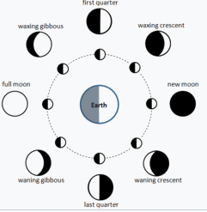
Google Rants and Raves
ILI 2018
Karen Blakeman, RBA Information Services
Karen.Blakeman@rba.co.uk, www.rba.co.uk, twitter.com/karenblakeman
Warning! What you see on your device may differ from what is shown here. Google goes to great lengths to personalise your results according to your search history, contacts, what other people have searched and clicked on, location, device, phase of the moon....

Slide 2
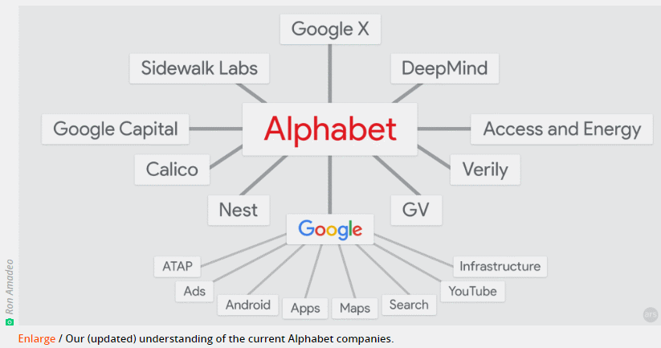
2016 Google Tracker: Everything Google is working on for the new year | Ars Technica http://arstechnica.com/gadgets/2016/01/2016-google-tracker-everything-google-is-working-on-for-the-new-year/
Alphabet/Google 2016.
(A few changes since then)
Name changes, reshuffling for some divisions e.g. Nest

Slide 3
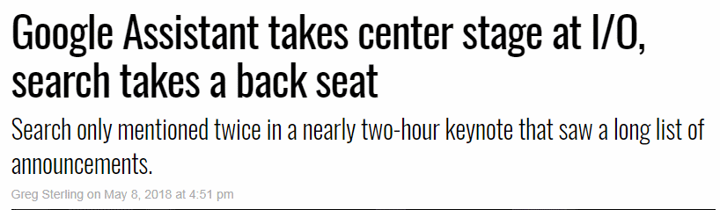
Google Assistant takes center stage at I/O, search takes a back seat https://searchengineland.com/google-assistant-takes-center-stage-at-i-o-search-takes-a-back-seat-297867
Also:
The new Google News: AI meets human intelligence https://www.blog.google/products/news/new-google-news-ai-meets-human-intelligence/
Gmail Smart Compose: Google will now autocomplete whole emails - The Guardian https://www.theguardian.com/technology/2018/may/09/gmail-smart-compose-google-will-now-autocomplete-whole-emails [What could possibly go wrong?!]

Slide 4

Mobile takes precedence!

Slide 5
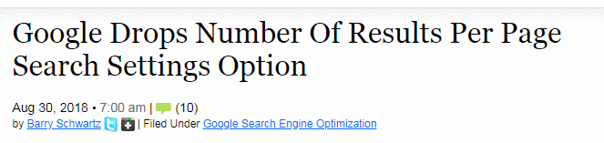

Experiment, intended change or genuine mistake?
Google Updates Search Settings Page & Drops Number Of Results Per Page Option https://www.seroundtable.com/google-number-results-per-page-search-setting-gone-26289.html
Google Search Settings Now Back To Normal
https://www.seroundtable.com/google-search-settings-revert-26297.html

Slide 6
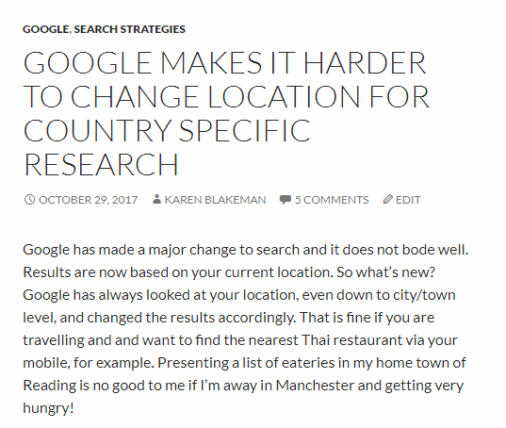
Location, location, location
“We’re confident this change will improve your Search experience, automatically providing you with the most useful information based on your search query and other context, including location”
http://www.rba.co.uk/wordpress/2017/10/29/google-makes-it-harder-to-change-location-for-country-specific-research/

Slide 7
Country versions of Google and local information
Country versions of Google give priority to local content
Useful if you are researching a person, company, or sector in another country
Useful if you want a different viewpoint on what is going on in your country from other countries
But Google now directs you to the Google for your current physical location regardless of the country version of Google you have specified

Slide 8
Google country search strategies
Settings, Advanced search, “Then narrow your results by...” and select country from list
May want also to change language - Settings, Languages and select the relevant language
Or add &cr=countryXX to the end of the URL of your search, where XX is the 2 letter country code
Use a VPN and set to the appropriate country,
Include site: command e.g. site:no but would lose relevant .com sites
Alternative search tools - DuckDuckGo easy to change countries
See Phil Bradley's weblog: Google improves search; makes it much harder http://philbradley.typepad.com/phil_bradleys_weblog/2017/10/google-improves-search-makes-it-much-harder.html

Slide 9
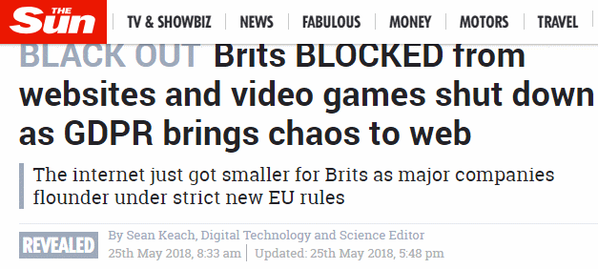
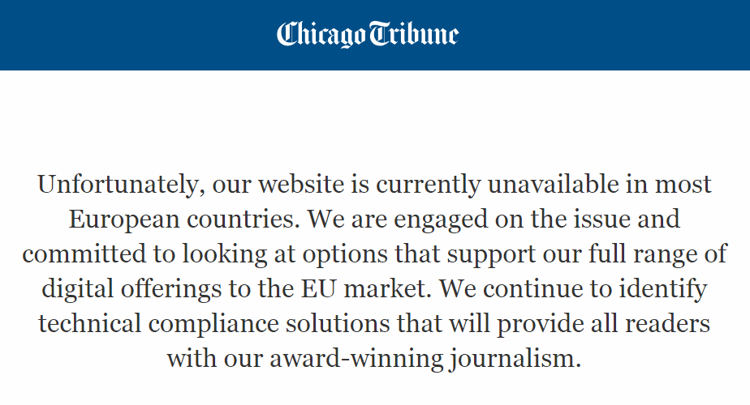
GDPR – access to some sites from outside Europe blocked or restricted
Brits BLOCKED from websites and video games shut down as GDPR brings chaos to web https://www.thesun.co.uk/tech/6374543/gdpr-websites-down-eu-not-working/

Slide 10
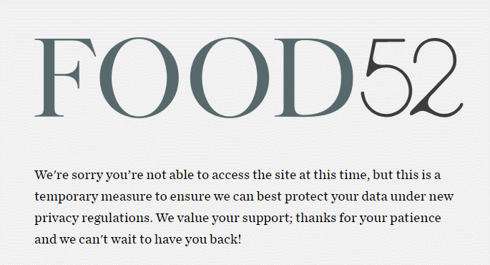
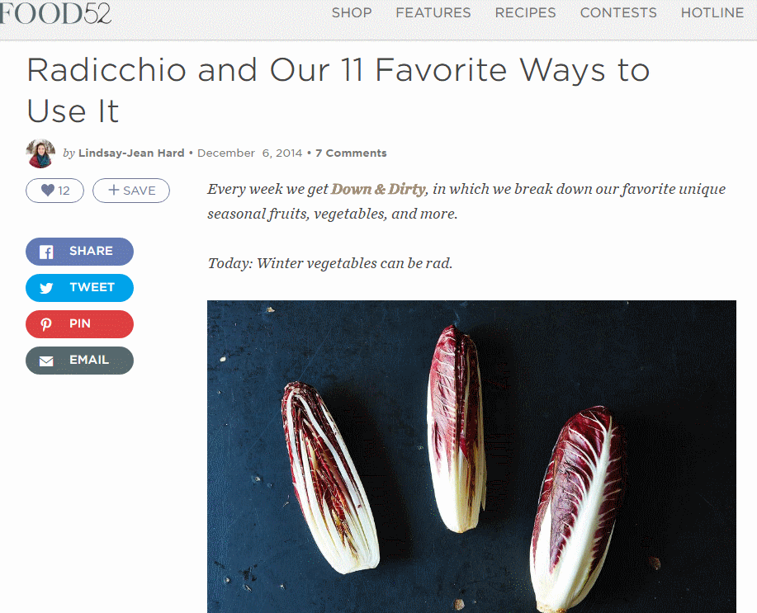
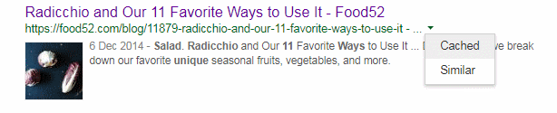
GDPR – access to some sites from outside Europe blocked or restricted
https://food52.com/blog/11879-radicchio-and-our-11-favorite-ways-to-use-it
Using Google’s cached copy

Slide 11
Hiding your location
Cached copy does not work for some sites
Opera browser has built-in, optional VPN but limited to Asia, Europe, Americas
5 Best VPNs to access websites blocked due to GDPR [priced but some with free trial] https://www.comparitech.com/blog/vpn-privacy/best-vpn-gdpr/#gref
Download the Best Free VPN Services for Windows PC in July 2018 http://www.vpnden.com/free-downloads/
Google Search Looks To Deal With GDPR Site Blocking
https://www.seroundtable.com/google-search-gdpr-site-blocking-26362.html

Slide 12

And don’t forget the “right to be forgotten”
Affects those of us located in Europe and searching on a person’s name – valuable and important information may not be included in the results
Also some other countries – for example Canada, Japan, Russia – have similar regulations
Use a VPN?
Information is not removed from the web, just not shown in Google results
Get to know relevant sources e.g. company directors databases, insolvency databases, professional directories, news sources, industry specific sources etc.

Slide 13
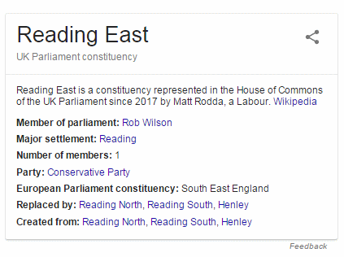
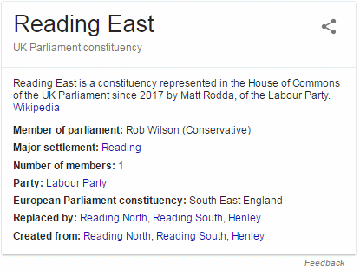
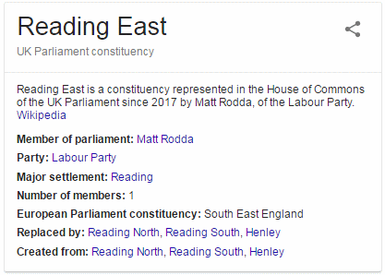
9th June 2017
NEVER trust Google’s facts, quick answers or knowledge graph
13th June 2017
25th June 2017
Information on the Reading East (UK Parliament) constituency following the general election on June 8th, 2017

Slide 14
Choosing your search terms
Google automatically looks for synonyms and variations
Google Begins Using Neural Matching to Understand Synonyms, Impacting 30% of Queries https://www.searchenginejournal.com/google-begins-using-neural-matching-to-understand-synonyms-impacting-30-of-queries/271035/
Use individual synonyms and variations in separate searches and you may see very different results
For example: steam engine, steam train, steam locomotive, steam locomotives
Use more technical terms that are subject/industry specific for research oriented searches
Repeating a term may alter your results, changing the order of your terms may alter your results

Slide 15
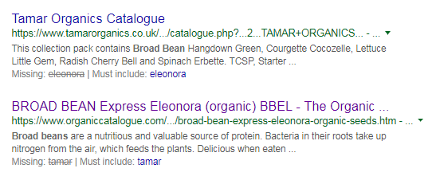
Google drops terms from your search
Google tells you which terms it has ignored and offers options for including one that has been dropped
See Google offers to include missing search terms – sometimes http://www.rba.co.uk/wordpress/2018/08/28/google-offers-to-include-missing-terms/
For example, a search on broad beans eleonora tamar organics

Slide 16
Stop Google dropping terms
“..” around terms, phrases, names, titles of documents - but does not always work
To force an exact match and inclusion of a term in a search
prefix it with ‘intext:’
memorial garden intext:penryn heritage
trail
Use Verbatim to search for all of your terms without any variations or omissions (but not reliable)

Slide 17
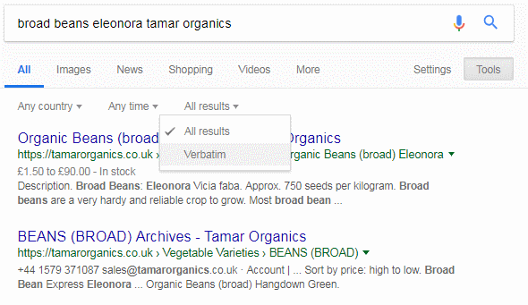
Google Verbatim
Run your search then click on Tools, All results and select Verbatim
Or add &tbs=li:1 to the URL of your search

Slide 18
Google commands
GOOGLE DOES NOT DO BOOLEAN!!!
(chocolate OR confectionery OR candy) AND (production OR manufacture) AND (belgium OR switzerland) NOT austria
Google will do an OR (sort of) but parentheses are ignored, NOT and AND are treated as search terms

Slide 19
Google commands
minus sign (-) to exclude a term Caversham –otago
OR to specify alternatives hematology OR haematology (sometimes better to run separate searches)
asterisk * to stand in for one or more words
solar * panels picks up solar PV panels, solar photovoltaic panels, solar water heating panels

Slide 20
Google commands filetype:
filetype:
PDF for research documents, government reports, industry papers
ppt or pptx for presentations, tracking down an expert on a topic
xls or xlsx for spreadsheets containing data
energy production by country filetype:pdf
energy production by country filetype:ppt OR filetype:pptx
energy production by country filetype:xls OR filetype:xlsx
energy production by country filetype:xls OR filetype:csv

Slide 21
Google commands site:
site: to search within an individual site or type of site
  household energy consumption site:www.gov.uk
  household energy consumption site:ac.uk OR site:edu
  household energy consumption site:no
Combine with filetype command
  household energy consumption site:gov.uk filetype:xls OR filetype:xlsx OR filetype:csv

Slide 22
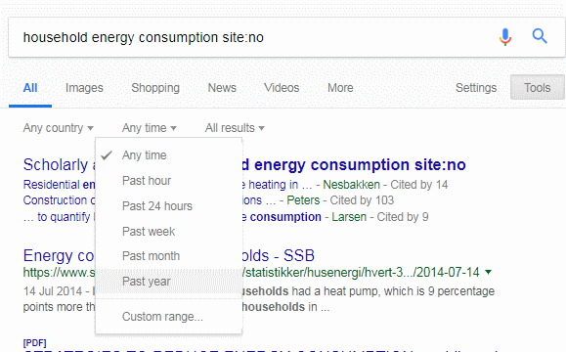
Date (cannot be used with Verbatim)
Restrict your results to information that has been published within the last hour, day, week, month, year or your own date range (Note: Custom range not available for mobile users)
Tools, Any time and select an option

Slide 23
Google commands intitle: inurl:
Words in the title – can be single words, multiple words or phrases
  intitle:organic vegetables
  intitle:”organic vegetables”
  allintitle:organic vegetables
Words in the URL – can be single words, multiple words or phrases
  inurl:organic vegetables
  inurl:”organic vegetables”
  allinurl:organic vegetables

Slide 24
Google commands inurl:
In Praise of inurl:
https://researchbuzz.me/2018/07/10/in-praise-of-inurl/
When site: may not work because of the structure of the domain in a country or because there are too many options you want to search on
“carbon emissions” inurl:gov
“carbon emissions” inurl:gov -site:gov.uk
-site:gov

Slide 25
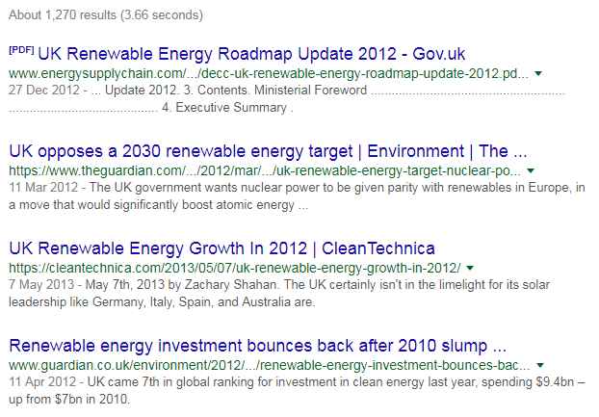
Google commands inurl:
For date/year – depends on software used to generate articles and web pages
intitle:“renewable energy” inurl:uk inurl:2012

Slide 26
Google numeric range search
Anything to do with numbers – years, prices, weights, scientific measurements
Syntax:
search terms first number..second number units [units are optional]
For example:
  toblerone 1..5kg
  electric car production forecasts 2020..2050

Slide 27
Specialist Google tools (note that Google will usually redirect to your country version)
Maps https://maps.google.com/
Google Images https://images.google.com/
Google News https://news.google.com/ (may be better to use News from the menu at the top of the standard results page)
Google Finance https://www.google.com/finance A shadow of its former self – use Yahoo! Finance instead
Google Video (NOT the same as YouTube) https://video.google.com/
Google Scholar httsp://scholar.google.com/
Google Patents https://patents.google.com/

Slide 28
Specialist Google tools (note that Google will usually redirect to your country version)
Google Books http://books.google.com/
Google Books Ngram Viewer https://books.google.com/ngrams
Google Public Data Explorer http://www.google.com/publicdata/
Google Dataset Search https://toolbox.google.com/datasetsearch
Google Trends https://trends.google.com/trends/
Constitute https://www.constituteproject.org/
Google Arts & Culture https://artsandculture.google.com/

Slide 29
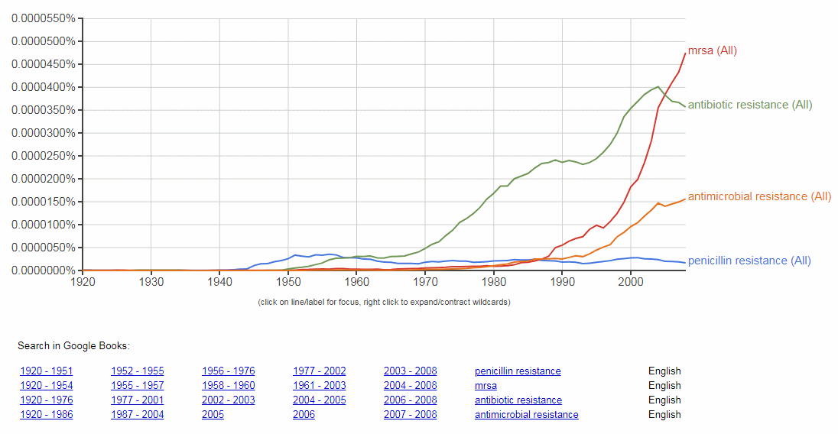
Google Books Ngram Viewer https://books.google.com/ngrams

Slide 30
Google Trends https://trends.google.com/trends/
Shows how often a search term or phrase is used in searches relative to the total search volume
Can select individual countries, region, city
See latest trending topics, show trends over times
Can compare different search terms
Good for monitoring interest in products, people, events, research areas, companies, organisations etc.
Google Trends Subscriptions (alerts) https://trends.google.com/trends/subscriptions

Slide 31
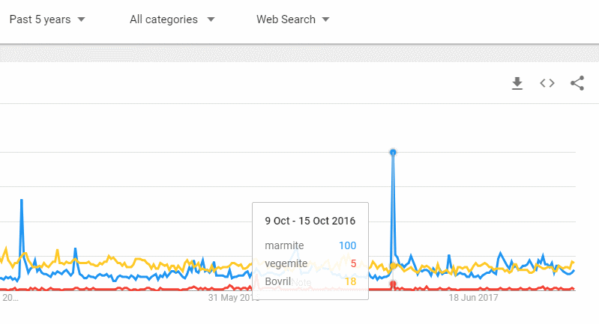
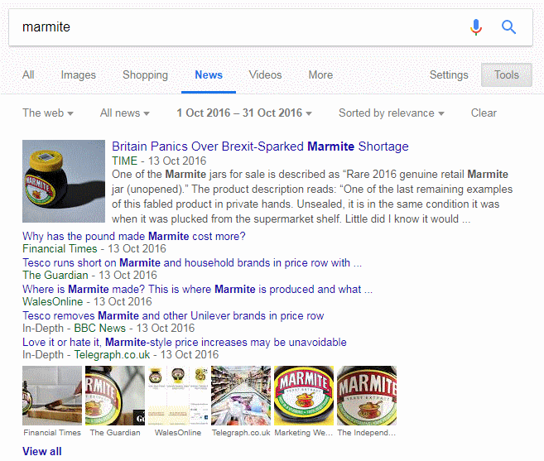
Google Trends

Slide 32
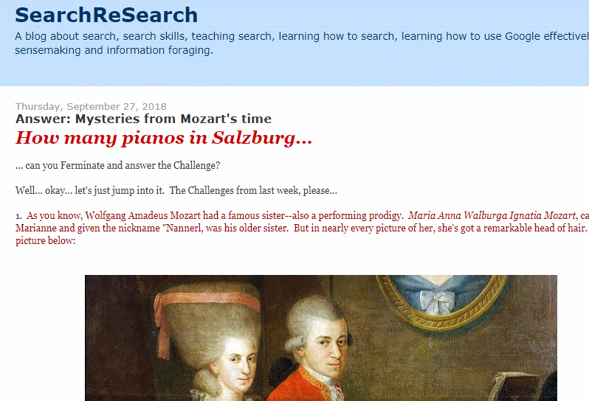
SearchReSearch http://searchresearch1.blogspot.com/

